Slide 1
University Transportation Centers
^{Presented by:}
USDOT’s University Transportation
Centers (UTC) Program and the Council of
University Transportation Centers (CUTC)

Slide 2
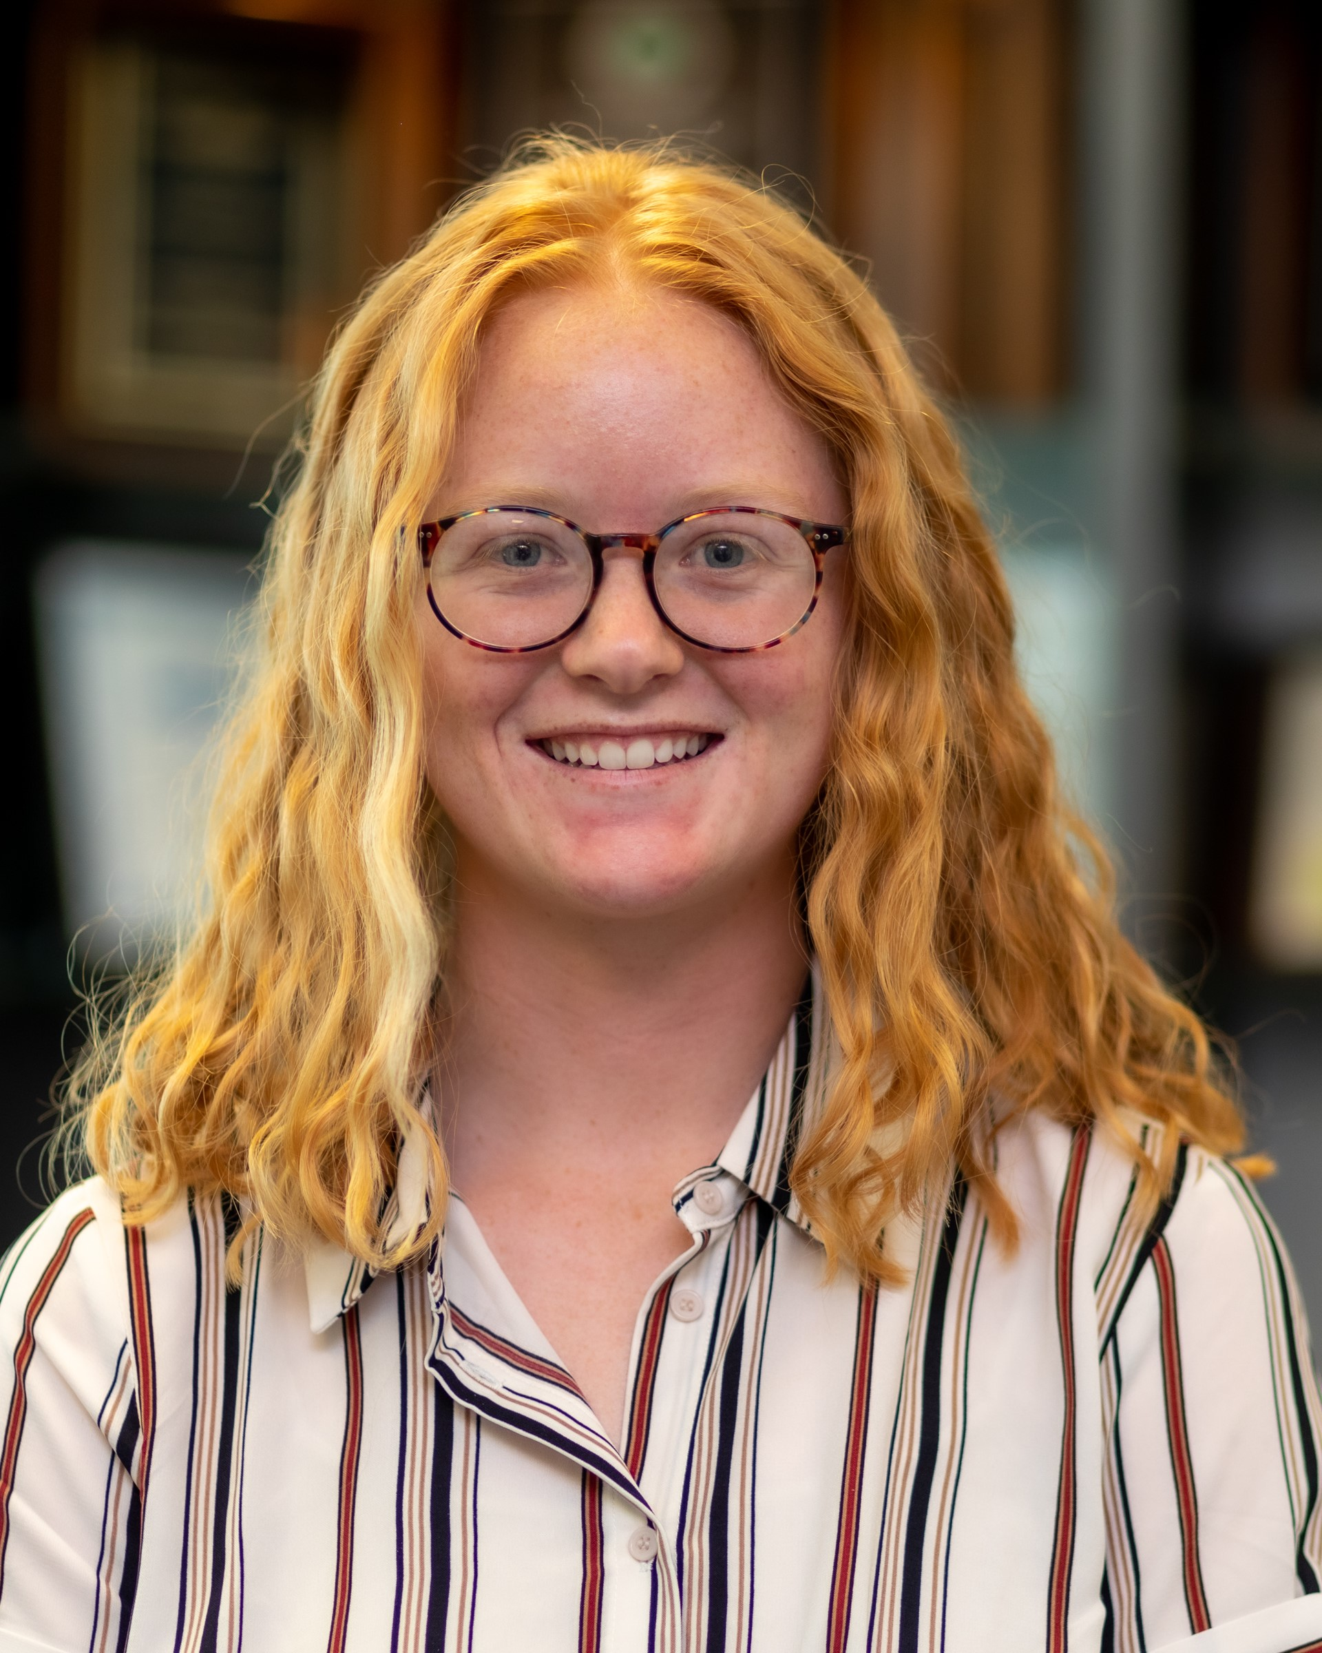
Kaley Collins
MARITIME
University of Arkansas
Maritime Transportation Research and Education Center (MarTREC)
Research Area(s):
Numerical modeling of materials to determine failure conditions under different loads
Thesis Title:
Port Infrastructure Resilience through Combined Wind-Surge Demand Characterization

Slide 3
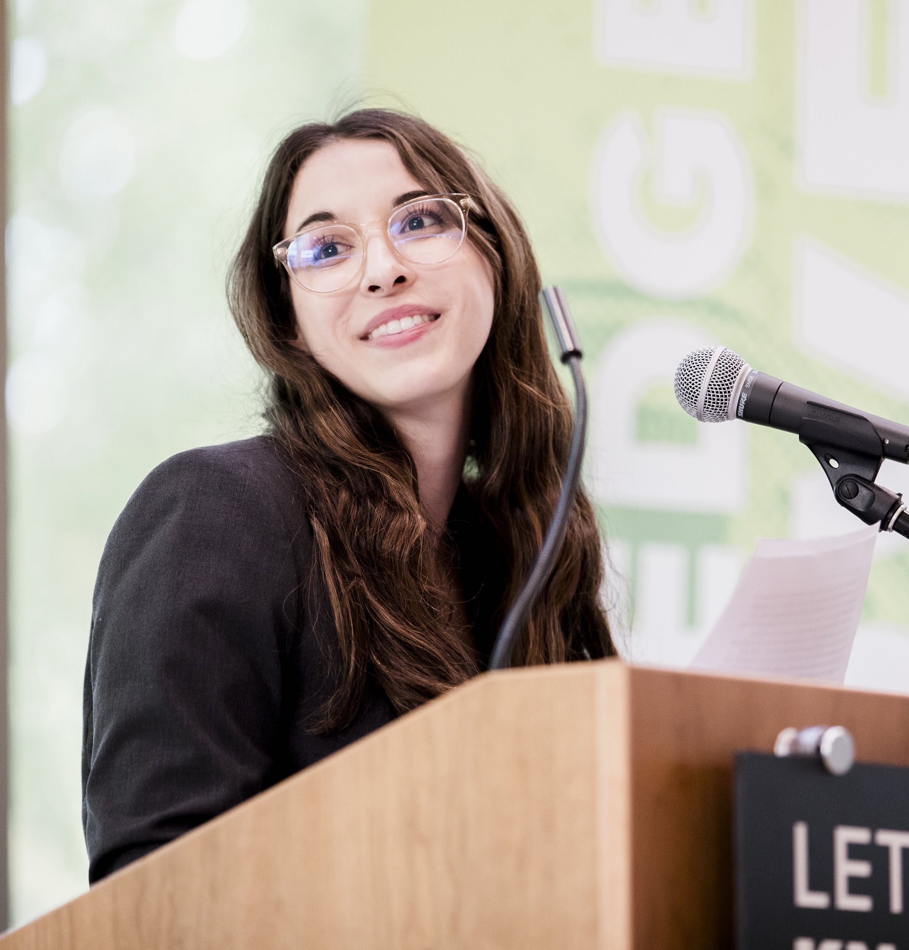
Gabriella Abou-Zeid
MULTIMODAL
Portland State University
National Institute of Transportation and Communities (NITC)
Research Area(s):
Transportation, land use, and travel behavior
Thesis Title:
Household Provisioning and COVID-19: Transportation Impacts, Technology Adoption, and Barriers to Food Access

Slide 4
Jennifer Hall
MULTIMODAL
The University of Texas at Austin
Center for Advanced Multimodal Mobility Solutions and Education (CAMMSE) led by the University of North Carolina, Charlotte
Research Area(s):
Active transportation; traffic operations; public transportation
Thesis Title:
Forecasting Off-Street Bicycle Facility Demands

Slide 5
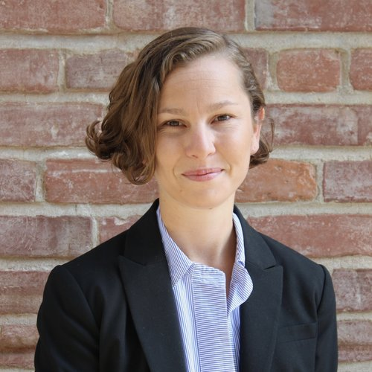
Amy Lee
MULTIMODAL
University of California, Davis
National Center for Sustainable Transportation (NCST)
Research Area(s):
Transportation and land use
Thesis Title:
Big Structural Change: A Mixed-Methods Investigation into the Policy and Politics of Land Use and Transportation Infrastructure in California

Slide 6
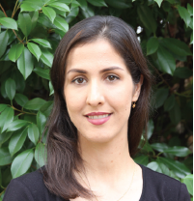
Ladan Mozaffarian
MULTIMODAL
University of Texas at Arlington
Center for Transportation Equity, Decisions, and Dollars (CTEDD)
Research Area(s):
The intersection of innovation, equity, and transportation policy in cities
Thesis Title:
The Role of Built Environment Attributes and Transportation in Enhancing Innovation and Productivity in Urban Areas

Slide 7
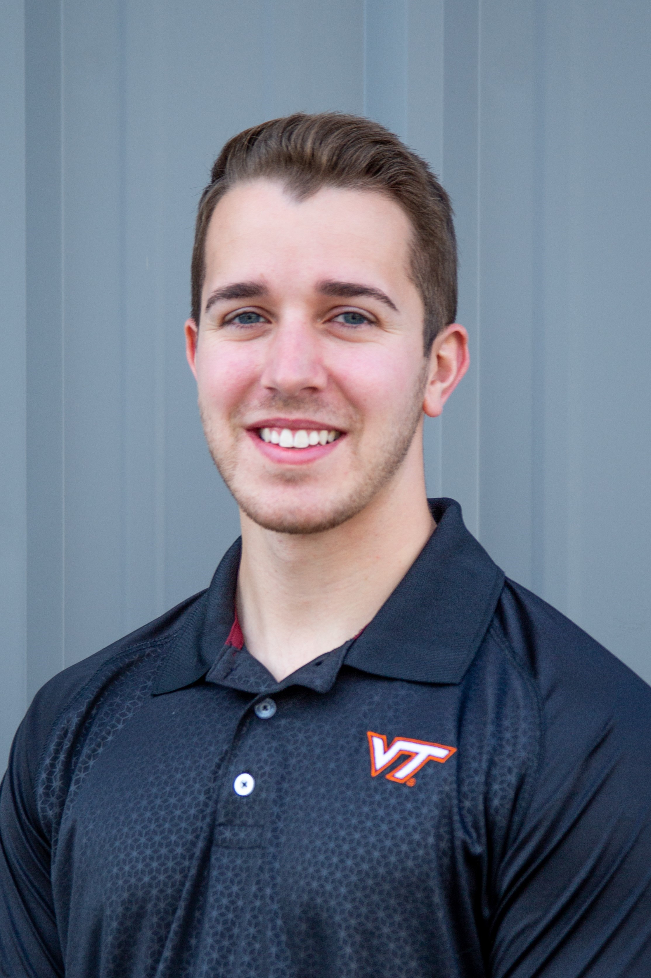
Adam Novotny
MULTIMODAL
Virginia Tech
Safety Through Disruption (Safe-D)
Research Area(s):
Human factors and biomechanics in advanced vehicle safety systems; automated and connected vehicle technology development
Thesis Title:
E-Scooter Safety Improvements through Design and Training

Slide 8
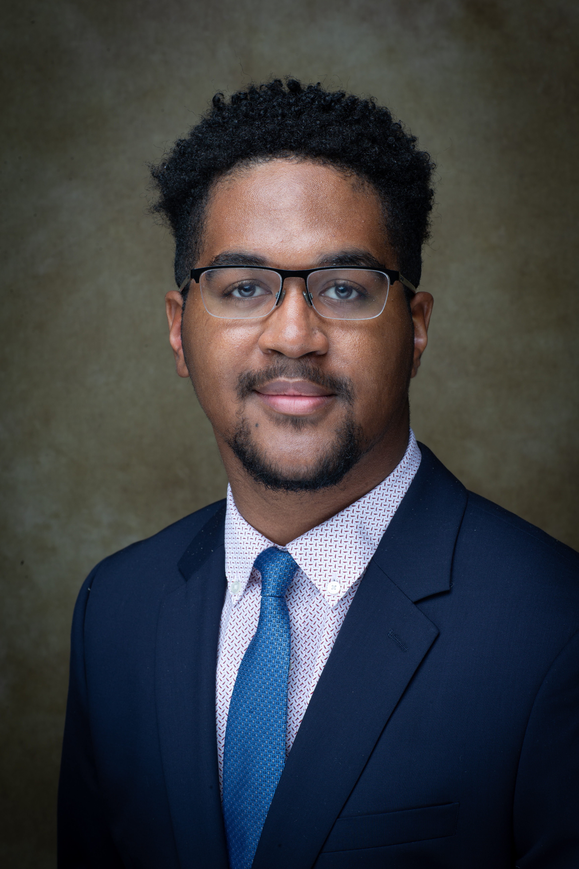
Nigel Pugh
MULTIMODAL
North Carolina Agricultural and Technical State University
Center for Advanced Transportation Mobility (CATM)
Research Area(s):
Emergency planning, emergency evacuations, and safety
Thesis Title:
AI-Based Decision Making in Human-In-the-Loop

Slide 9
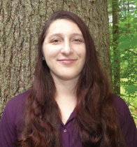
Rachel Seigel
MULTIMODAL
University of Vermont
Transportation Infrastructure Durability Center (TDIC) led by the University of Maine
Research Area(s):
Modeling bridge-stream network interactions under transient conditions, and evaluating these interactions to frame bridge risk assessments and flood mitigation
Thesis Title:
Bridge-Stream Network Analysis across Multiple Sites to Identify Sensitive Structural and Hydraulic Parameters for Flood Risk Assessment and Floodplain Reconnection

Slide 10
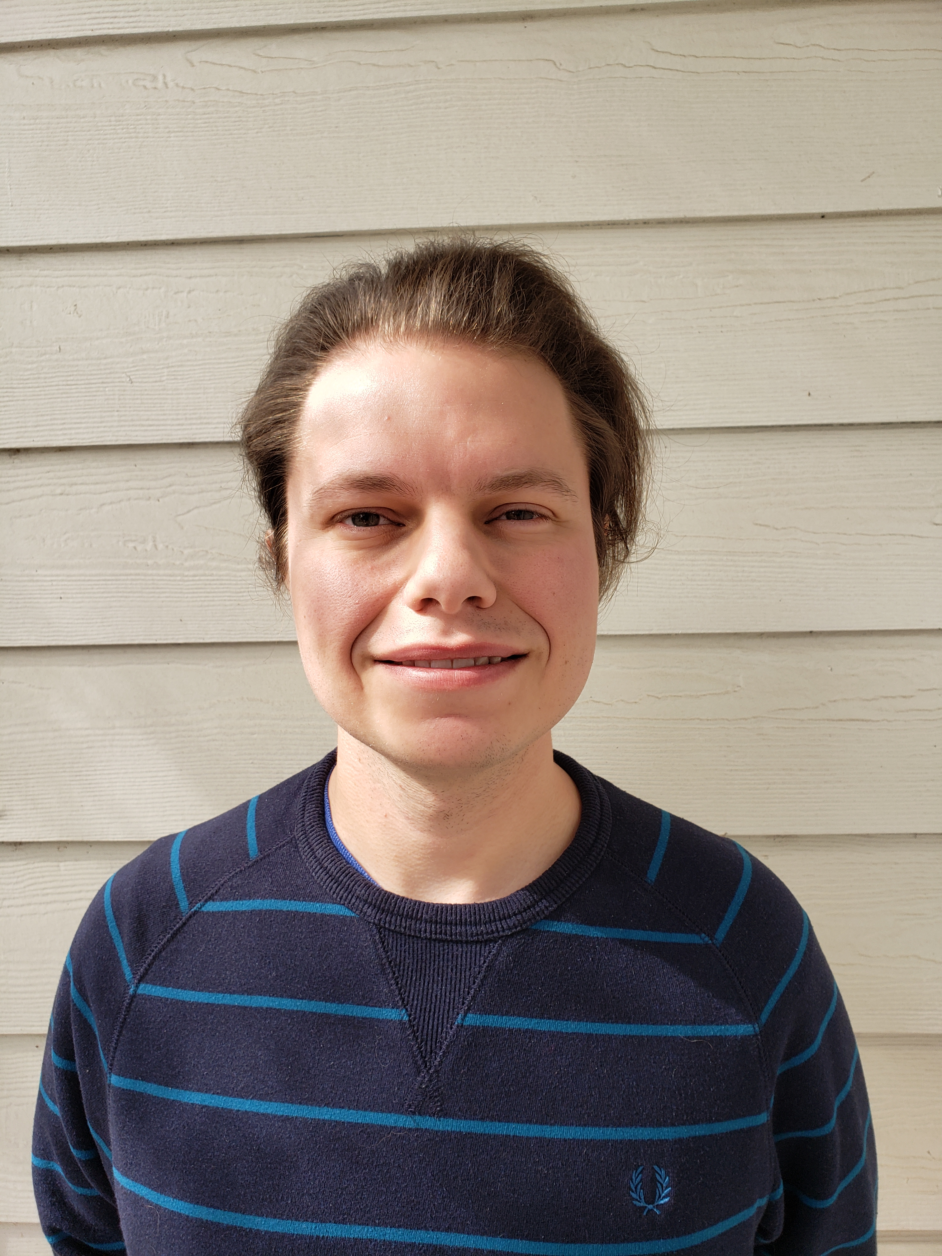
Rydell Walthall
MULTIMODAL
The University of Texas at Austin
Cooperative Mobility for Competitive Megaregions (CM2)
Research Area(s):
Transportation economics and policy
Thesis Title:
Rail Electrification’s Potential for Emissions Abatement in the Freight Industry: A Case Study of a Transcontinental Rail Corridor

Slide 11
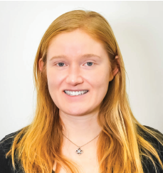
Amy Wyman
MULTIMODAL
Oregon State University
Pacific Northwest Transportation Consortium (PacTrans) led by the University of Washington
Research Area(s):
Transportation Human Factors and Safety
Thesis Title:
Integrating Active Transportation Modes into Connected and Automated Transportation Systems: Conceptual Design and Evaluation of Human Machine Interfaces

Slide 12
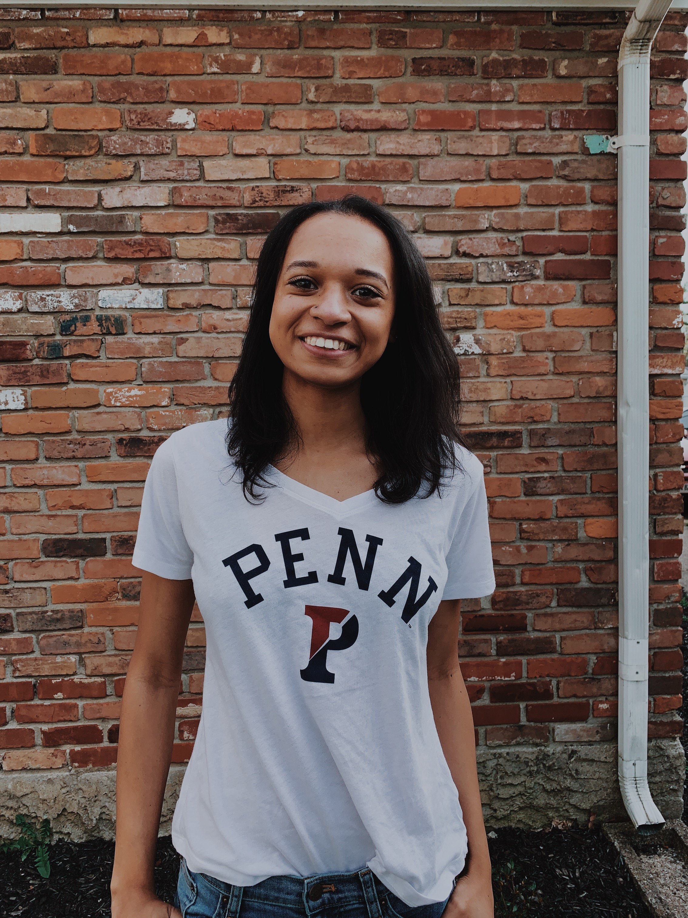
Camille Boggan
PUBLIC TRANSIT
University of Pennsylvania
Mobility21, A National University Transportation Center for Improving Mobility of People and Goods led by Carnegie Mellon University
Research Area(s):
Women-centered transit planning
Thesis Title:
Encumbered Journeys: Evaluating Mobility of Transit-Reliant Female Caregivers

Slide 13
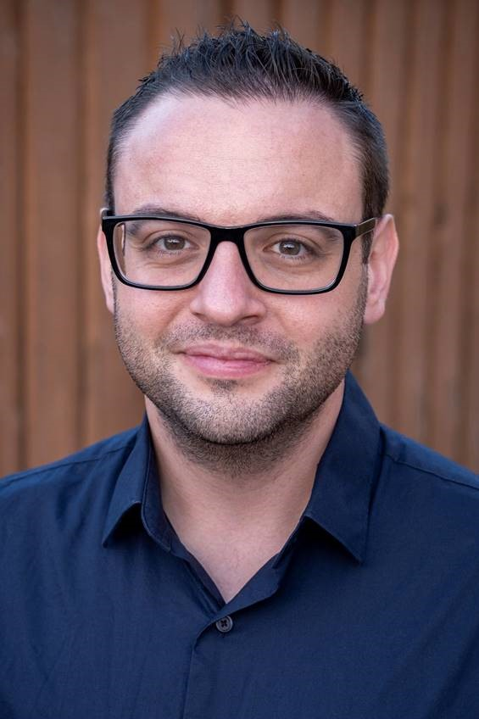
Alex Eisenhart
PUBLIC TRANSIT
San Jose State University
Mineta Transportation Institute
Research Area(s):
Reimagining transportation planning and marketing strategies to foster increased
public transit ridership
Thesis Title:
Evaluating the Launch of SamTrans’ Foster City Commuter Express (Route FCX)

Slide 14
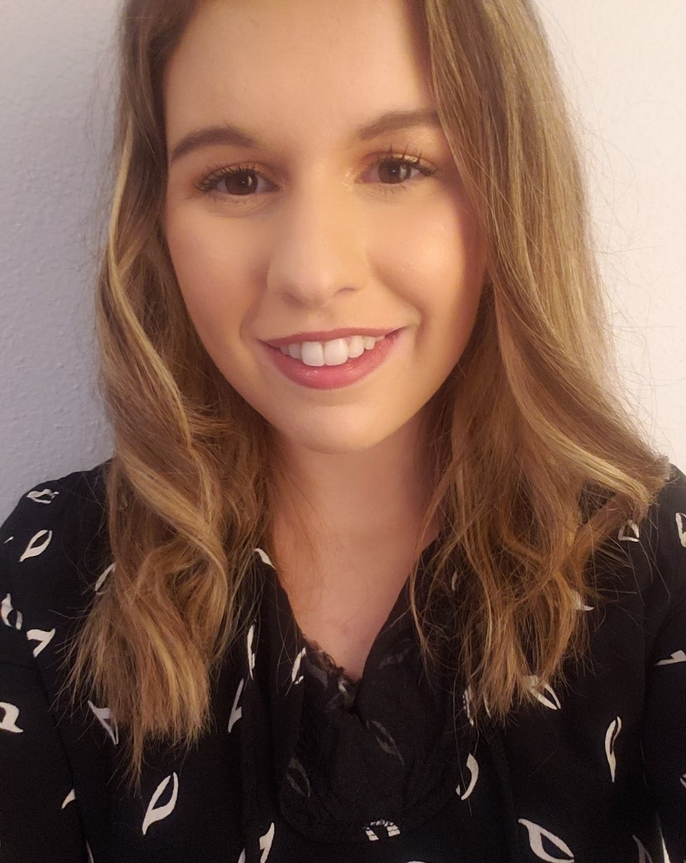
Lori Palaio
PUBLIC TRANSIT
University of South Florida
Center for Teaching Old Models New Tricks (TOMNET) led by Arizona State University
Research Area(s):
System-level bikeshare ridership analysis
Thesis Title:
A Multi-City Investigation of the Effect of Holidays on Bikeshare System Ridership

Slide 15
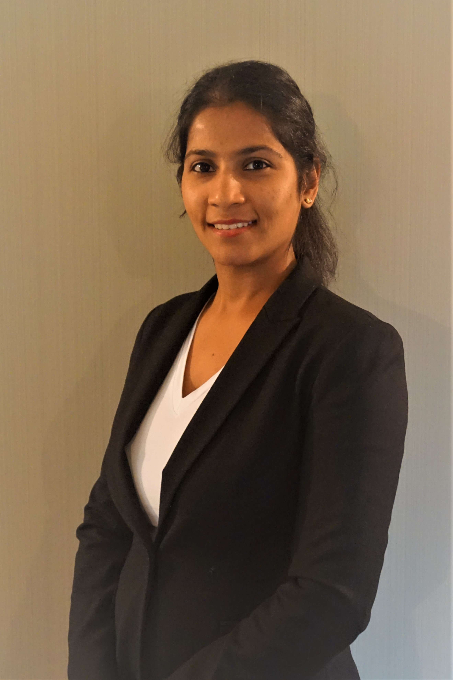
Prarthana Raja
PUBLIC TRANSIT
Rutgers, The State University of New Jersey
Center for Advanced Infrastructure and Transportation (CAIT)
Research Area(s):
Remote sensing; Building/Civil Information Modeling (BIM); coastal hazards and climate risk
Thesis Title:
Asset and Infrastructure Vulnerability Assessment of Hazards in Coastal
Communities

Slide 16
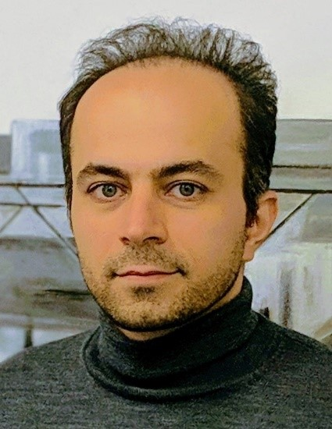
Ali Rahim-Taleqani
PUBLIC TRANSIT
North Dakota State University
Small Urban, Rural and Tribal Center on Mobility (SURCOM) led by Montana State University
Research Area(s):
Transportation network analysis; machine learning
Thesis Title:
Next-Visiting Location Prediction Using Encoder-Decoder Long Short-Term Memory (LSTM)

Slide 17
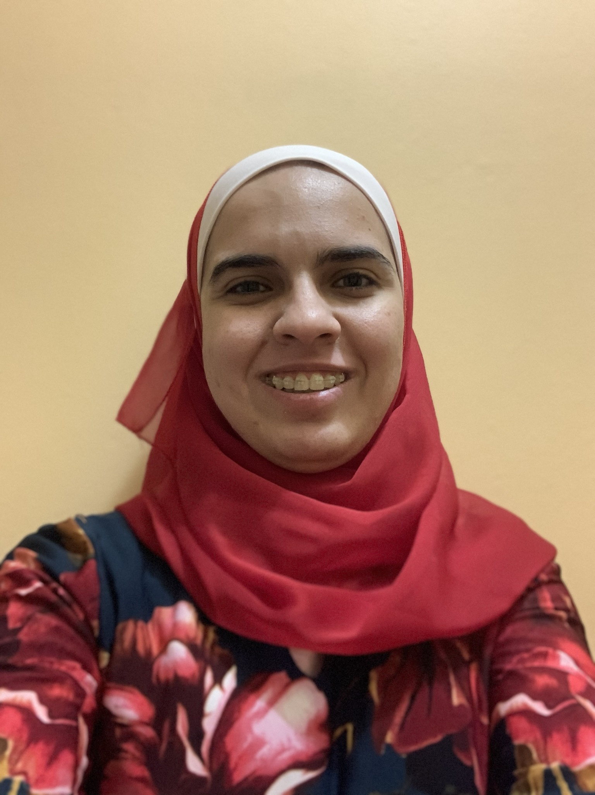
Ruwa AbuFarsakh
ROAD
Louisiana State University
Transportation Consortium of South-Central States (Tran-SET) (a FAST Act UTC)
Research Area(s):
Engineered geopolymer composites (EGCs) for sustainable transportation infrastructure
Thesis Title:
Novel Metakaolin Based Engineered Geopolymer Composites for Transportation Applications

Slide 18
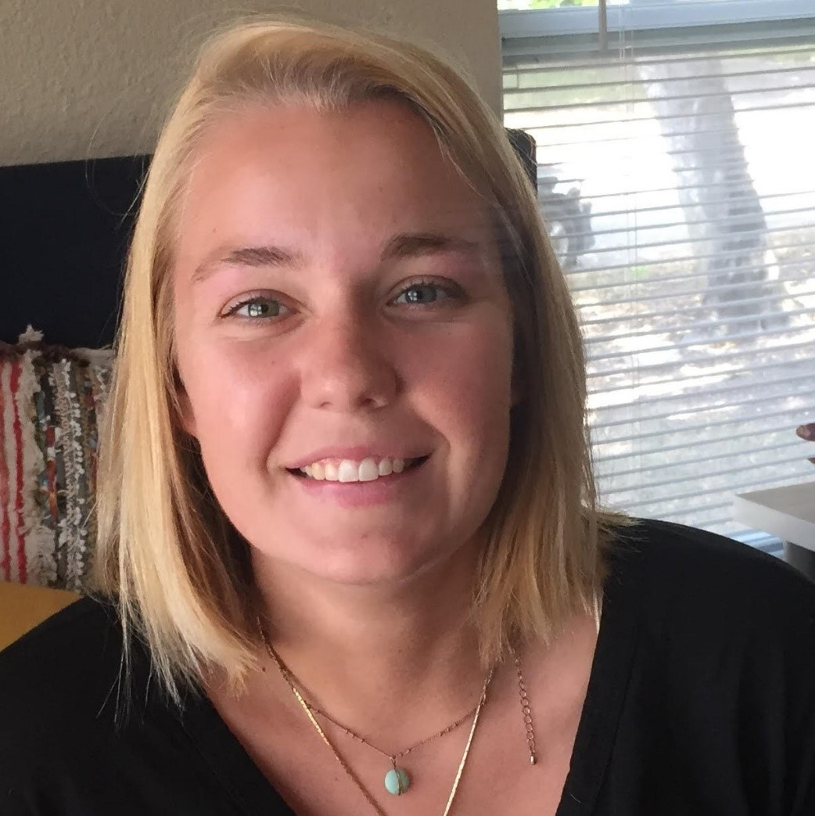
Katherine Asmussen
ROAD
The University of Texas at Austin
Data-Supported Transportation Operations and Planning (D-STOP) Center led by the University of Austin (a MAP-21 UTC)
Research Area(s):
Connected and automated vehicles; behavior analysis; travel behavior and demand modeling
Thesis Title:
A Socio-Technical Model of Autonomous Vehicle Adoption Using Ranked Choice Stated Preference Data

Slide 19
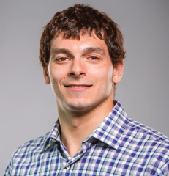
Benjamin Bauchwitz
ROAD
Duke University
Collaborative Sciences Center for Road Safety (CSCRS) led by the University of
North Carolina, Chapel Hill
Research Area(s):
Technology, methods, and analytics for certification of autonomous vehicles
Thesis Title:
Formal Methods for Rigorous Autonomous Systems Certification

Slide 20
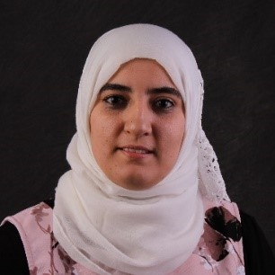
Maha Elouni
ROAD
Virginia Tech
Urban Mobility & Equity Center led by Morgan State University
Research Area(s):
Traffic flow and speed control for urban networks
Thesis Title:
Traffic Flow and Speed Control on a Large-Scale Network with the Geographical Self-Organizing Maps (Geo SOM) Clustering Algorithm

Slide 21
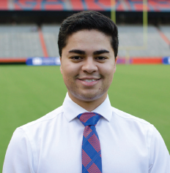
Patrick Emami
ROAD
University of Florida
Southeastern Transportation Research, Innovation, Development and
Education Center
Research Area(s):
Computer vision for traffic scene understanding
Thesis Title:
On Representation Learning for Multi-Object Video Understanding

Slide 22
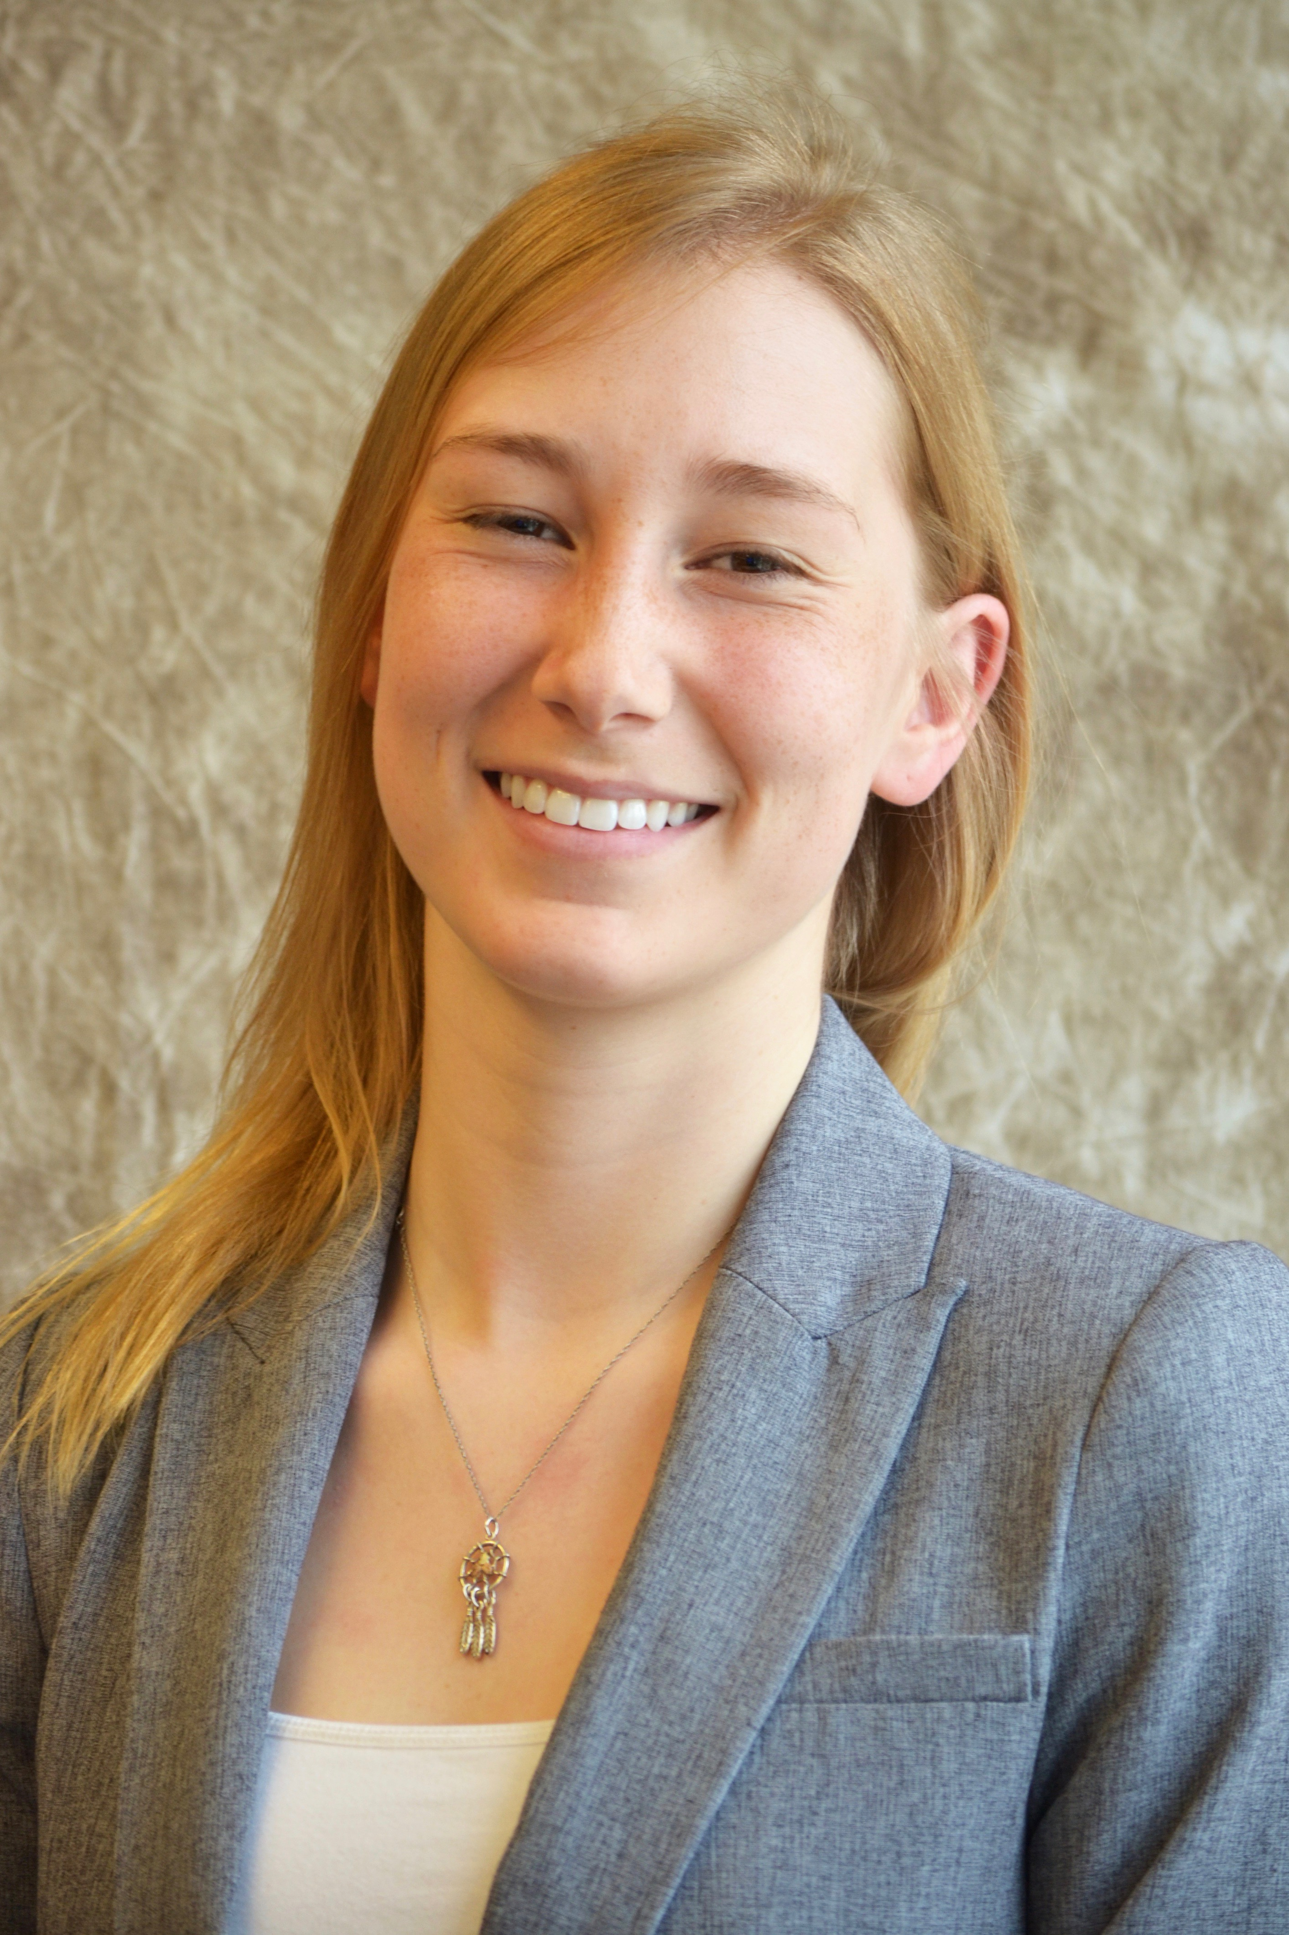
Sydney James
ROAD
University of Nebraska-Lincoln
Mid-America Transportation Center
Research Area(s):
Transportation safety for vehicles transporting hazardous material in rural and tribal areas
Thesis Title:
Risk and Safety Associated with Hazardous Materials Transport: A Case Study of Rural and Native American Communities in Nebraska

Slide 23
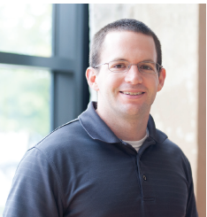
Trevor Looney
ROAD
The University of Oklahoma
Accelerated Bridge Construction University Transportation Center
(ABC-UTC) led by Florida International University
Research Area(s):
Multiaxial stress behavior of and constitutive models for non-proprietary UHPC intended for bridge infrastructure
Thesis Title:
Tensile Failure Criteria of Ultra-High Performance Concrete at Different Fiber
Percentages

Slide 24
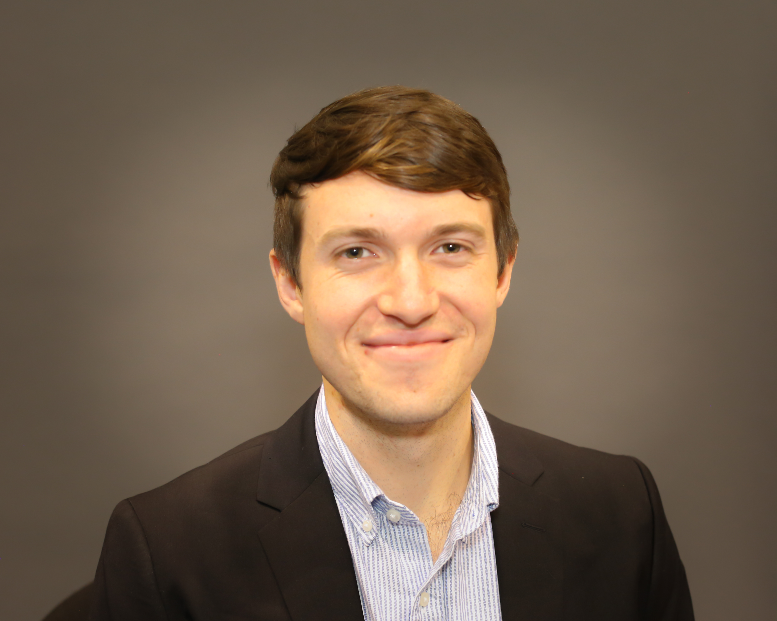
Daniel McCabe
ROAD
University of Washington
Connected Cities for Smart Mobility towards Accessible and Resilient
Transportation (C2SMART) Center led by New York University
Research Area(s):
Transportation network optimization; electric vehicles
Thesis Title:
Optimization Model for Battery-Electric Bus Charging Infrastructure

Slide 25
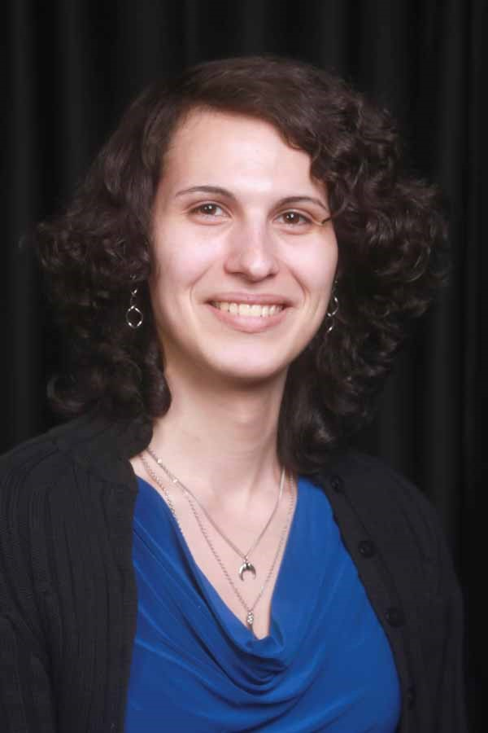
Cadence Motley
ROAD
University of Nevada at Reno
INSPIRE University Transportation Center led by Missouri University of
Science and Technology
Research Area(s):
Robotics research
Thesis Title:
Climbing Robot Design, Development, and Manufacturing for Steel Bridge
Inspection

Slide 26
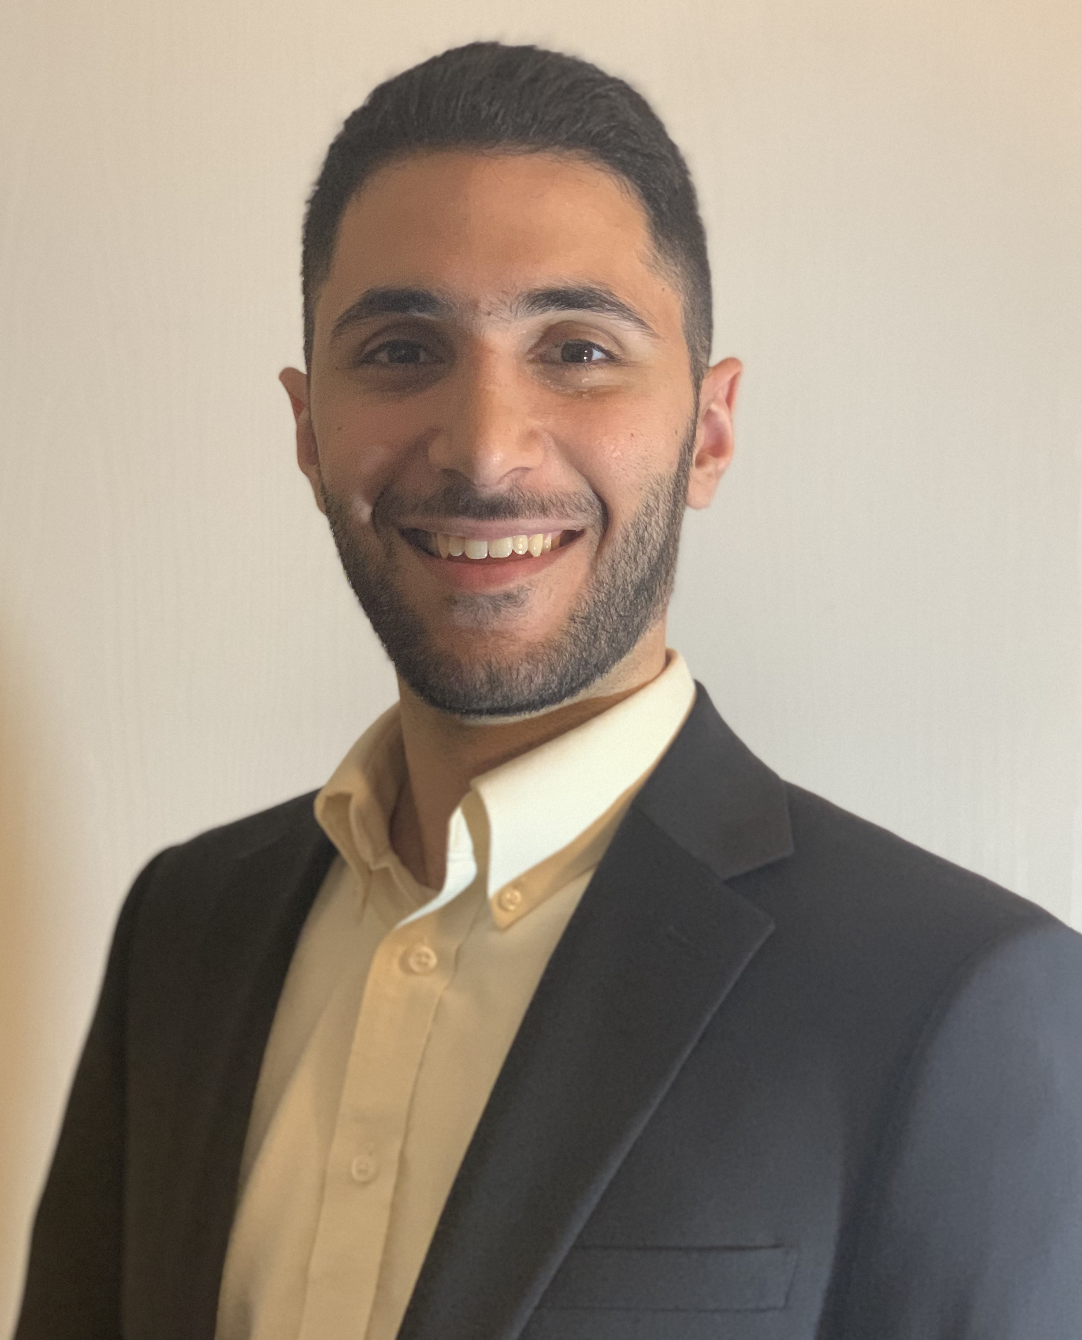
Abdullah Jalal Nafakh
ROAD
Purdue University
Center for Connected and Automated Transportation (CCAT) led by the
University of Michigan
Research Area(s):
Pedestrian infrastructure to improve safety
Thesis Title:
Optimal Selection of Pedestrian Crossing Treatments

Slide 27
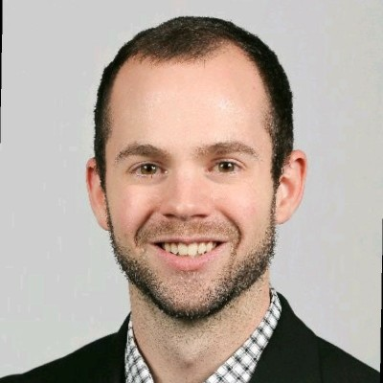
Campbell Neighborgall
ROAD
Virginia Tech
Improving Rail Transportation Infrastructure Sustainability and Durability (RailTEAM) led by the University of Nevada, Las Vegas
Research Area(s):
Roll stability of heavy trucks; vehicle dynamic-control system testing; long combination vehicle maneuverability; sensor fusion
Thesis Title:
An Investigation on Low-Speed Off-Tracking, High-Speed Roll-Stability, and Brake Type Performance of Class 8 Trucks with 33-ft A-Double Trailers

Slide 28
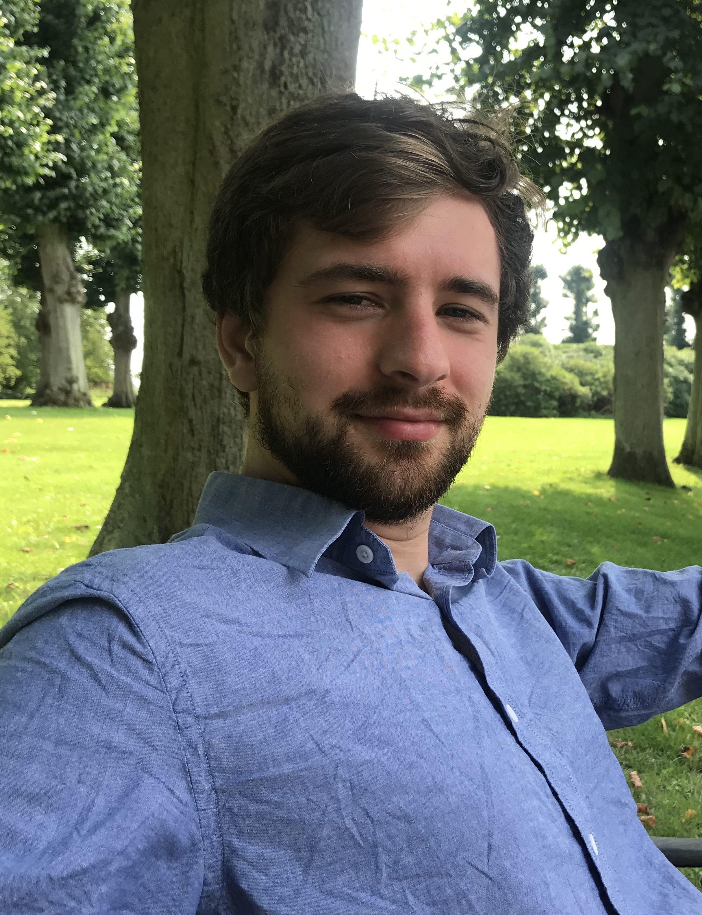
Samuel (Sam) Ricord
ROAD
University of Washington (UW)
Center for Safety Equity in Transportation (C-SET) led by the University
of Alaska Fairbanks
Research Area(s):
Traffic safety; smart sensing; rural transportation planning; transportation justice
Thesis Title:
Impact of Homeless Encampments on State Department of Transportation Right of Way

Slide 29
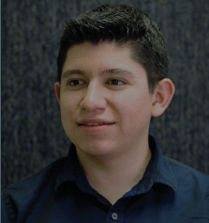
Emiliano Ruiz
ROAD
The University of Texas at El Paso
Center for Transportation, Environment, and Community Health (CTECH) led by Cornell University
Research Area(s):
Parking, simulation, and health impacts of transportation
Thesis Title:
Assessing the Impacts of Health Benefits and Carbon Footprint in Student Parking Decisions at a University Campus

Slide 30
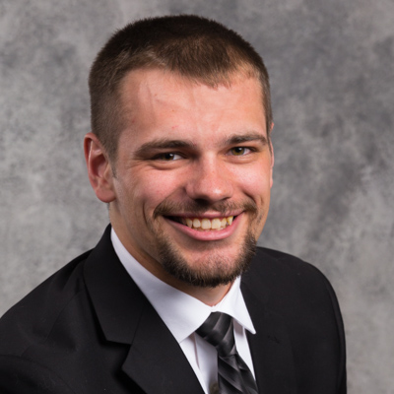
Theodore Sjurseth
ROAD
South Dakota State University
Mountain-Plains Consortium (MPC) led by North Dakota State University
Research Area(s):
Accelerated bridge construction
Thesis Title:
Seismic Performance of Mechanically Spliced Bridge Columns through Experimental Studies

Slide 31
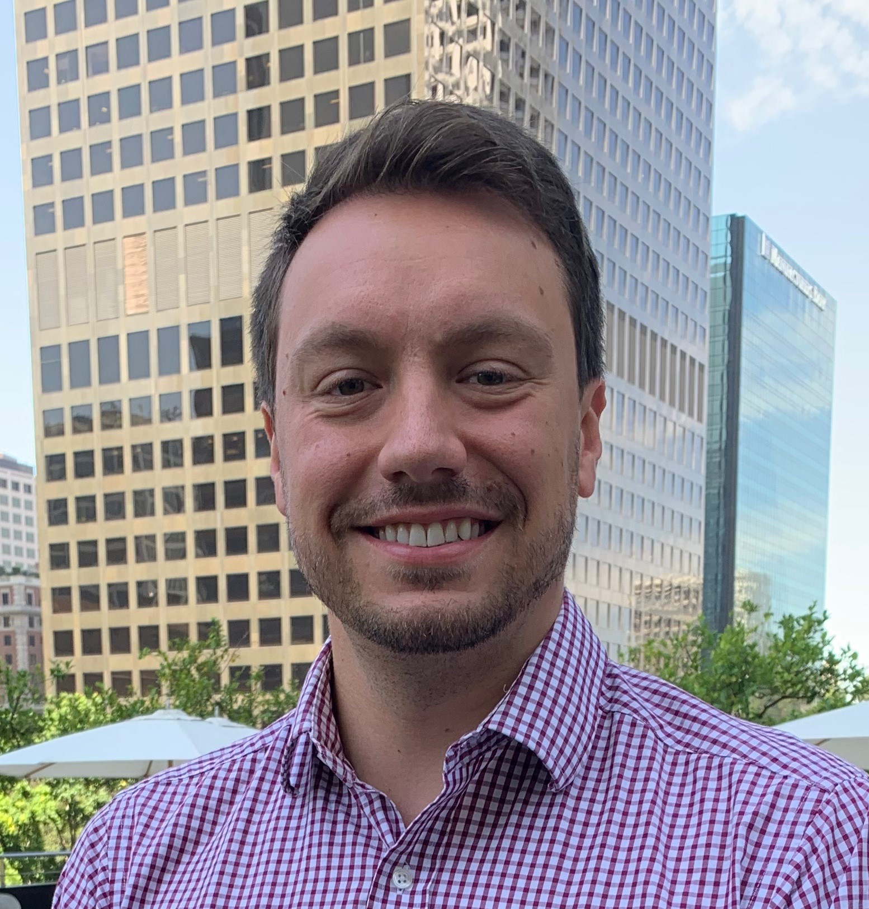
Samuel Speroni
ROAD
University of California, Los Angeles
Pacific Southwest Region UTC(PSR-UTC) led by the University of Southern California
Research Area(s):
School transportation; travel behavior; transportation equity; politics and finance
Thesis Title:
School Transportation Equity for Vulnerable Student Populations through
Ridehailing: An Analysis of HopSkipDrive and Other Trips to School in Los Angeles
County

Slide 32
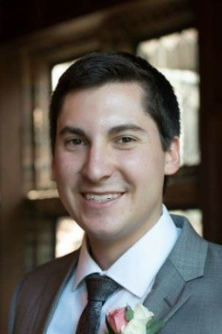
Christian Viniarski
ROAD
University of Delaware
Center for Integrated Asset Management for Multimodal Transportation Infrastructure Systems (CIAMTIS) led by Pennsylvania State University
Research Area(s):
Carbon fiber reinforced polymers and concrete structures
Thesis Title:
Design of Anchors for Rapid and Durable Strengthening of Bridges with Externally Bonded Carbon Fiber Reinforced Polymers

Slide 33
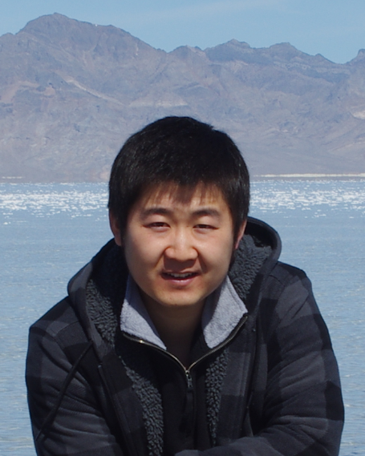
Yan Zhang
ROAD
Washington State University
National Center for Transportation Infrastructure Durability & Life-Extension (TriDurLE)
Research Area(s):
Anti-icing pavement, snow and ice control, environmentally friendly pavement, sustainable materials, and metallic corrosion
Thesis Title:
Development, Assessment, and Modeling of an Anti-Icing Asphalt Pavement

Slide 34
University Transportation Centers
^{Presented by:}
USDOT’s University Transportation
Centers (UTC) Program and the Council of
University Transportation Centers (CUTC)

