Slide 1
University Transportation Centers
Transportation Research Board 99th Annual Meeting

Slide 2
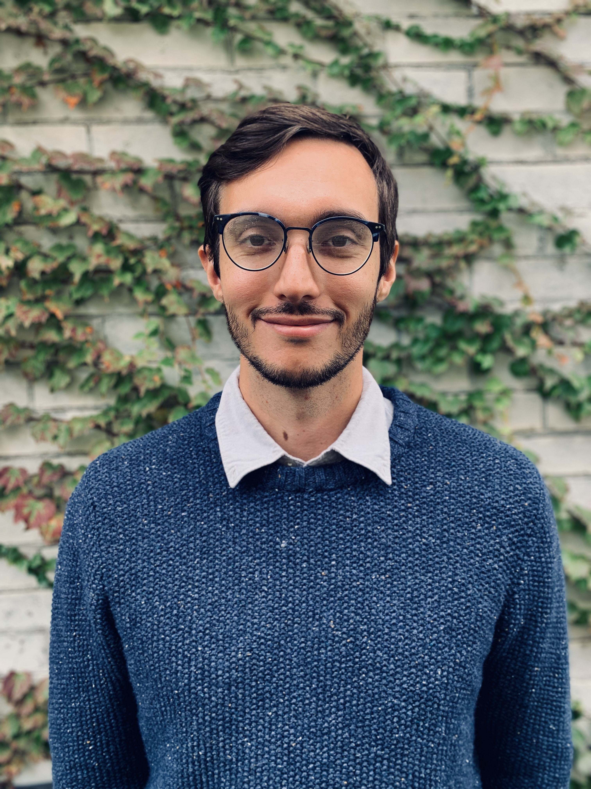
Matt Battifarano
MULTIMODAL
Carnegie Mellon University
Mobility21, A National University Transportation Center for Improving Mobility of People and Goods
Research Area(s):
Transportation Network Modeling
Thesis Title:
Socially optimal congestion policy for connected fleets

Slide 3
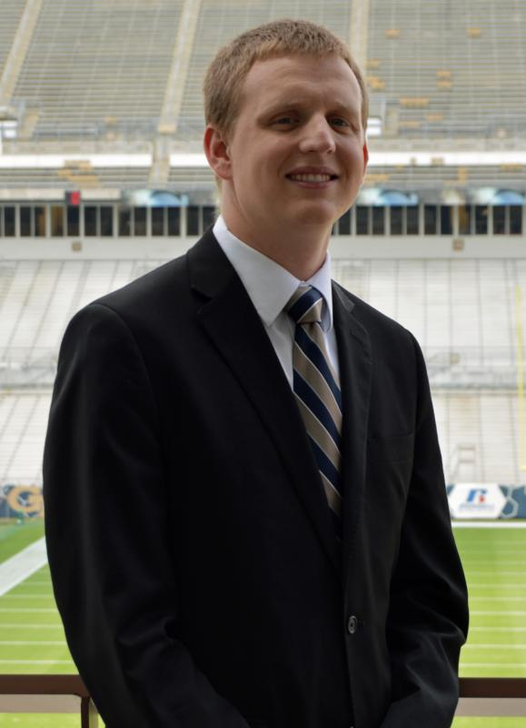
Calvin Clark
MULTIMODAL
Georgia Institute of Technology
National Center for Sustainable Transportation
Research Area(s):
Bicycle infrastructure
Thesis Title:
Bicycle Facility Preferences and Effects on Bicycle Trips

Slide 4
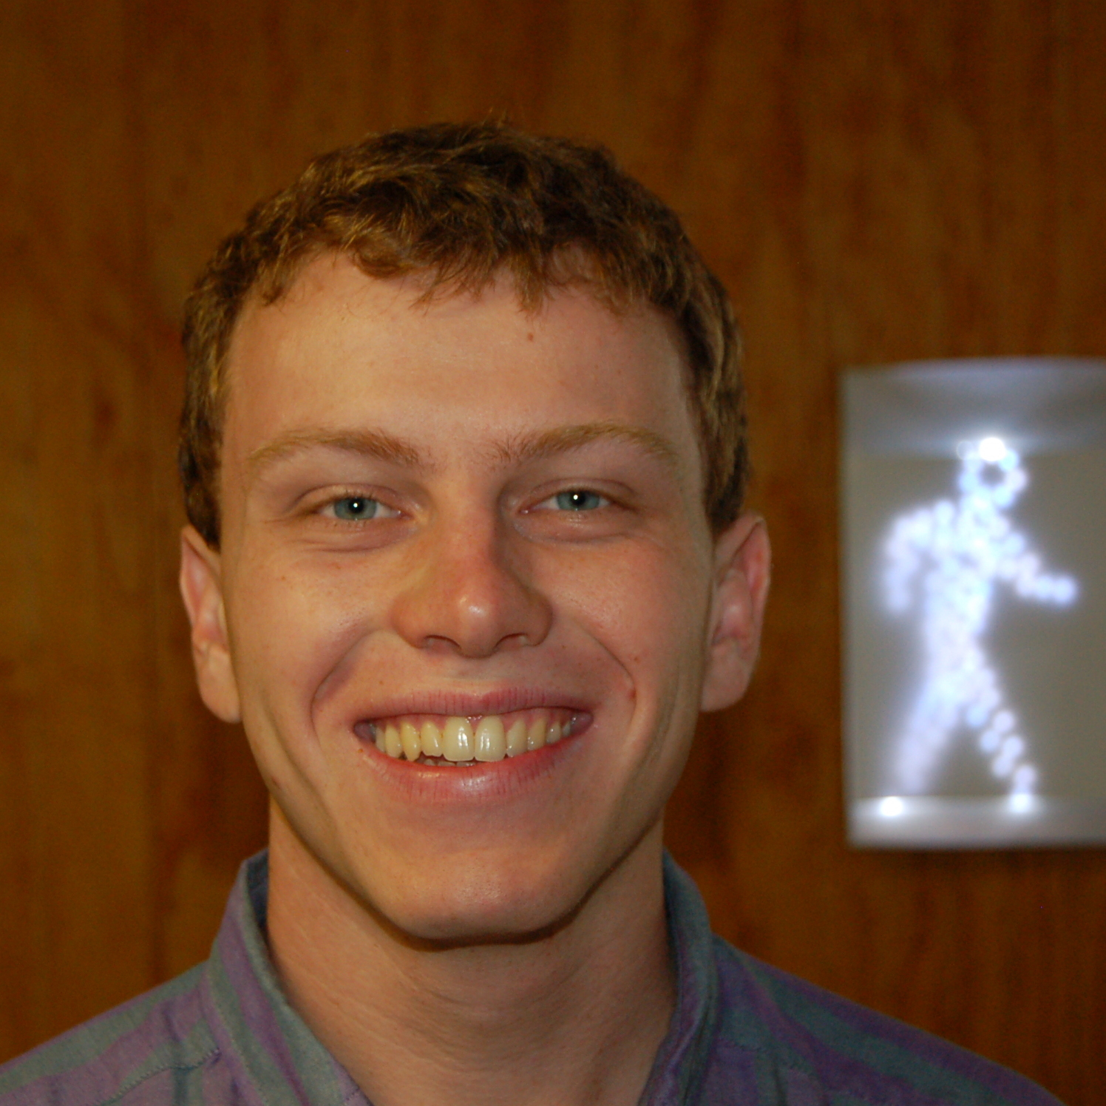
Matthew Wigginton Conway
MULTIMODAL
Arizona State University
Center for Teaching Old Models New Tricks
Research Area(s):
Transportation accessibility and emerging mobility options
Thesis Title:
The effects of relaxed zoning regulations on travel outcomes

Slide 5
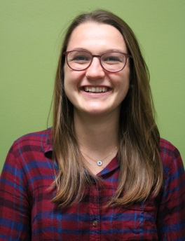
Rebecca Kiriazes
MULTIMODAL
Georgia Institute of Technology
Southeastern Transportation Research, Innovation, Development & Education Center
Research Area(s):
Multimodal / Transit
Thesis Title:
Facilitating a Future of Shared Transportation: Embracing shared usage of vehicles is critical to improving the urban transportation system

Slide 6
Cole Kopca
MULTIMODAL
University of Washington
Pacific Northwest Transportation Consortium
Research Area(s):
New Mobility Solutions
Thesis Title:
Exploring the Interactions of New Mobility Solutions such as BikeShare/ScooterShare and Public Transit

Slide 7
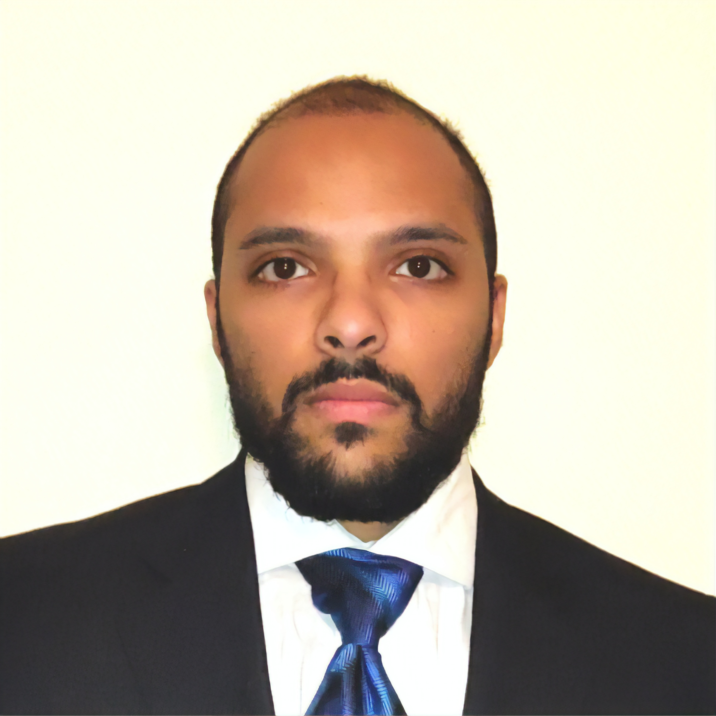
Mohammed Suyedur Luqman Rahman
MULTIMODAL
Texas Southern University
Center for Advanced Multimodal Mobility Solutions and Education
Research Area(s):
Enhancing Multimodal Mobility, Traffic Operations, Public Transportation
Thesis Title:
Impacts of bicycling corridor improvements on bike shares in large cities

Slide 8
Kaitlyn Schaffer
MULTIMODAL
Georgia Institute of Technology
Center for Advancing Research in Transportation Emissions, Energy, and Health
Research Area(s):
Pollutant exposure, health and transportation
Thesis Title:
Pollutant Exposure Studies of Emerging Modes of Transportation

Slide 9
Jesse Simpson
MULTIMODAL
University of Memphis
Freight Mobility Research Institute
Research Area(s):
Technological innovation and their influence in transportation, primarily freight and passenger vehicles
Thesis Title:
Adoption of autonomous trucks by freight organizations

Slide 10
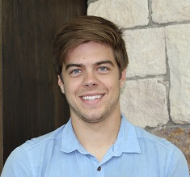
Logan Verkamp
MULTIMODAL
University of Arkansas
Maritime Transportation Research and Education Center
Research Area(s):
Fatigue of steel components subject to multi-axial loading
Thesis Title:
Effective fatigue retrofit strategies for multi-axially loaded lock-gate pintles

Slide 11
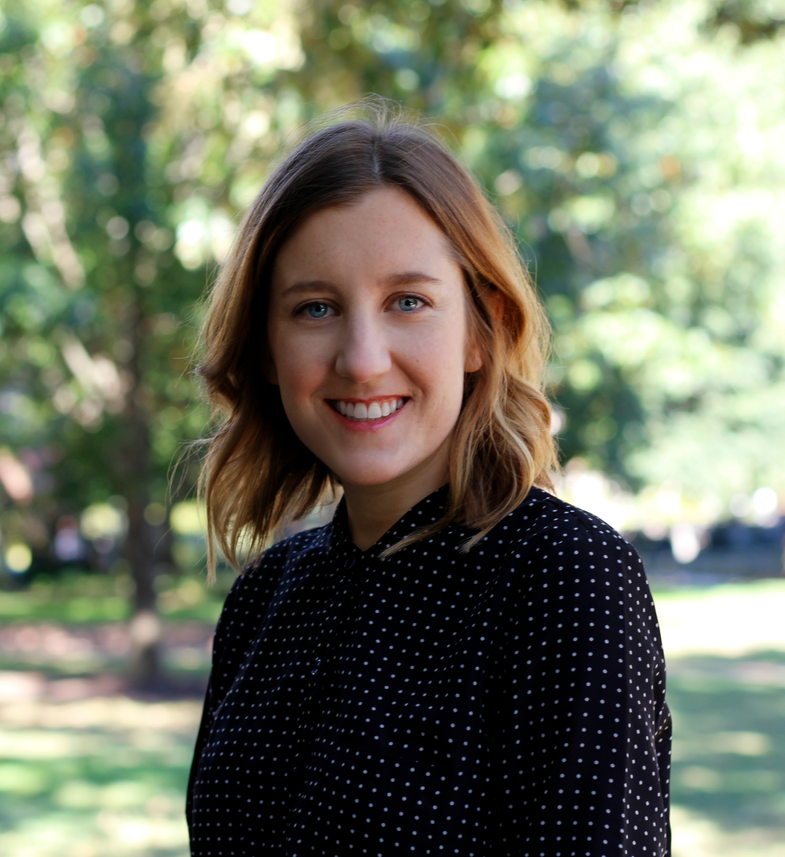
Mary Wolfe
MULTIMODAL
University of North Carolina at Chapel Hill
Collaborative Sciences Center for Road Safety
Research Area(s):
Connections between the built environment and travel behavior, emphasizing transportation health implications
Thesis Title:
Three Essays on Access to Healthcare

Slide 12
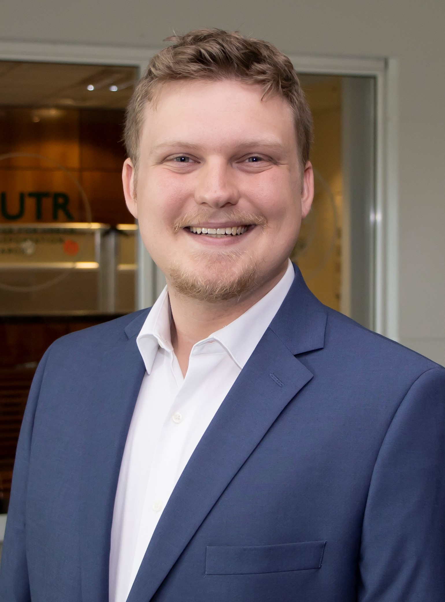
Kevin James Dennis
PUBLIC TRANSIT
University of South Florida
National Center for Transit Research
Research Area(s):
Cybersecurity

Slide 13
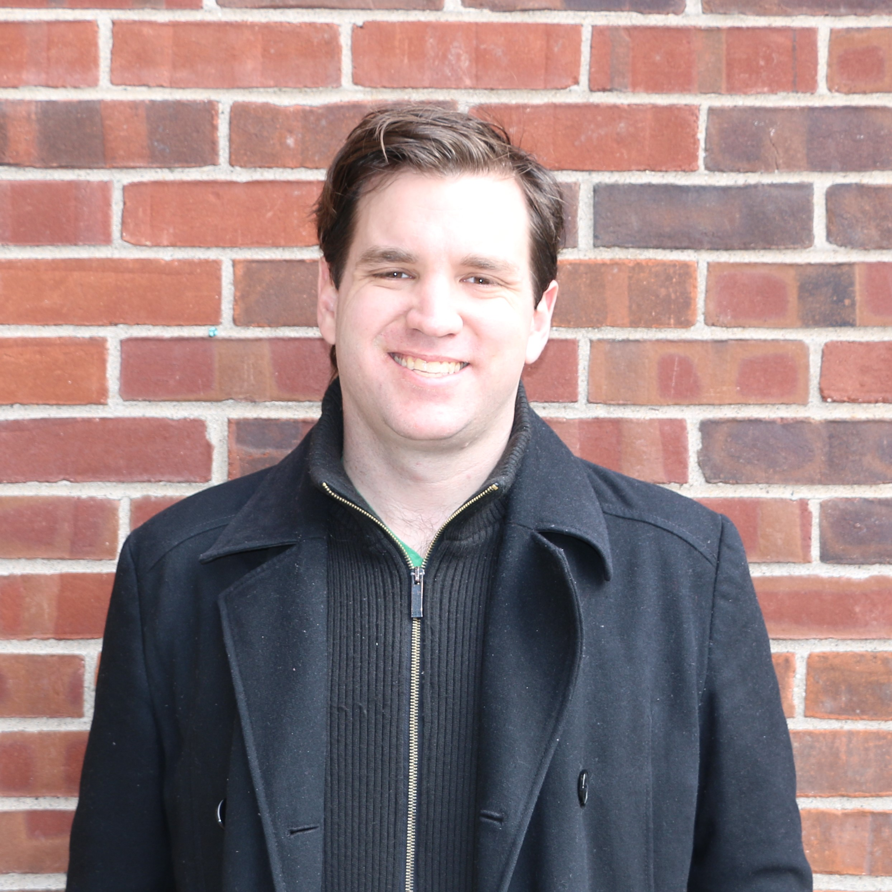
Luke Hassall
PUBLIC TRANSIT
University of Pennsylvania
Cooperative Mobility for Competitive Megaregions
Research Area(s):
Comparative rail tunnel costs, transit agency institutional design, bus network redesign
Thesis Title:
Congestion Pricing in New York

Slide 14
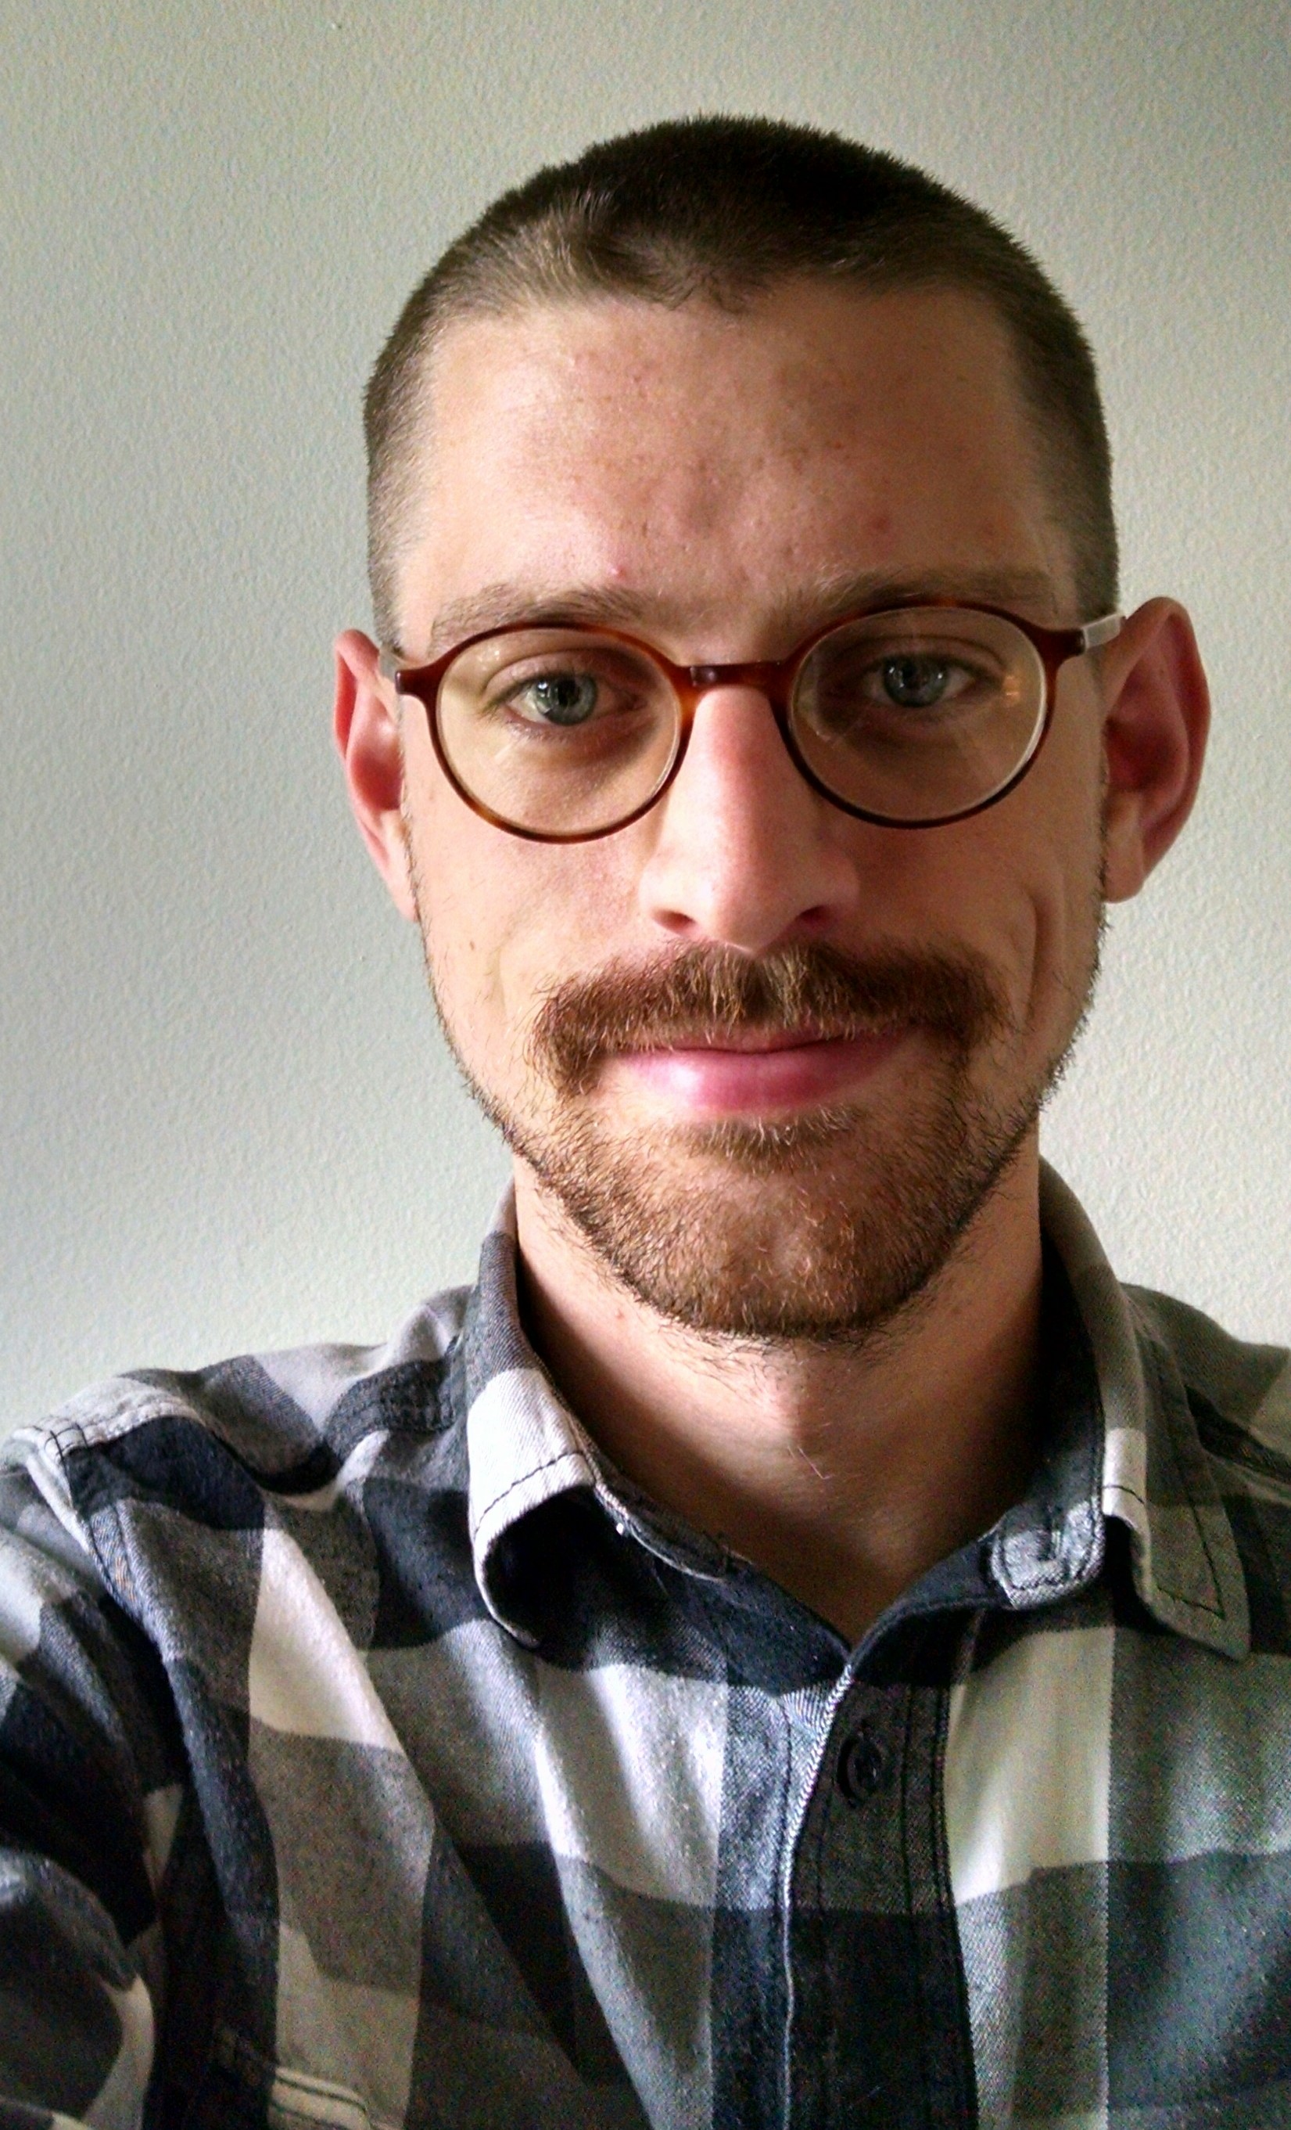
Samuel Jensen
PUBLIC TRANSIT
University of Arizona
National Institute for Transportation and Communities
Research Area(s):
Bicycle and Pedestrian Planning and Safety, Racial and Social Equity
Thesis Title:
An Inventory of Bus Stop Amenity Guidelines at U.S. Transit Agencies

Slide 15
Reza Nasouri
PUBLIC TRANSIT
University of Texas at San Antonio
Transportation Consortium of Southcentral States
Research Area(s):
Public transit infrastructure, sustainable energy, structural integrity assessment, finite element analysis
Thesis Title:
Prognosis and Mitigation of Weldment Cracking in High-Mast Illumination Poles due to Hot-Dip Galvanization

Slide 16
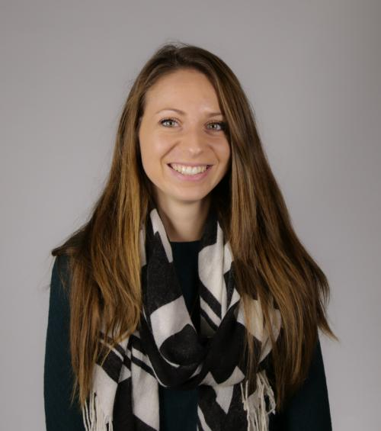
Hannah Younes
PUBLIC TRANSIT
University of Maryland College Park
Urban Mobility & Equity Center
Research Area(s):
Low-carbon mobility, modal shifts, emerging modes of transportation
Thesis Title:
Shifting toward Micromobility: Analyzing the determinants of usage of shared micromobility in the United States

Slide 17
Timothy Mast
RAIL
Virginia Tech
Rail Transportation Engineering and Advance Maintenance
Research Area(s):
Optical Detection of Top-of-Rail Friction Modifiers (TOR or TORFM)
Thesis Title:
Practical Assessment of Laser-based Sensors for Qualitative Measurement of Top-of-Rail Friction Modifiers on Revenue Service Track

Slide 18
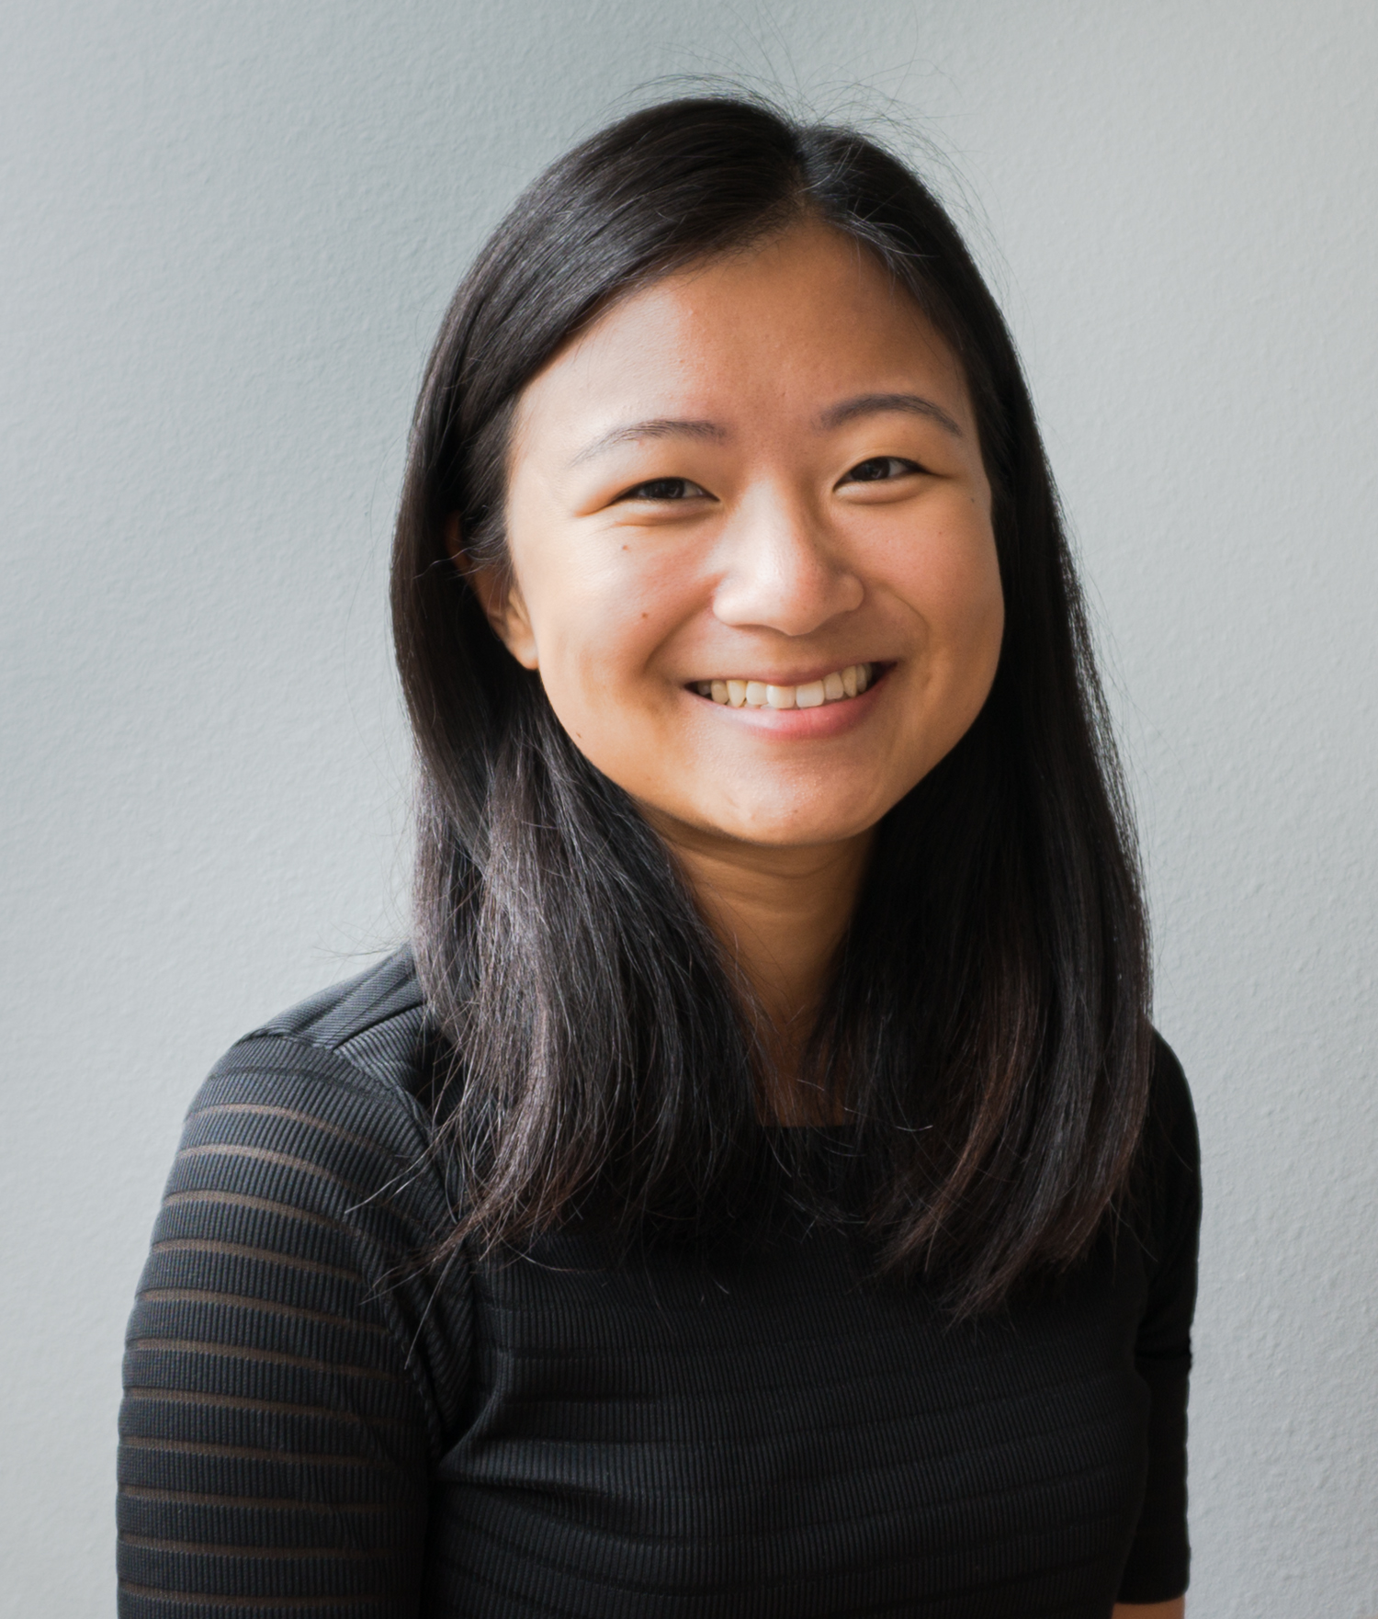
Michelle Chang
ROAD
University of Washington
Accelerated Bridge Construction University Transportation Center
Research Area(s):
Structural Engineering
Thesis Title:
Reinforced Concrete Column-to-Shaft Connections in Seismic Regions

Slide 19
John Joon Young Chung
ROAD
University of Michigan
Center for Connected and Automated Transportation
Research Area(s):
Recovering autonomous vehicle failure with collective human interventions
Thesis Title:
Improving and scaffolding machine learning or AI systems with complex human inputs

Slide 20
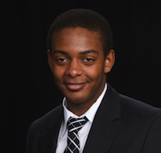
Alexander Curtis
ROAD
New York University
Connected Cities towards Smart Mobility and Resilient Transportation
Research Area(s):
Reliability engineering, time series analysis, reliability analysis, condition-based maintenance, predictive maintenance, event/log-based systems
Thesis Title:
Applications of Reliability Engineering Techniques for Vehicle System Maintenance Alternatives

Slide 21
Sue Dexter
ROAD
University of Southern California
Pacific Southwest Region University Transportation Center
Research Area(s):
Sustainable urban freight, transportation planning and infrastructure, land use policy, environmental policy, climate change mitigation, international development
Thesis Title:
Life cycle comparisons between diesel and alternative fuel heavy-duty trucks: how much better are battery-electric or hydrogen fuel cell trucks for the environment?

Slide 22
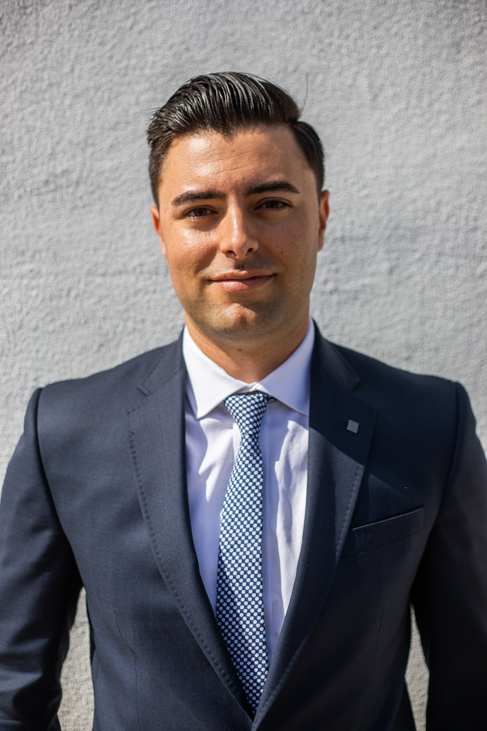
Ryan Fallica
ROAD
San Jose State University
Mineta Transportation Institute
Research Area(s):
The intersection of transportation and housing policy
Thesis Title:
VMT Analysis in California: SB 743 Implementation in Early Adopter Cities

Slide 23
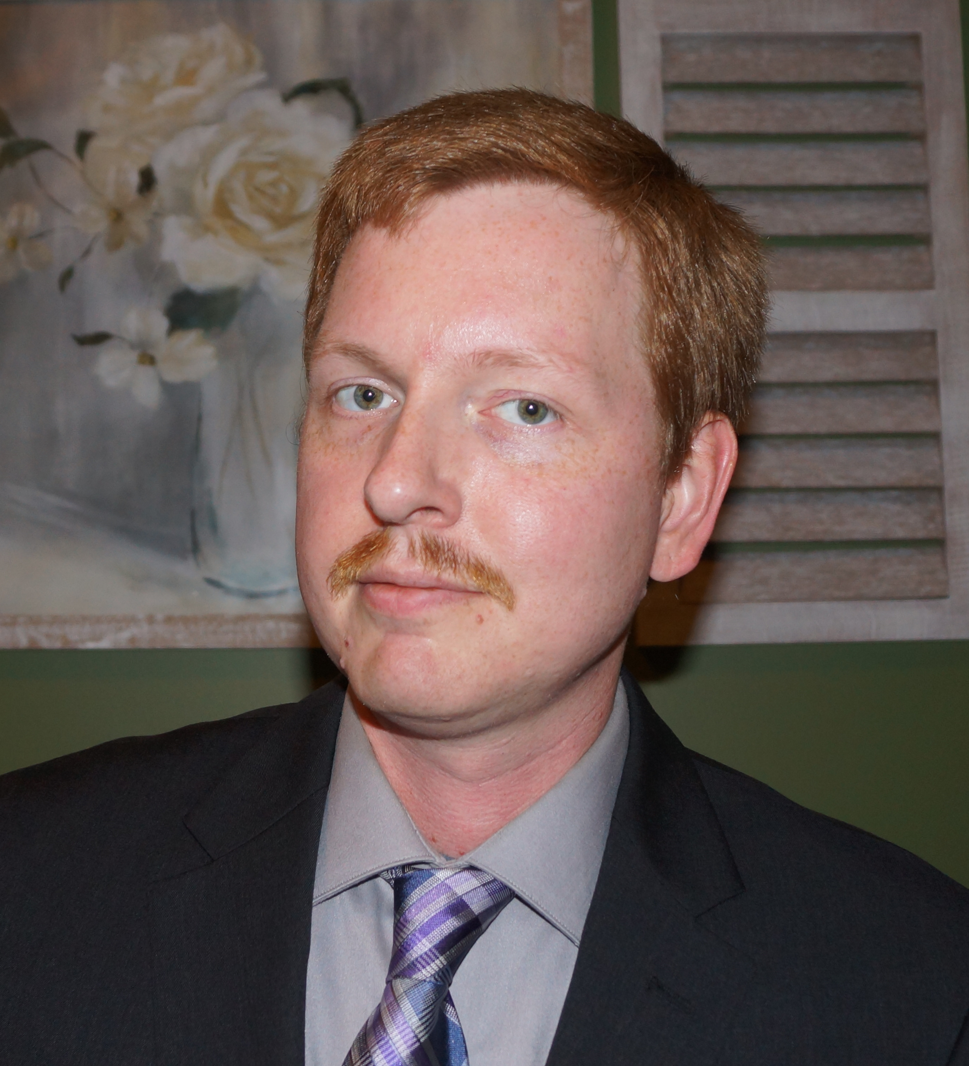
Larkin Folsom
ROAD
North Carolina Agricultural and Technical State University Center for Advanced Transportation Mobility
Research Area(s):
Connected Vehicles and Unmanned Aerial Vehicles
Thesis Title:
Information-Theoretic Multi-agent Route Planning in Uncertain Environments

Slide 24
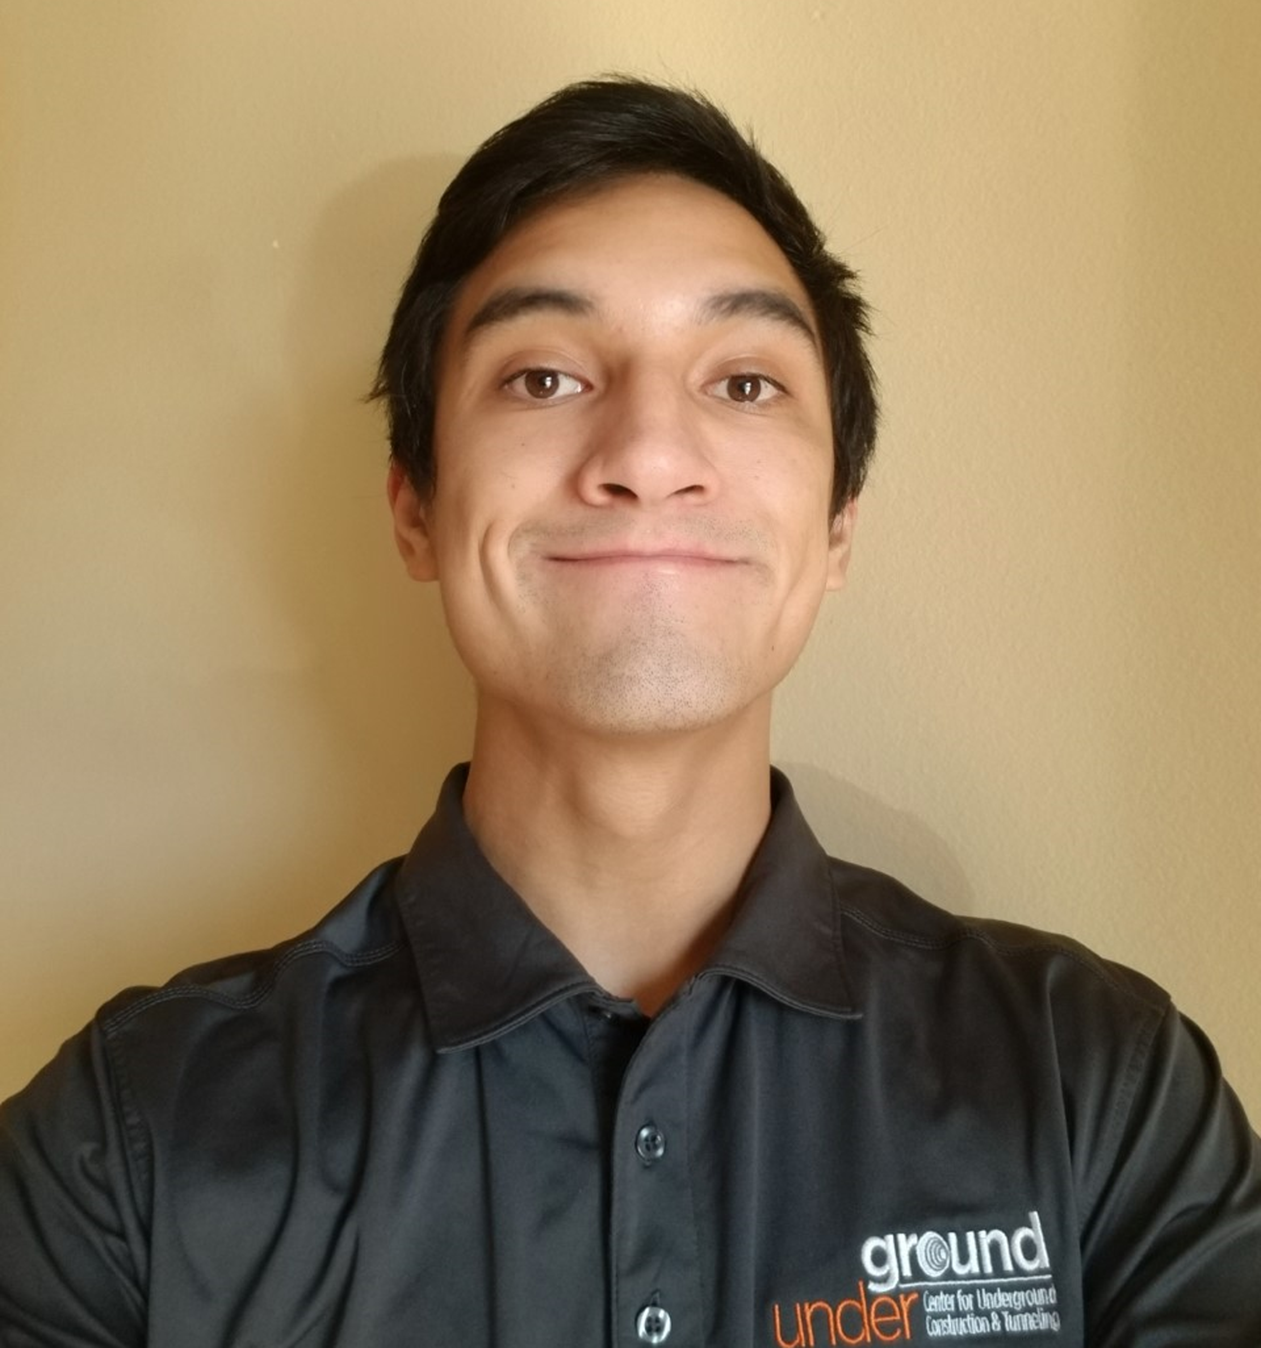
Ashton Krajnovich
ROAD
Colorado School of Mines
Transportation Informatics (TransInfo)
Research Area(s):
Geologic characterization for transportation tunnels, 3D geologic modeling, Uncertainty assessment
Thesis Title:
Adaptive and Predictive 3D Geologic Modeling for Hard Rock Tunneling

Slide 25
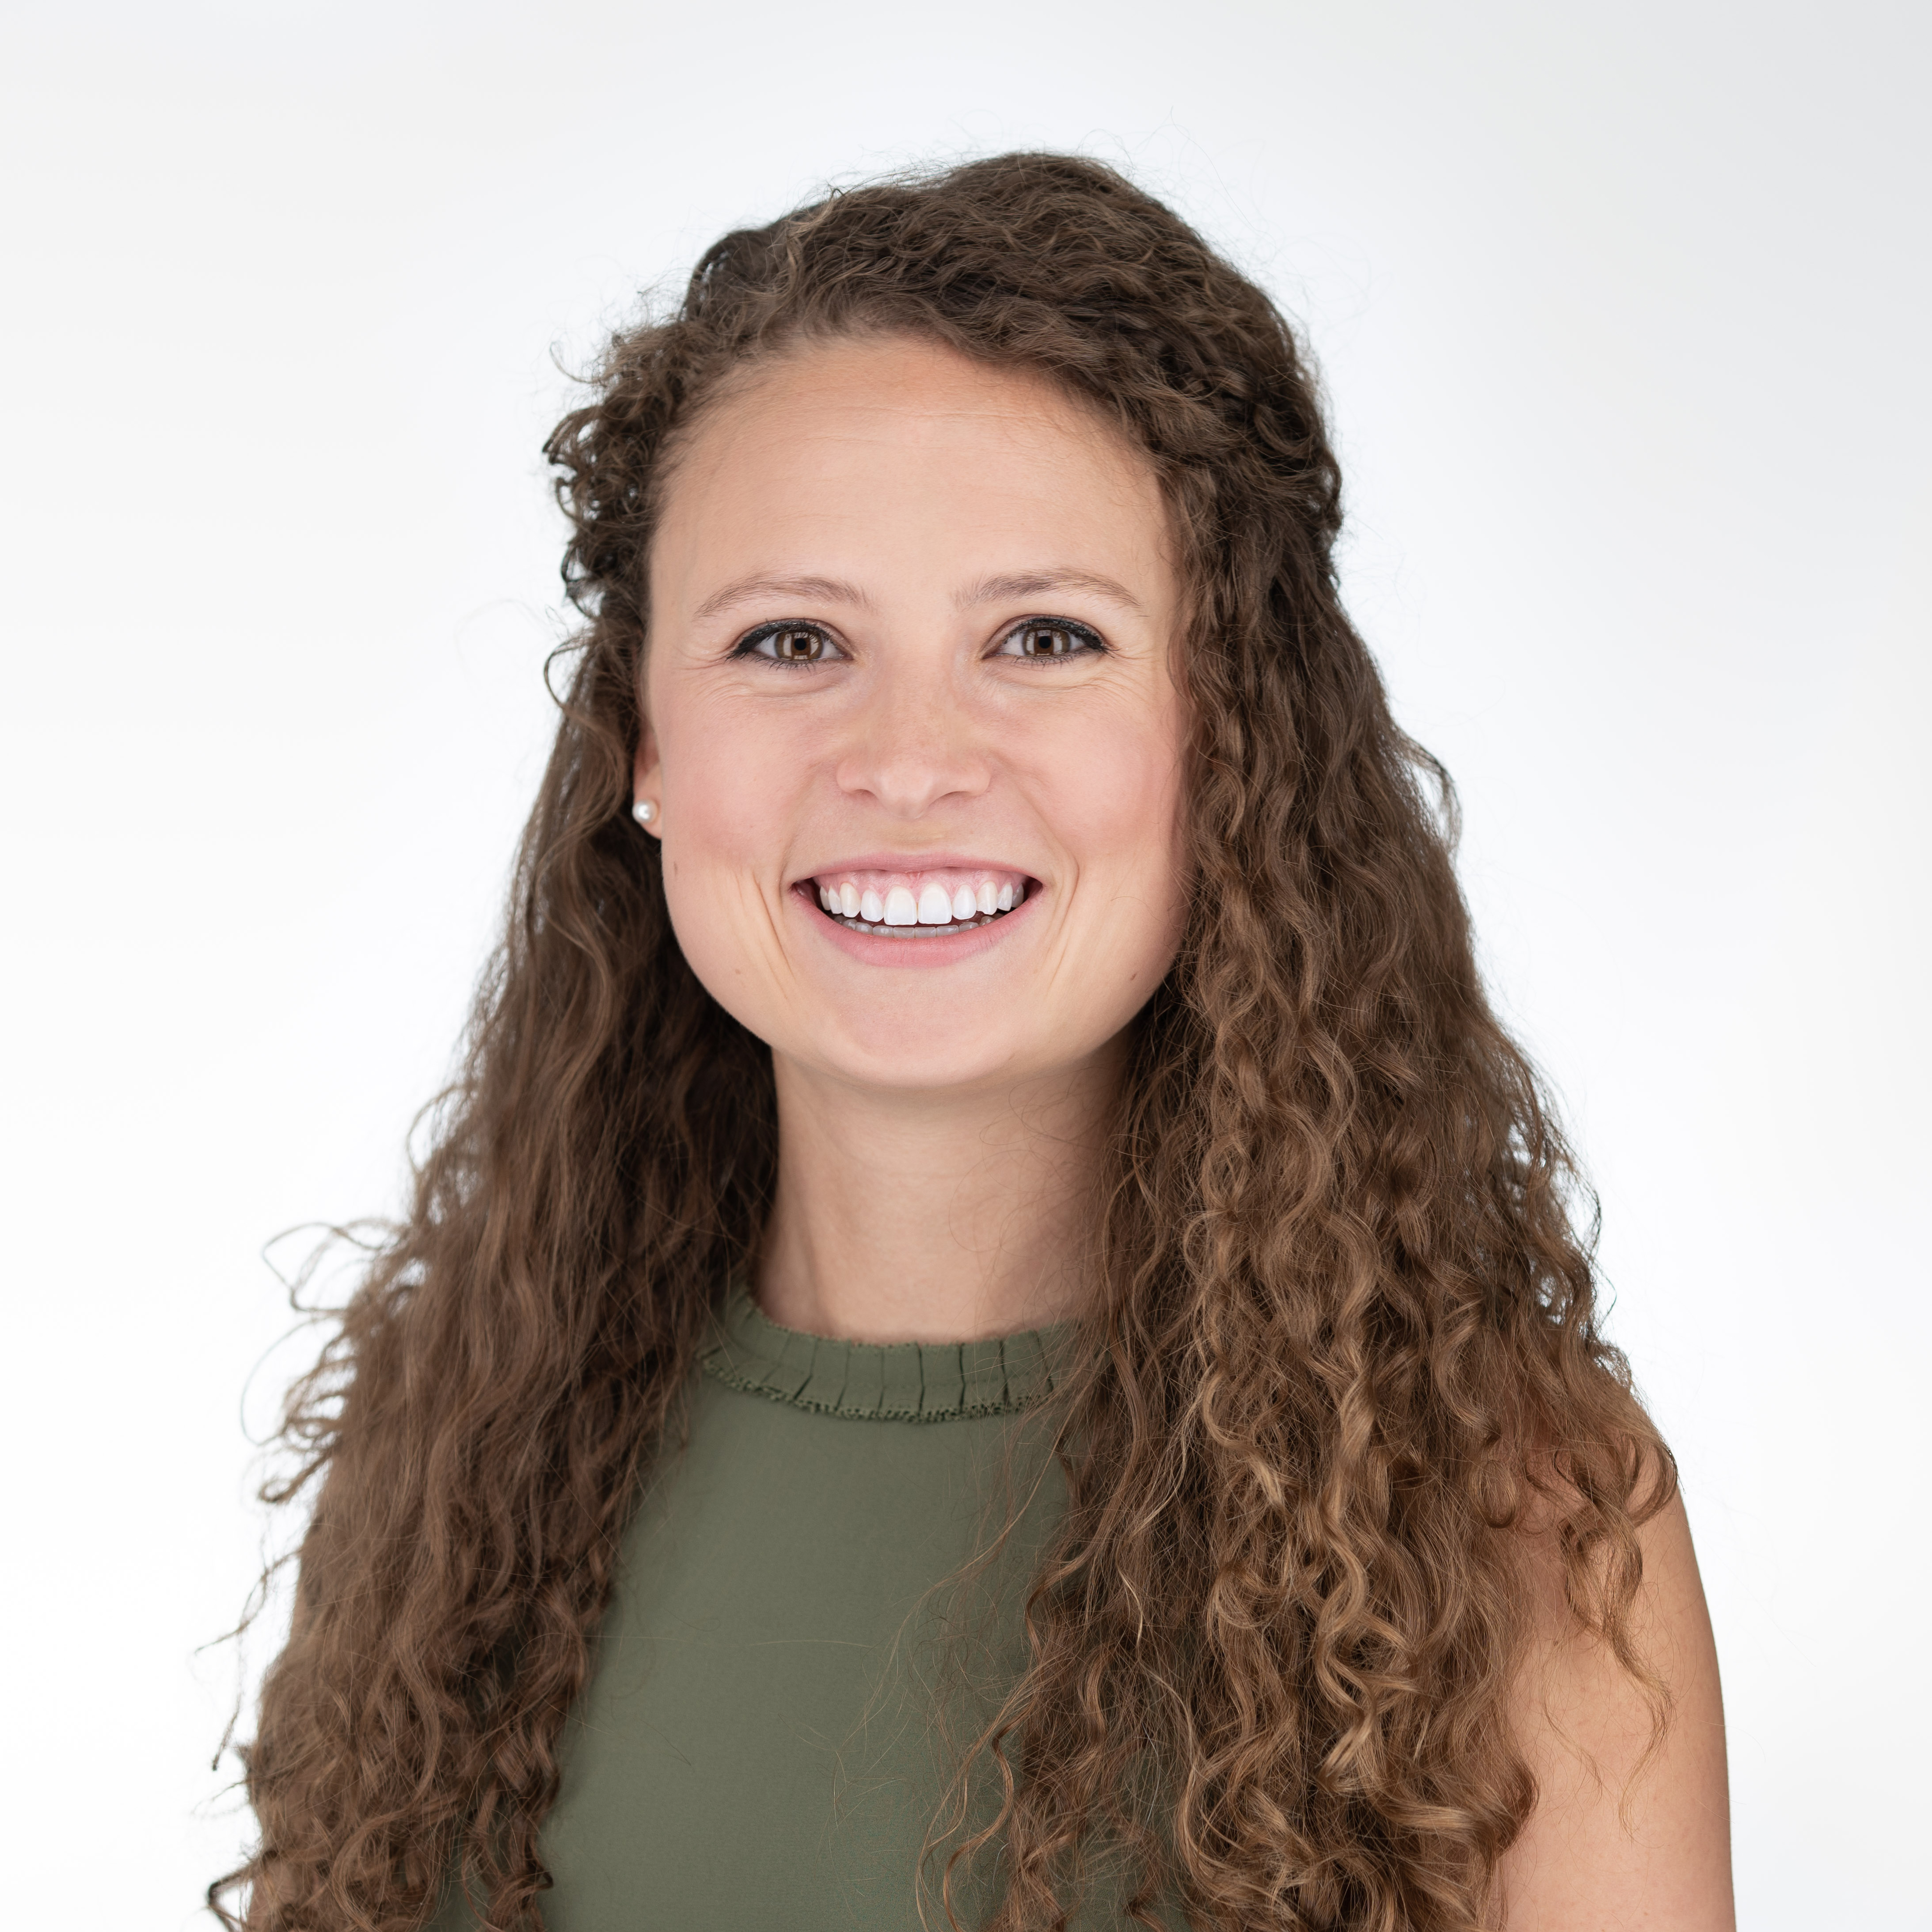
Vanessa McEntee
ROAD
University of Utah
Mountain-Plains Consortium
Research Area(s):
Repair and Retrofit of concrete structures with Fiber Reinforced Polymers (FRP) for increased community seismic resiliency.
Thesis Title:
Seismic Retrofit and Repair of Existing Bridge Wall Pier Using Conventional and CFRP systems

Slide 26
Michael Moore
ROAD
The University of Texas at Austin
Data-Supported Transportation Operations and Planning Center
Research Area(s):
Connected and Automated Vehicles, Emerging Technology, Big Data
Thesis Title:
Operational Design Domains and Certification Programs for the Safe Integration of Connected and Automated Vehicles onto Public Roads

Slide 27
Isa Musa
ROAD
South Carolina State University
Center for Connected Multimodal Mobility
Research Area(s):
Pedestrian safety
Thesis Title:
Trip Generation of Electric Vehicles charging Stations in Columbia, South Carolina

Slide 28
Alexandria Noble
ROAD
Virginia Tech
Safety through Disruption National UTC
Research Area(s):
Driver Behavior with Emerging Vehicle Technologies
Thesis Title:
The More You Know: Driver Training and Behavioral Adaptation to Driving Automation Systems

Slide 29
Tristan Sayre
ROAD
University of Alaska Fairbanks
Center for Safety Equity in Transportation
Research Area(s):
Alternative forms of transportation, safety, spatial analysis
Thesis Title:
Quantifying Unlawful Use of Off-Highway Vehicles in Alaska

Slide 30
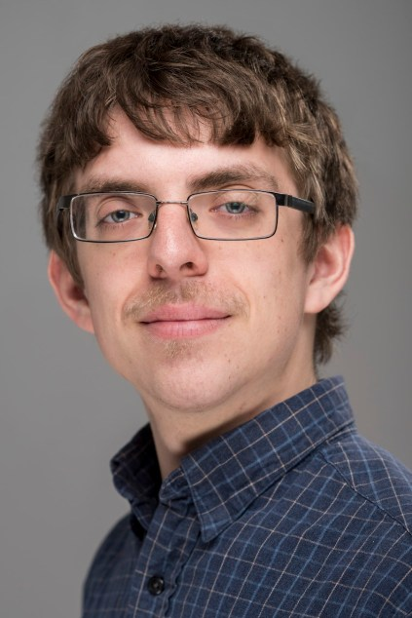
Andrew Schanck
ROAD
University of Maine
Transportation Infrastructure Durability Center
Research Area(s):
Structural health monitoring, composite tub girder system, live-load testing of bridges
Thesis Title:
Determination of Reinforced Concrete T-Beam and Fiber Reinforced Polymer Tub-Girder Bridge Live-Load Behavior through Live-Load Testing and Advanced Finite Element Analysis

Slide 31
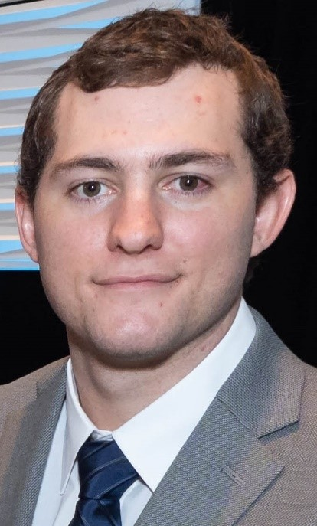
Brian Staes
ROAD
University of South Florida
Center for Transportation Equity, Decisions, and Dollars
Research Area(s):
Highway operations, specifically as they relate to evacuation/disaster incidents
Thesis Title:
Travel Time Optimization of Roadway Facilities During Large Scale Mass Evacuations

Slide 32
Francis Tainter
ROAD
University of Massachusetts/Amherst
Safety Research Using Simulation
Research Area(s):
Transportation safety, traffic operations, crash-prediction modeling
Thesis Title:
Investigating the Safety Impacts of Left-Turn Infrastructure on the Vulnerable Driving Population

Slide 33
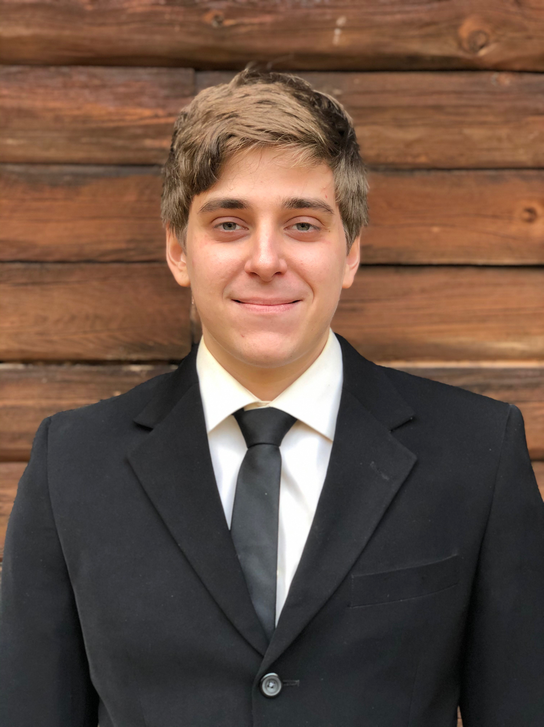
Noah Thibodeaux
ROAD
New Jersey Institute of Technology
Center for Advanced Infrastructure and Transportation
Research Area(s):
Concrete Materials
Thesis Title:
Freeze-thaw Durability of the Bond Zone Between Cementitious Rapid Repair Materials and Concrete Substrate

Slide 34
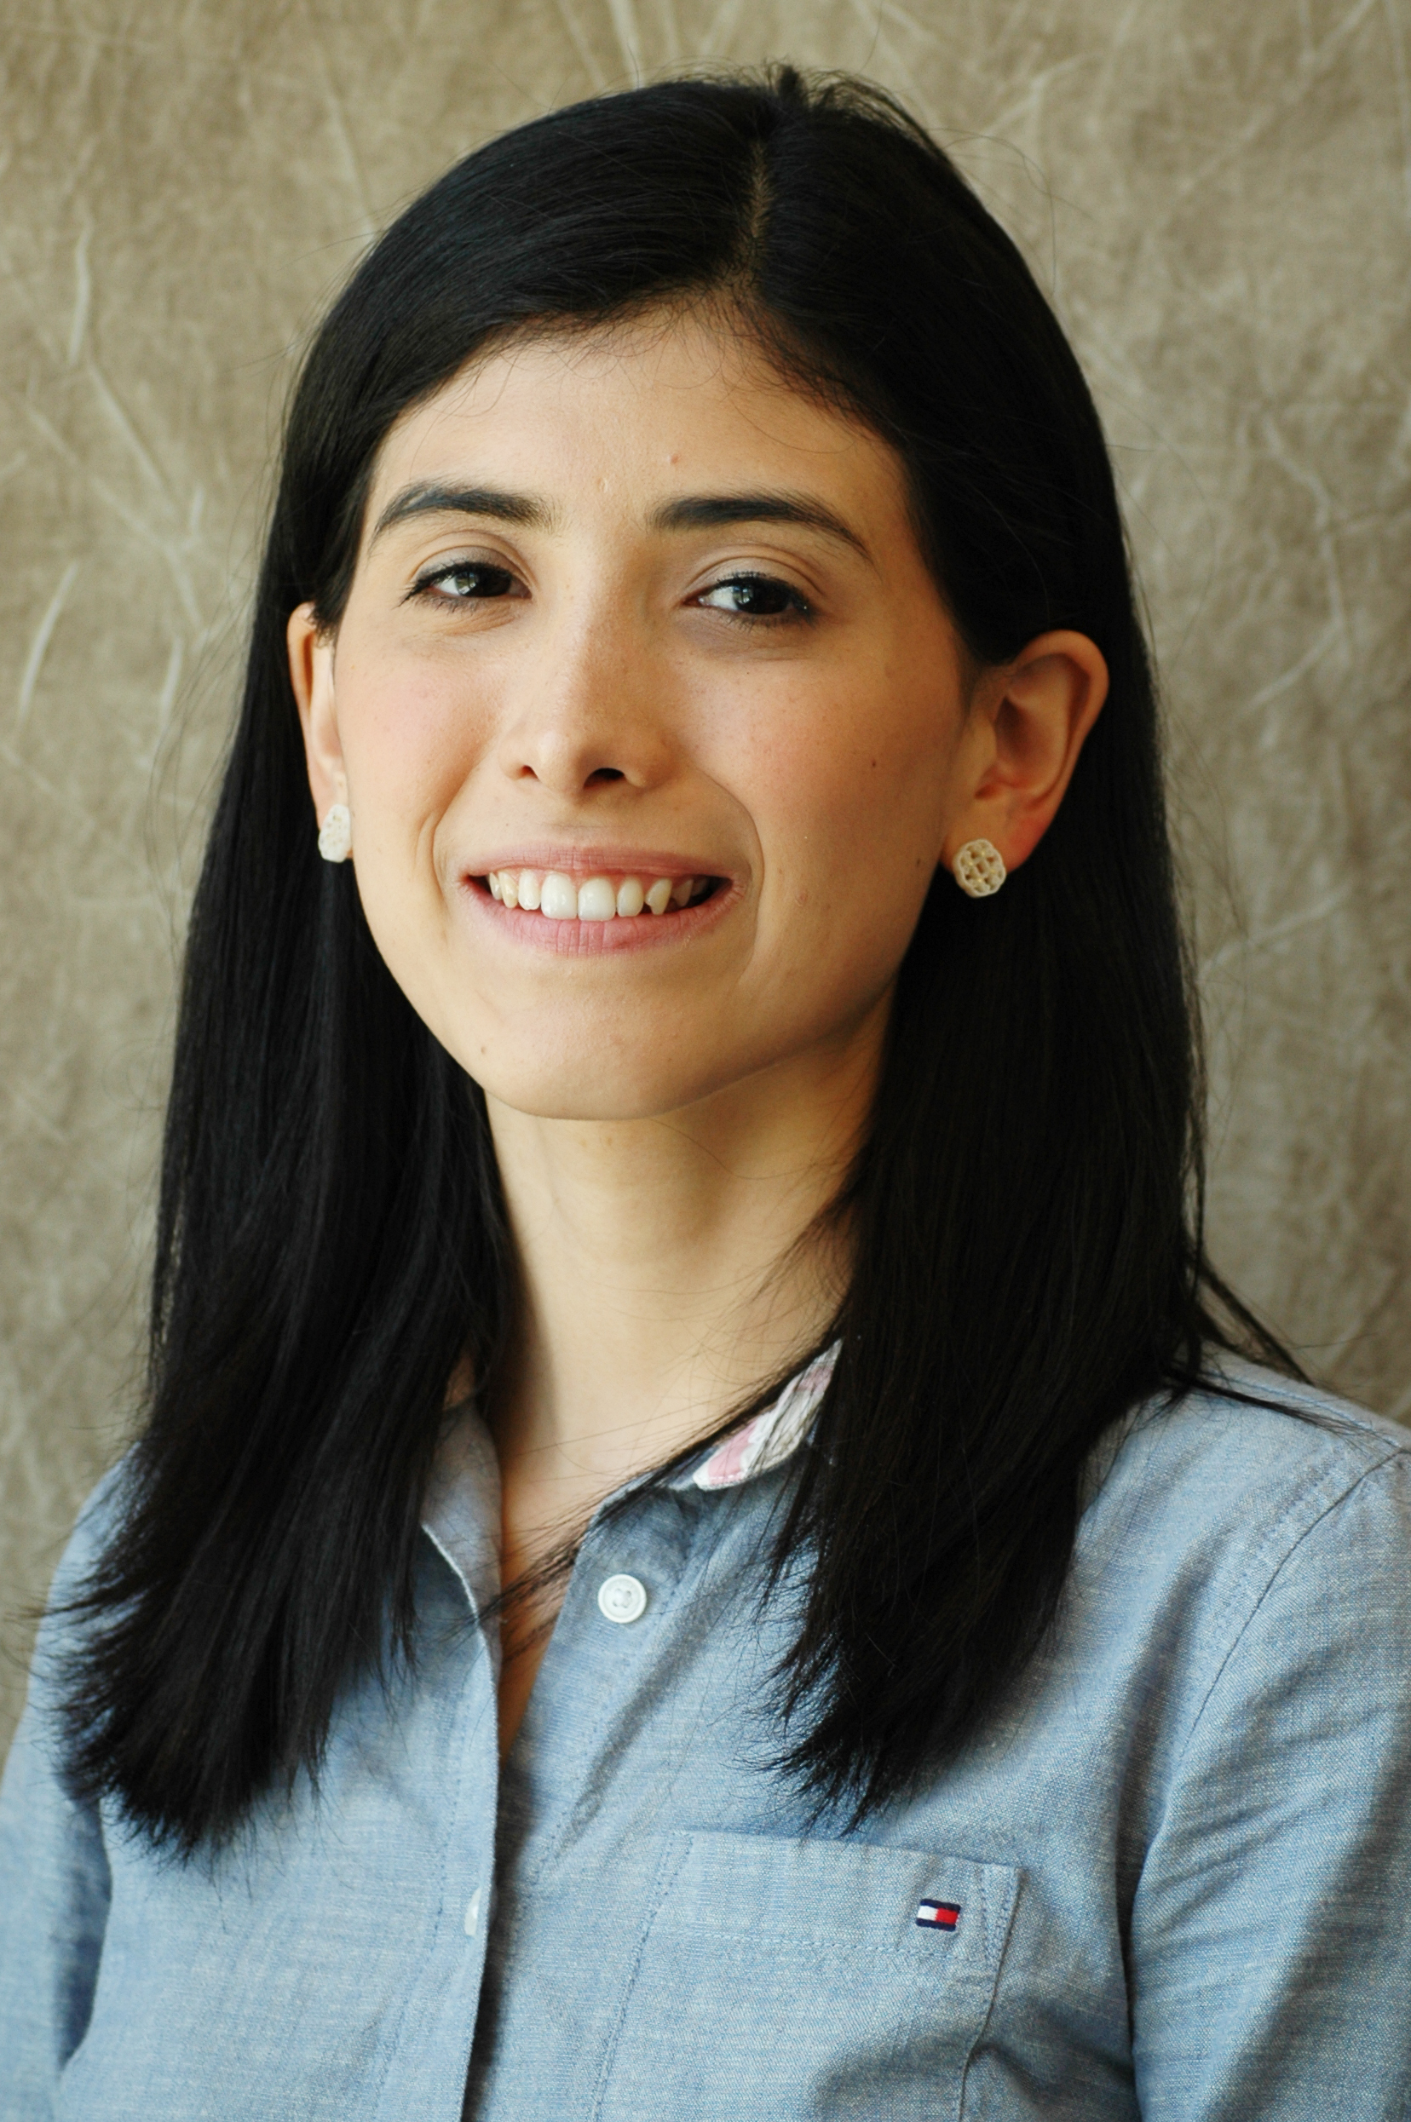
Elisa Vasquez
ROAD
University of Nebraska-Lincoln
Mid-America Transportation Center
Research Area(s):
Finite element analysis
Thesis Title:
Investigation and Development of a MASH Test Level 6 Barrier, Phase II

Slide 35
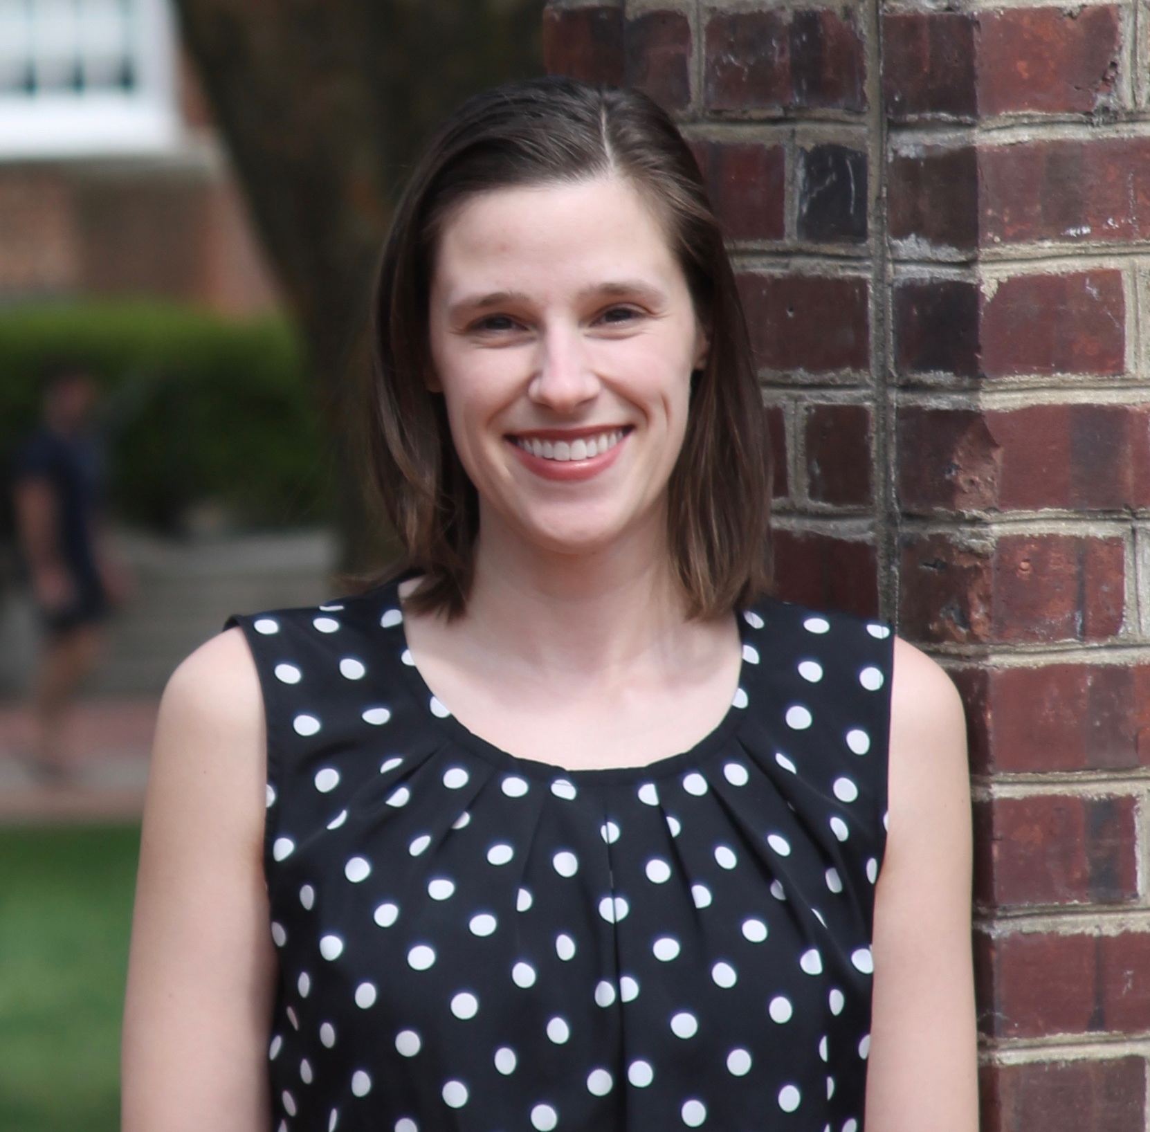
Michelle Woody
ROAD
University of Delaware
Center for Integrated Asset Management for Multi-Modal Transportation Infrastructure Systems
Research Area(s):
Disaster Recovery and Mitigation
Thesis Title:
Local Disaster Debris Management Planning Priorities: Qualitative Assessment of Plans From Virginia

Slide 36
University Transportation Centers
Transportation Research Board 99th Annual Meeting

