Slide 1
AUTOMATED VEHICLES
Comprehensive Plan

Slide 2
What is the Comprehensive Plan?
Builds on previous voluntary guidance | ADS 2.0, AV 3.0, AV 4.0
Explains Departmental goals related to Automated Driving Systems (ADS) | Promote Collaboration and Transparency Modernize the Regulatory Environment Prepare the Transportation System
Identifies actions being taken to meet those goals | Stakeholder Engagement, Research, Guidance, Rulemakings
Provides real-world examples of how these Departmental actions relate to emerging ADS applications | Occupant-less Low-Speed Vehicles Passenger Vehicle Conditional Driving Automation Passenger Vehicle Automated Driving Systems Automated Trucking Operations Low-Speed Passenger Shuttle

Slide 4
Promoting Collaboration and Transparency
Engage with stakeholders to monitor for emerging trends, issues, and needs
FHWA National Dialogues on Highway Automation
FTA Transit Automation Community of Practices
Cooperative Automated Transportation Coalition
Provide guidance to industry to encourage transparency and adoption of best practices
ADS 2.0, AV 3.0, AV 4.0
Facilitate information sharing
Automated Vehicle Transparency and Engagement for Safe Testing (AV TEST) Initiative
Voluntary Safety Self-Assessments
FTA Transit Bus Automation Market Assessment
Emerging Automated Urban Freight Delivery Concepts State of the Practice Scan

Slide 5
Modernizing the Regulatory Environment
Streamline Paths to Deployment
Grant of Temporary Exemption for a Low-Speed Vehicle with an Automated Driving System
NPRM: Expansion of Temporary Exemption Program to Domestic Manufacturers for Research, Demonstrations, and Other Purposes
NPRM: Updating the Process for Temporary Exemptions
Update Existing Regulations to Remove Unnecessary Barriers
NPRM: Occupant Protection for Automated Driving Systems
ANPRM: Removing Regulatory Barriers for Automated Driving Systems
ANPRM: Considerations for Telltales, Indicators, and Warnings in ADS Vehicles
ANPRM: Passenger-less Delivery Vehicles Equipped with Automated Driving Systems
ANPRM: Specialized Motor Vehicles with Automated Driving Systems
NPRM: Safe Integration of Automated Driving Systems-Equipped Commercial Motor Vehicles
Conduct Appropriate Safety Oversight of ADS
ANPRM: Framework for Automated Driving System Safety
Voluntary Technical Standards

Slide 6
Preparing the Transportation System
Conduct targeted technical research
Automated Commercial Motor Vehicle Evaluation (ACE) Program
Automated Driving Systems (ADS) Operational Behavior and Traffic Regulation Information
Work Zone Data Exchange Demonstration Grants
Port Cooperative Driving Automation Drayage Truck Development and Testing
Provide funding for ADS-focused demonstrations, pilots, and deployments
Automated Driving System Grants
Integrated Mobility Innovation Grants
Accelerating Innovative Mobility Initiative
Inclusive Design Challenge
Update infrastructure standards to reflect ADS technologies
Manual on Uniform Traffic Control Devices (MUTCD) Notice of Proposed Amendment

Slide 8
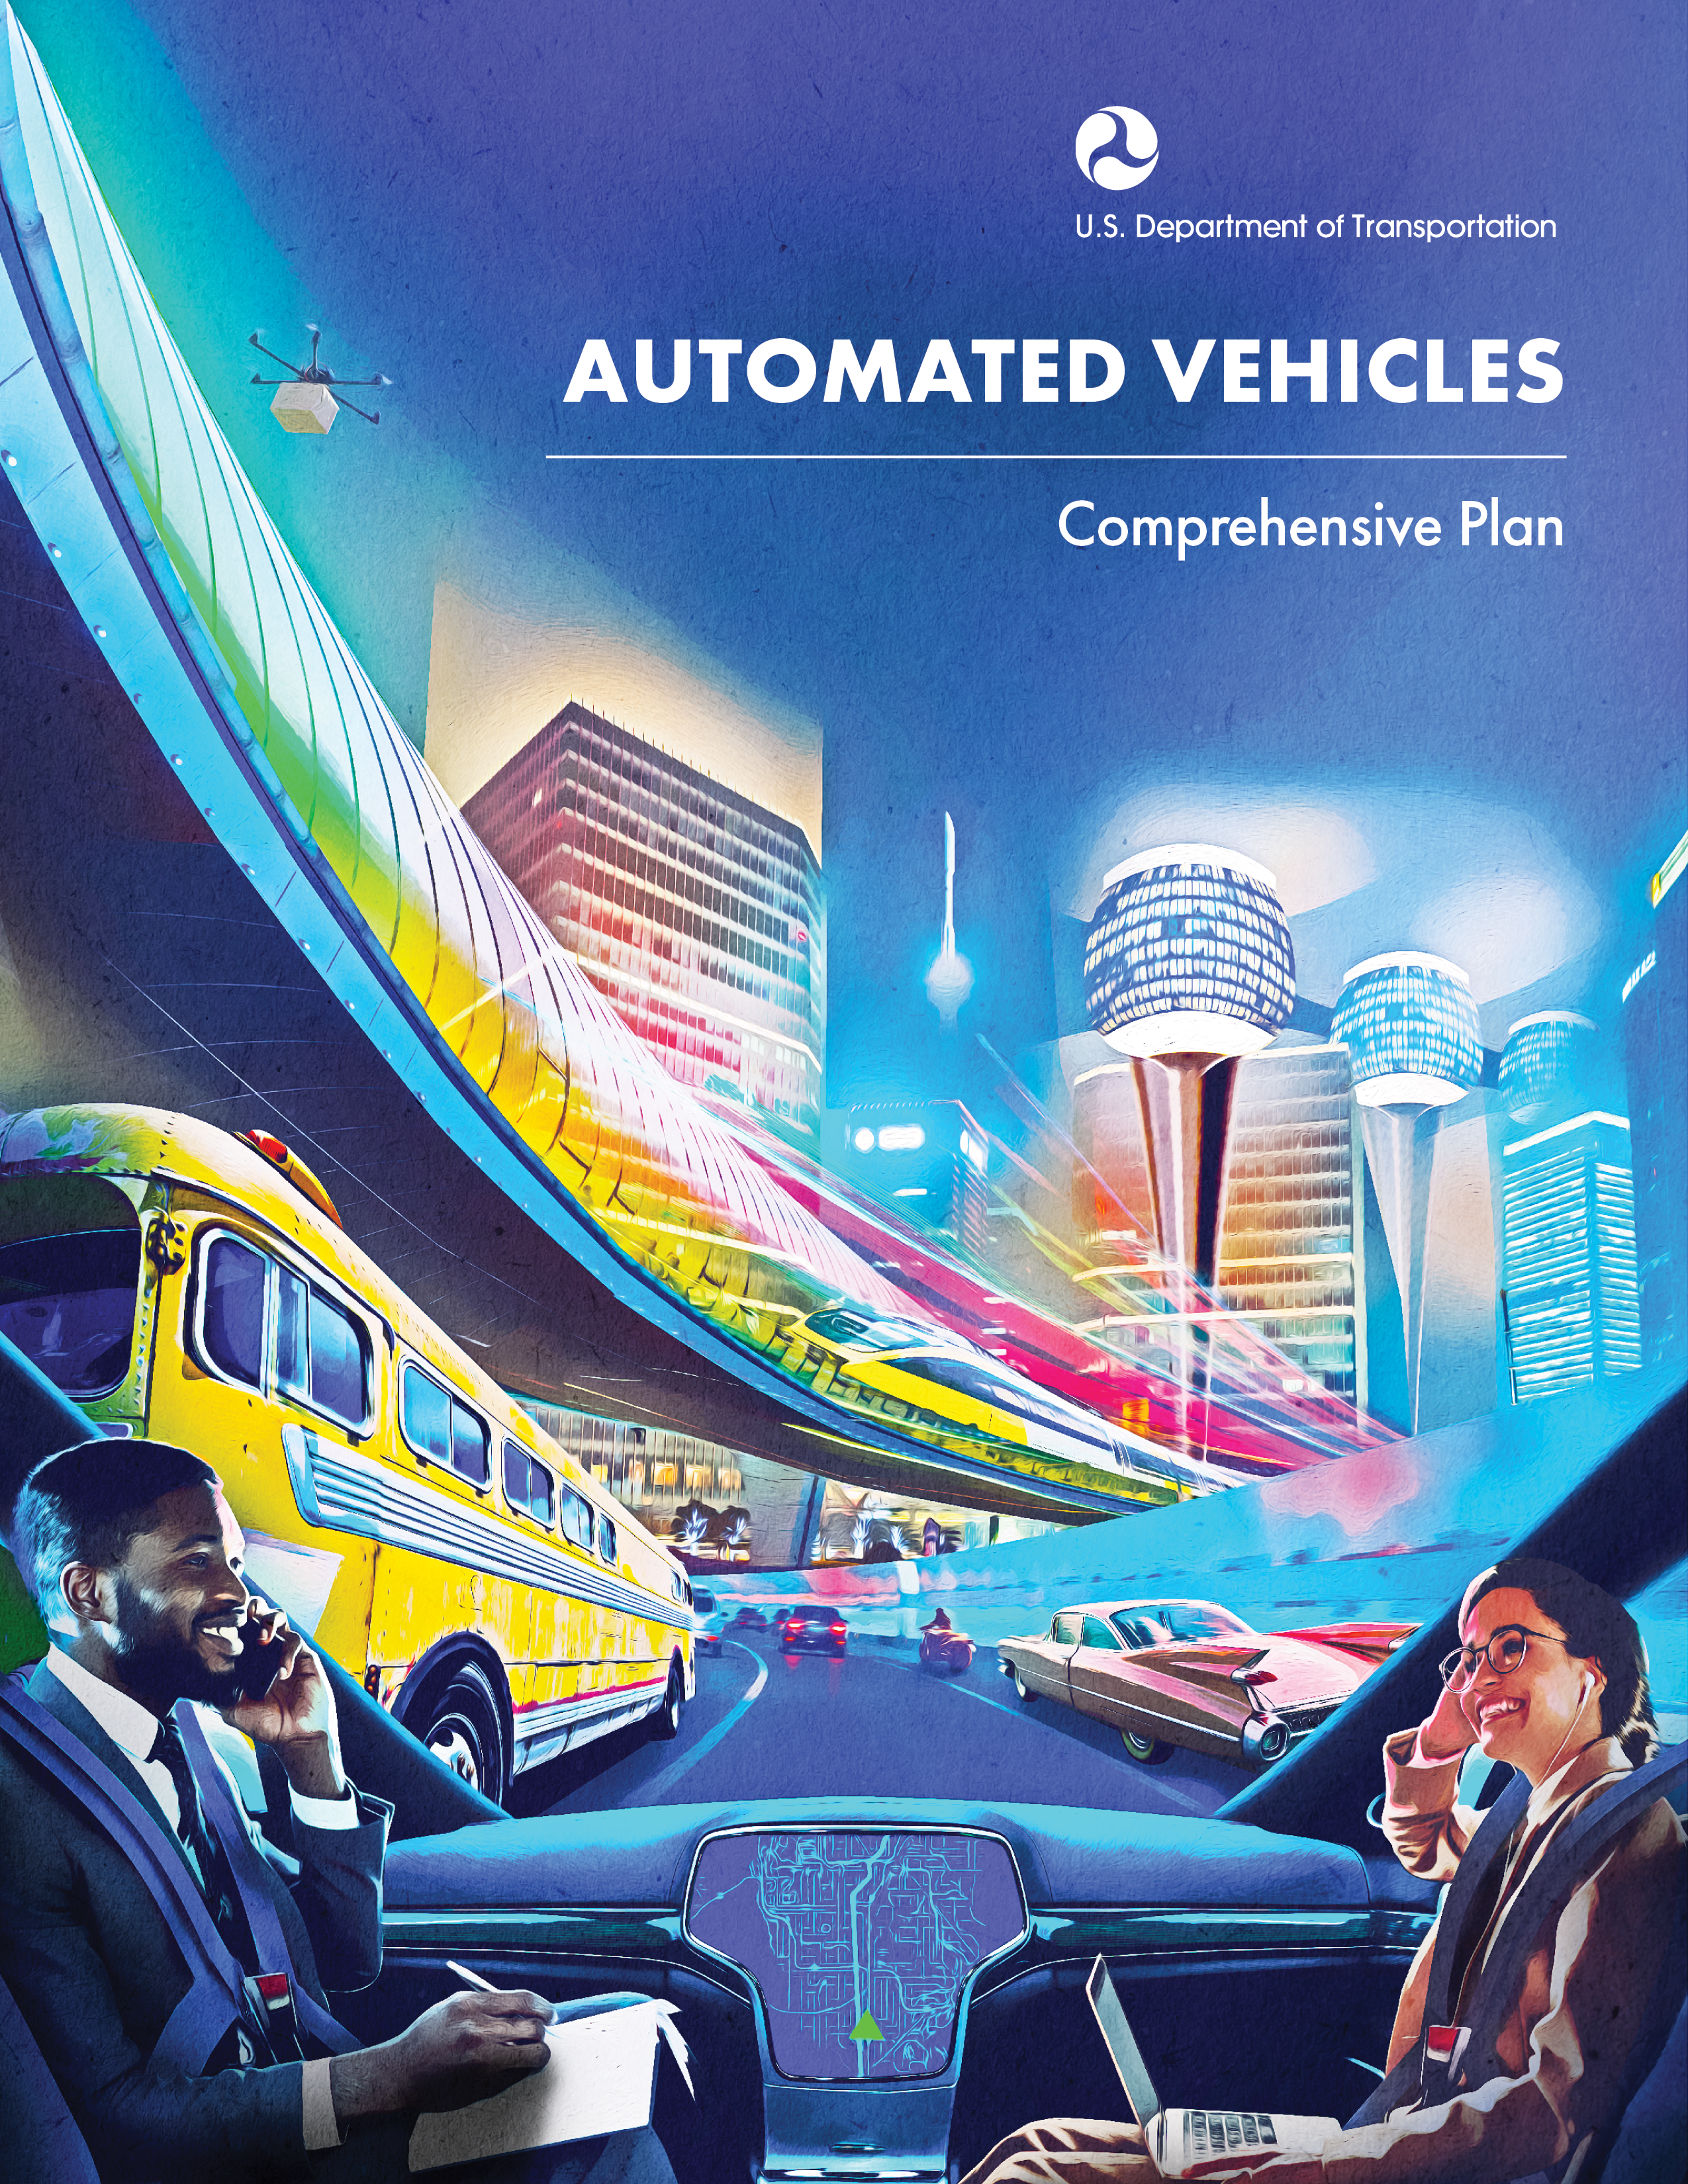
transportation.gov/av

Slide 9
Additional Slides

Slide 10
Background
2017: Automated Vehicles: Comprehensive Plan Could Help DOT Address Challenges (GAO-18-132)
“The Secretary of Transportation should develop and implement a comprehensive plan to better manage departmental initiatives related to automated vehicles. This plan should include leading principles such as goals, priorities, steps to achieve results, milestones, and performance measures to track progress.”
2018: Consolidated Appropriations Act, March 2018
“…develop a comprehensive plan to better manage departmental initiatives related to automated vehicles…[and] to specify within this plan goals, priorities, steps to achieve results, milestones, and performance measures to track progress”

Slide 11
Stakeholder Engagement

Slide 12
What is ADS?
Scope of Automated Vehicles Comprehensive Plan
Source: National Highway Traffic Safety Administration; adapted from SAE International, Taxonomy and Definitions for Terms Related to Driving Automation Systems for On-Road Motor Vehicles (J3016_201806)

Slide 13
ADS Testing on Public Roads
Source: National Highway Traffic Safety Administration, Automated Vehicle Transparency and Engagement for Safe Testing Initiative, updated December 21, 2020 (https://www.nhtsa.gov/automated-vehicles-safety/av-test-initiative-tracking-tool)

Slide 14
Recent Rulemaking Activity
December 2020 – Notice Regarding the Applicability of NHTSA FMVSS Test Procedures to Certifying Manufacturers (NHTSA)
December 2020 – NPA of National Standards for Traffic Control Devices; the Manual on Uniform Traffic Control Devices for Streets and Highways; Revision (FHWA)
November 2020 - ANPRM on Framework for Automated Driving System Safety (NHTSA)
March 2020 – NPRM on Occupant Protection for Automated Driving Systems (NHTSA)

Slide 15
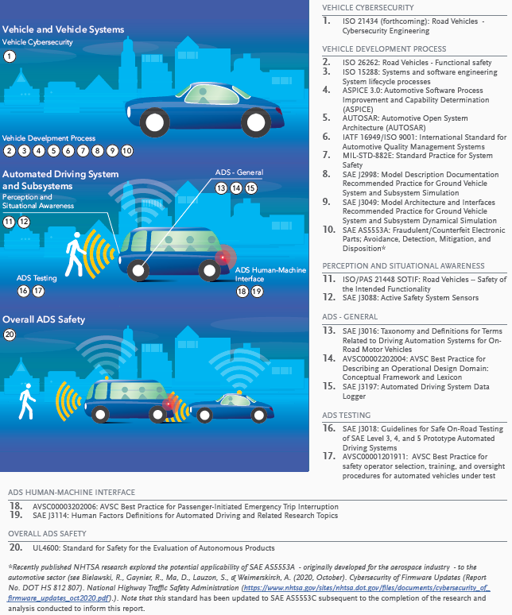
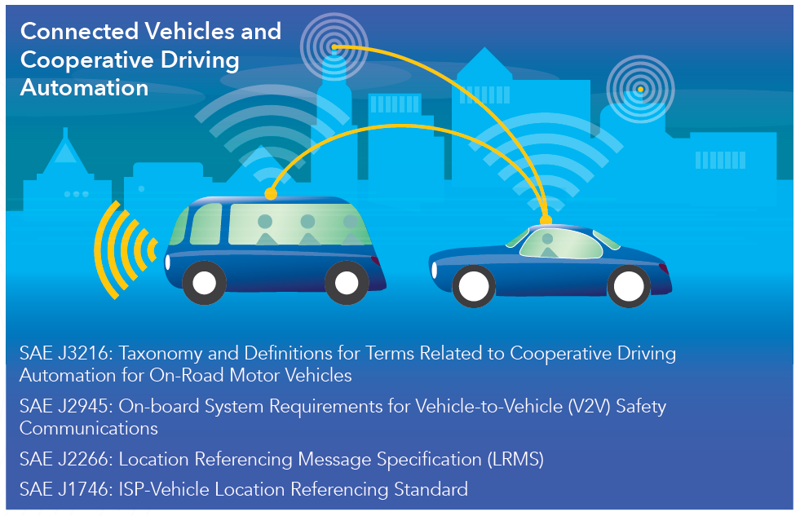
Voluntary Standards
15

Slide 16
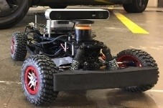
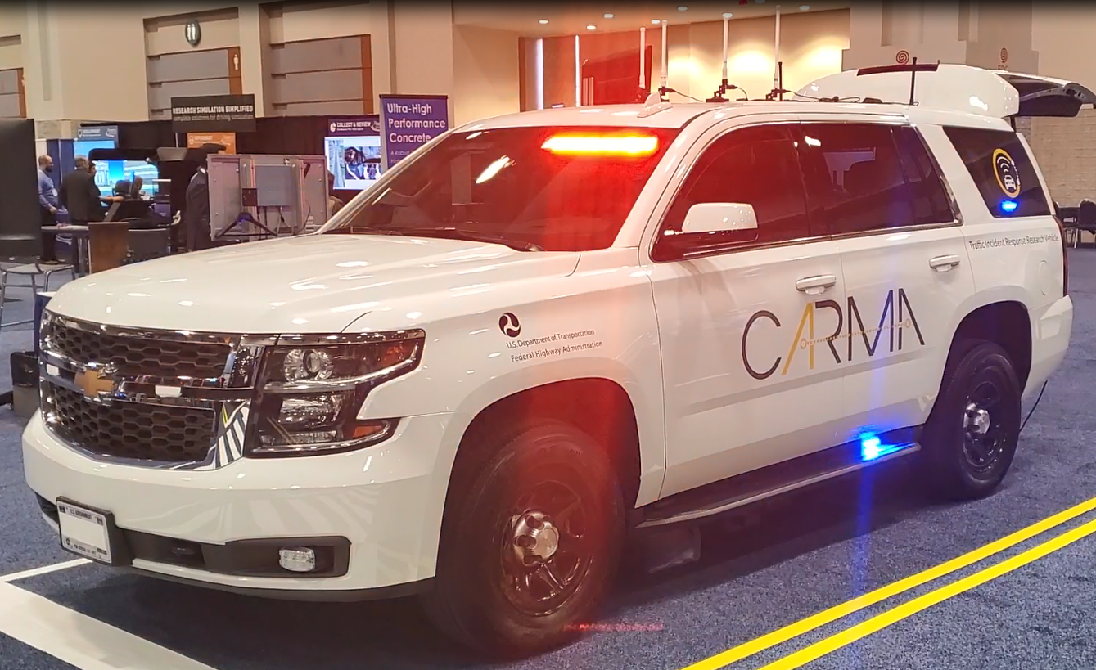
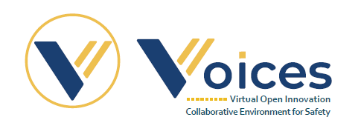
Key Research Activities
U.S. DOT is conducting research on enabling and complementary technologies that could support the integration of ADS into the transportation system.

Slide 17
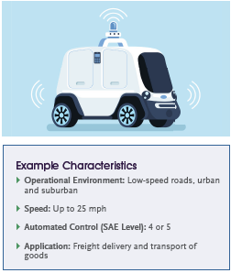
How do U.S. DOT actions support ADS development? – Occupant-less Low-Speed Vehicles
Example Characteristics
U.S. DOT activities addressing this use case:
Manufacturers that use vehicles that do not comply with the FMVSS must seek an exemption. In February 2020, NHTSA granted a request from Nuro for a temporary exemption from certain low-speed vehicle standard requirements, with terms and conditions in place to facilitate NHTSA’s oversight.
In the longer term, changes to the regulations themselves would further support deployment. NHTSA plans to consider this issue in the rulemaking on Removing Barriers to Automated Driving Systems, as well as a future ANPRM on Passenger-less Delivery Vehicles Equipped with Automated Driving Systems. These two rulemakings address the currently known unintended barriers at the Federal level to the commercialization of this use case.
The ITS JPO is sponsoring exploratory research on emerging automated freight delivery applications and technologies, including low-speed occupant-less delivery, to document current industry activity such as pilots and early deployments.

Slide 18
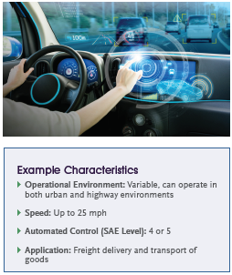
How do U.S. DOT actions support ADS development? – Passenger Vehicle Conditional Driving Automation
Example Characteristics
U.S. DOT activities addressing this use case:
NHTSA’s human factors research portfolio addresses topics related to this use case, ranging from supporting drivers’ understanding of ADS functionality to determining the best way to transition the driver to control of the vehicle. For example, in situations when ADS systems break down, and control needs to be handed over either to the driver or when the minimal risk condition must be automatically achieved.
Current work is aimed at determining the kinds of information drivers may need to regain control successfully and quickly, as well as approaches to presenting this information. Part of the take-over process will involve a vehicle warning or notification.
Another study is currently exploring the temporal components of the warning or notification to gain insights on how long it takes to build sufficient situational awareness to resume full manual driving safely, depending on different types and durations of disengagement.

Slide 19
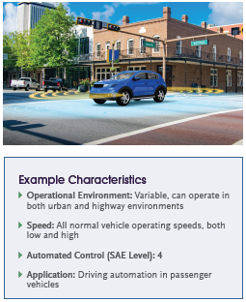
How do U.S. DOT actions support ADS development? – Passenger Vehicle Automated Driving Systems
Example Characteristics
U.S. DOT activities addressing this use case:
Manufacturers that use vehicles that do not comply with the FMVSS, such as those without manual driving controls, must seek an exemption. For example, in February 2020, NHTSA granted a request from Nuro for a temporary exemption from certain FMVSS, with terms and conditions in place to facilitate NHTSA’s oversight.
Changes to the regulations themselves would facilitate deployment without need of an exemption. NHTSA’s rulemakings to removing barriers to Automated Driving Systems would eliminate unnecessary and unintended obstacles, while maintaining levels of safety provided in existing standards.
Simultaneously, NHTSA is engaged in activities to establish a regulatory or subregulatory framework for ADS safety. This framework would objectively define, assess, and manage the safety of ADS performance while ensuring the needed flexibility to enable further innovation.

Slide 20
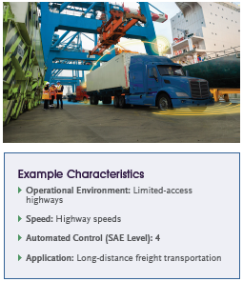
How do U.S. DOT actions support ADS development? – Automated Trucking Operations
Example Characteristics
U.S. DOT activities addressing this use case:
In AV 3.0, U.S. DOT clarified that FMCSA regulations will no longer assume that the CMV driver is always a human or that a human is necessarily present onboard a commercial vehicle during its operation.
In July 2019, FMCSA released an ANPRM seeking comment on questions regarding several key regulatory areas to understand better how changes to its rules can account for significant differences between human operators and ADS. These questions focus on topics such as: requirements of human drivers; CDL endorsements; hours of service rules; medical qualifications; distracted driving; safe driving, inspection, repair, and maintenance; roadside inspections; and cybersecurity. FMCSA is developing an NPRM that would propose rules to provide motor carriers with a uniform regulatory framework for deploying Levels 4 and 5 ADS-equipped CMVs in interstate commerce.
FMCSA plans to host a series of collaborative sessions with ADS-equipped CMV developers, truck manufacturers, motor carriers, industry associations, and other interested stakeholders to facilitate development of industry-based consensus standards for the operation of ADS-equipped CMVs.
U.S. DOT has awarded ADS Demonstration Grants to projects that include a significant focus on ADS-equipped CMVs.
FMCSA has initiated its ACE Program to conduct ADS Performance Research.
U.S. DOT is actively studying the potential impacts of ADS on the Nation’s long-haul trucking workforce.

Slide 21
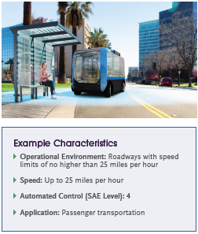
How do U.S. DOT actions support ADS development? – Low-Speed Passenger Shuttle
Example Characteristics
U.S. DOT activities addressing this use case:
FTA is exploring automation in bus transit through:
Funding for demonstration projects, such as the Integrated Mobility Innovation Demonstration and the Accelerating Innovative Mobility Programs
Analysis of the resulting data; and
Outreach to the transportation community to share what is being learned through ongoing knowledge transfer. Research topics include policy, human factors, benefit-cost, and others.
NHTSA’s NPRMs on Updating the Process for Temporary Exemptions and the Expansion of Temporary Exemption Program to Domestic Manufacturers for Research, Demonstrations, and Other Purposes are expected to streamline the exemption process and allow domestic startup companies the ability to seek approval to test or demonstrate these vehicles on public roads, which would be subject to the same safety scrutiny as currently exists for imported vehicles.

