Slide 1
What happens when PNT is denied, disrupted, or manipulated in a maritime environment
CAPT Michael Glander
Commanding Officer, U.S. Coast Guard Navigation Center
U.S. Department of Transportation
Notes:
Are these bullets associated with specific months?

Slide 2
GPS Problem Report
USCG
MARAD
Various Intelligence Offices
MOTR (GMCC)
Other PIRT and DOD Stakeholders
International Partners as appropriate
FAA
DOD
DHS
FCC
Resolution
Assistance
Warning / awareness
Catalogue, publish, and study
Notes:
Presently, the most significant intersection between the Coast Guard and PNT is NAVCEN, because GPS is the Nation’s primary PNT system, and NAVCEN has as seat at the table through its legacy DOT responsibilities.
NAVCEN provides the navigation information service for civil GPS users which involves a 24/7 watch, the NAVCEN CO co-chairs (with DOT) and provides staff support for the Civil GPS Service Interface Committee (CGSIC); NAVCEN’s NIS watch also receives all civil, non-aviation GPS outage reports and coordinates outage reports with USAF, DHS and the FAA National Operations Control Center (NOCC). Given the increasing reliance on GPS by critical infrastructure and commerce, the civil GPS information distributed through NAVCEN’s website, watch section and notification products has international significance.
Another area of involvement in PNT and GPS is the Coast Guard’s management and maintenance of the National Differential GPS utility. This augmentation to GPS provides integrity monitoring and a positional accuracy correction over MF to GPS users. The system was previously a jointly-funded venture with DOT and USACE, but today the Coast Guard continues to provide a DGPS signal only along major coastal waterways. The continued to improvements to GPS and the prospect of a maritime receiver standard incorporating WAAS allow precision navigation users to utilize alternative technologies. In the meantime, the system is still used by marine pilots, and NAV-1, NAVCEN, CYBER, and the C3CEN asset line are working to overcome resource challenges to ensure the service continues to meet service delivery targets.
NAV-1 also maintains an awareness of maritime PNT requirements and ensures these requirements are incorporated in the development of equipment standards (e.g. RTCM & IALA), waterways design (WAMs) and reflected in the Federal Radionavigation Plan. The aids to navigation system consists of approximately 33,000 buoys and beacons, and this system provides resilience to the marine transportation system in the event of a disruption to GPS. NAV-1 also acts as the legacy program manager for LORAN-C equipment that the Coast Guard maintains pursuant to the 2014 Howard Coble act. This currently includes supporting the DHS S&T –led Cooperative Research and Development Agreement with UrsaNav to explore precision timing signal delivery through eLORAN.
The Coast Guard also remains involved in supporting the whole-government effort to identify and implement a system to back up GPS. As mentioned earlier, the National EXCOM was established in 2004, and in 2014 the CPNT3 working group was established. In 2017, the DHS PNT Exec. Steering Committee was established to coordinate DHS PNT equities and consolidate input in support of the CPNT3 working group.
{NEXT SLIDE}

Slide 3
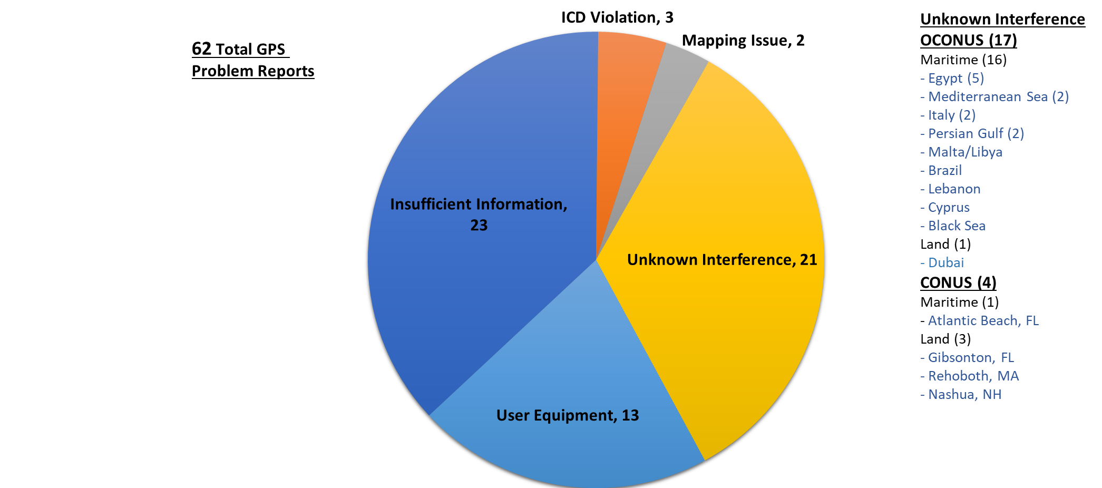
GPS Problem Reports Received by the
USCG Navigation Center in 2020
Notes:
Presently, the most significant intersection between the Coast Guard and PNT is NAVCEN, because GPS is the Nation’s primary PNT system, and NAVCEN has as seat at the table through its legacy DOT responsibilities.
NAVCEN provides the navigation information service for civil GPS users which involves a 24/7 watch, the NAVCEN CO co-chairs (with DOT) and provides staff support for the Civil GPS Service Interface Committee (CGSIC); NAVCEN’s NIS watch also receives all civil, non-aviation GPS outage reports and coordinates outage reports with USAF, DHS and the FAA National Operations Control Center (NOCC). Given the increasing reliance on GPS by critical infrastructure and commerce, the civil GPS information distributed through NAVCEN’s website, watch section and notification products has international significance.
Another area of involvement in PNT and GPS is the Coast Guard’s management and maintenance of the National Differential GPS utility. This augmentation to GPS provides integrity monitoring and a positional accuracy correction over MF to GPS users. The system was previously a jointly-funded venture with DOT and USACE, but today the Coast Guard continues to provide a DGPS signal only along major coastal waterways. The continued to improvements to GPS and the prospect of a maritime receiver standard incorporating WAAS allow precision navigation users to utilize alternative technologies. In the meantime, the system is still used by marine pilots, and NAV-1, NAVCEN, CYBER, and the C3CEN asset line are working to overcome resource challenges to ensure the service continues to meet service delivery targets.
NAV-1 also maintains an awareness of maritime PNT requirements and ensures these requirements are incorporated in the development of equipment standards (e.g. RTCM & IALA), waterways design (WAMs) and reflected in the Federal Radionavigation Plan. The aids to navigation system consists of approximately 33,000 buoys and beacons, and this system provides resilience to the marine transportation system in the event of a disruption to GPS. NAV-1 also acts as the legacy program manager for LORAN-C equipment that the Coast Guard maintains pursuant to the 2014 Howard Coble act. This currently includes supporting the DHS S&T –led Cooperative Research and Development Agreement with UrsaNav to explore precision timing signal delivery through eLORAN.
The Coast Guard also remains involved in supporting the whole-government effort to identify and implement a system to back up GPS. As mentioned earlier, the National EXCOM was established in 2004, and in 2014 the CPNT3 working group was established. In 2017, the DHS PNT Exec. Steering Committee was established to coordinate DHS PNT equities and consolidate input in support of the CPNT3 working group.
{NEXT SLIDE}

Slide 4
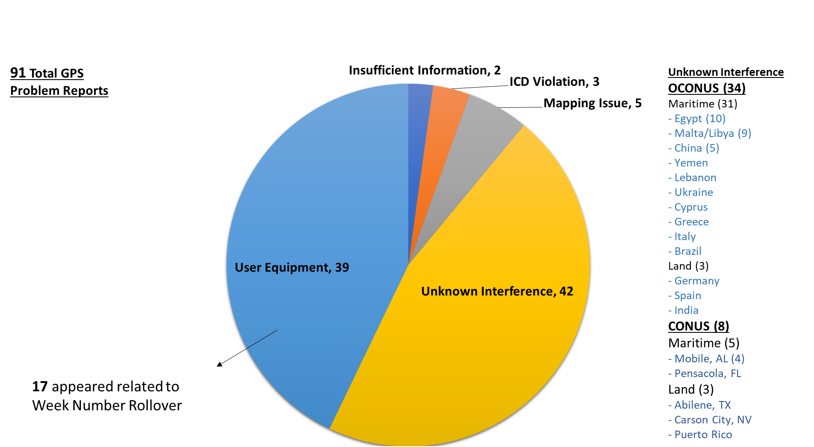
GPS Problem Reports Received by the
USCG Navigation Center in 2019
Notes:
Presently, the most significant intersection between the Coast Guard and PNT is NAVCEN, because GPS is the Nation’s primary PNT system, and NAVCEN has as seat at the table through its legacy DOT responsibilities.
NAVCEN provides the navigation information service for civil GPS users which involves a 24/7 watch, the NAVCEN CO co-chairs (with DOT) and provides staff support for the Civil GPS Service Interface Committee (CGSIC); NAVCEN’s NIS watch also receives all civil, non-aviation GPS outage reports and coordinates outage reports with USAF, DHS and the FAA National Operations Control Center (NOCC). Given the increasing reliance on GPS by critical infrastructure and commerce, the civil GPS information distributed through NAVCEN’s website, watch section and notification products has international significance.
Another area of involvement in PNT and GPS is the Coast Guard’s management and maintenance of the National Differential GPS utility. This augmentation to GPS provides integrity monitoring and a positional accuracy correction over MF to GPS users. The system was previously a jointly-funded venture with DOT and USACE, but today the Coast Guard continues to provide a DGPS signal only along major coastal waterways. The continued to improvements to GPS and the prospect of a maritime receiver standard incorporating WAAS allow precision navigation users to utilize alternative technologies. In the meantime, the system is still used by marine pilots, and NAV-1, NAVCEN, CYBER, and the C3CEN asset line are working to overcome resource challenges to ensure the service continues to meet service delivery targets.
NAV-1 also maintains an awareness of maritime PNT requirements and ensures these requirements are incorporated in the development of equipment standards (e.g. RTCM & IALA), waterways design (WAMs) and reflected in the Federal Radionavigation Plan. The aids to navigation system consists of approximately 33,000 buoys and beacons, and this system provides resilience to the marine transportation system in the event of a disruption to GPS. NAV-1 also acts as the legacy program manager for LORAN-C equipment that the Coast Guard maintains pursuant to the 2014 Howard Coble act. This currently includes supporting the DHS S&T –led Cooperative Research and Development Agreement with UrsaNav to explore precision timing signal delivery through eLORAN.
The Coast Guard also remains involved in supporting the whole-government effort to identify and implement a system to back up GPS. As mentioned earlier, the National EXCOM was established in 2004, and in 2014 the CPNT3 working group was established. In 2017, the DHS PNT Exec. Steering Committee was established to coordinate DHS PNT equities and consolidate input in support of the CPNT3 working group.
{NEXT SLIDE}

