Slide 1
PNT Capability Gaps
Jamming &
Spoofing
High Accuracy
With Integrity
Urban
Canyon
Image: US DOT
Timely Notification of
Inaccurate and/or
Out-of-Date Maps
Misleading Information
Other Images: ThinkStock

Slide 2
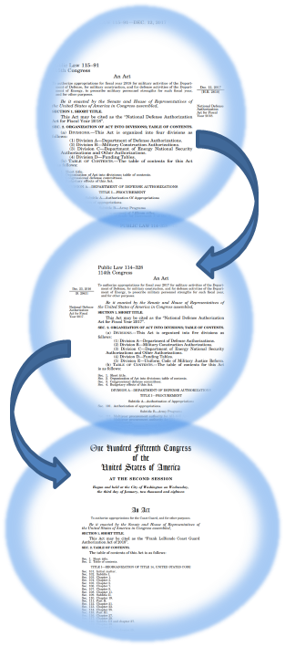
Approach to GPS Backup/Complementary PNT
Sequential Legislation on GPS Backup/Complementary PNT Service
Needs Established for PNT: FY17 NDAA
Demonstrate PNT Technologies: FY18 NDAA
Procure Alternative [to GPS] Timing System: National Timing Resilience and Security Act of 2018
FY17 & FY18 NDAA joint responsibility for DOT/DOD/DHS
Joint DOT/DOD/DHS Congressional briefing on NDAA coordination (Nov 2018)
DOT/OST-R/Volpe Center funded for demonstration (Dec 2018)
National Timing Resilience and Security Act Assigns Procurement to DOT

Slide 3
DOT Solicitation for Technology Vendors
On September 13th, the Department announced the opportunity for vendors to participate in the demonstration.
- The opportunity was published in FedBizOps and on the DOT Procurement Forecast Site.
The Solution must provide either timing information, position information, or both.
The Solution must be capable of operating independently of GPS/Global Navigation Satellite System (GNSS).
Specifically, the Solutions must operate in absence of GPS/GNSS broadcast signals and provide more than just interference mitigation of GPS/GNSS broadcast signals or provide resiliency to those specific signals.
Technology demonstration to be conducted in March 2020

Slide 4
GPS Backup Demonstration Participants & Technologies
SOoP (Globalstar)
(Positioning &Timing)
&
SOoP (Modified NDGPS)
(Positioning &Timing)
eLORAN
(Positioning &Timing)
White Rabbit (WR-PTP)
(Timing Only)
Terrestrial Beacons
(Positioning &Timing)
WPS Positioning
(Positioning Only)
White Rabbit (WR-PTP)
IMU Based
(Timing Only)
(Positioning Only)
PNT Mesh Networks
eLORAN
(Positioning &Timing)
(Positioning &Timing)
STL (Iridium)
(Positioning &Timing)
U.S. GOVERNMENT/VENDOR INTERFACE & COORDINATION

Slide 5
National PNT Architecture Recommendations to Address PNT Capability Gaps
Vision
US Leadership in Global PNT
Strategy
The US can Best Achieve Efficiency and Effectiveness through a
Greater Common Denominator Approach
Vectors
1
Multiple Phenomenologies
2
Interchangeable Solutions
3
Synergy of PNT & Communications
4
Cooperative Organizational Structures
1
GPS – An Architecture Cornerstone
6
Integrated User Equipment
12
Interchangeability with Foreign PNT Sources
16
Synergy of PNT & Communications
17
National PNT Coordination Process
2
PNT Signal Monitoring & Dissemination
7
Civil Use of Foreign PNT
13
Standards & Reference Frames
18
Phenomenology & Application Champions
Recommendations
3
Augmentation Transition Opportunities
8
US Military Use of Non-Military Signals
14
Info Exchange, Assurance & Protection
19
Modeling & Simulation Framework
4
High Accuracy with Integrity
9
PNT Pseudolites & Beacons
15
Grids & Coordinate Systems
5
Protect Strategic Advantage
10
Evolution of PNT Capabilities
11
Critical Infrastructure & Time

