Slide 1
The U.S. Department Of Transportation
Preserving the 5.9GHz Safety Band For Transportation
Intelligent Transportation Systems Joint Program Office

Slide 2
To Be Discussed Today:
Vehicle-to-Everything (V2X) technology is direct, device-to-device wireless messaging between vehicles, infrastructure and mobile devices—and uses 75 MHz of spectrum located at 5.9 GHz (termed the Safety Band) to support safety communications.
V2X technology enables game-changing advancements in transportation safety, system efficiency, and mobility.
The Safety Band is being utilized today—with substantial V2X deployments in 25 States—totaling over $1.5 billion in taxpayer funded investments—and more deployments are in the planning stage.
The proposed FCC NPRM reduces capacity in the Safety Band by 60%—which would limit the full potential of V2X technology to support innovative advancements in safety, system efficiency, and mobility.

Slide 3
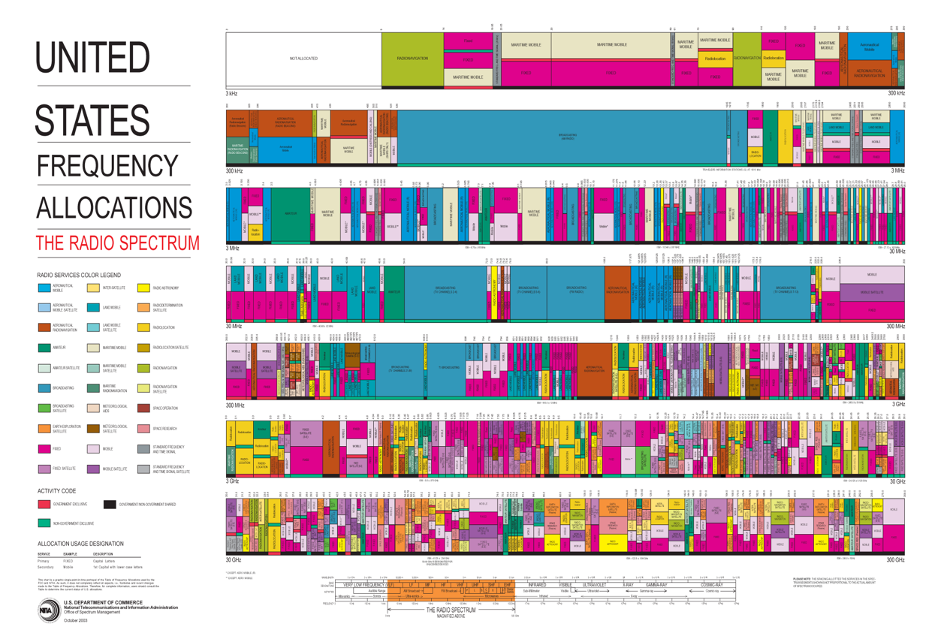
The Safety Band is 75 MHz of spectrum that supports “vehicle-to-everything” (V2X) wireless communications
Low Frequency
3 kHz
300 kHz
3 MHz
The “Safety Band” is a 75MHz slice of spectrum located at 5.9 GHz
30 MHz
300
MHz
High Frequency
3GHz
30 GHz

Slide 4
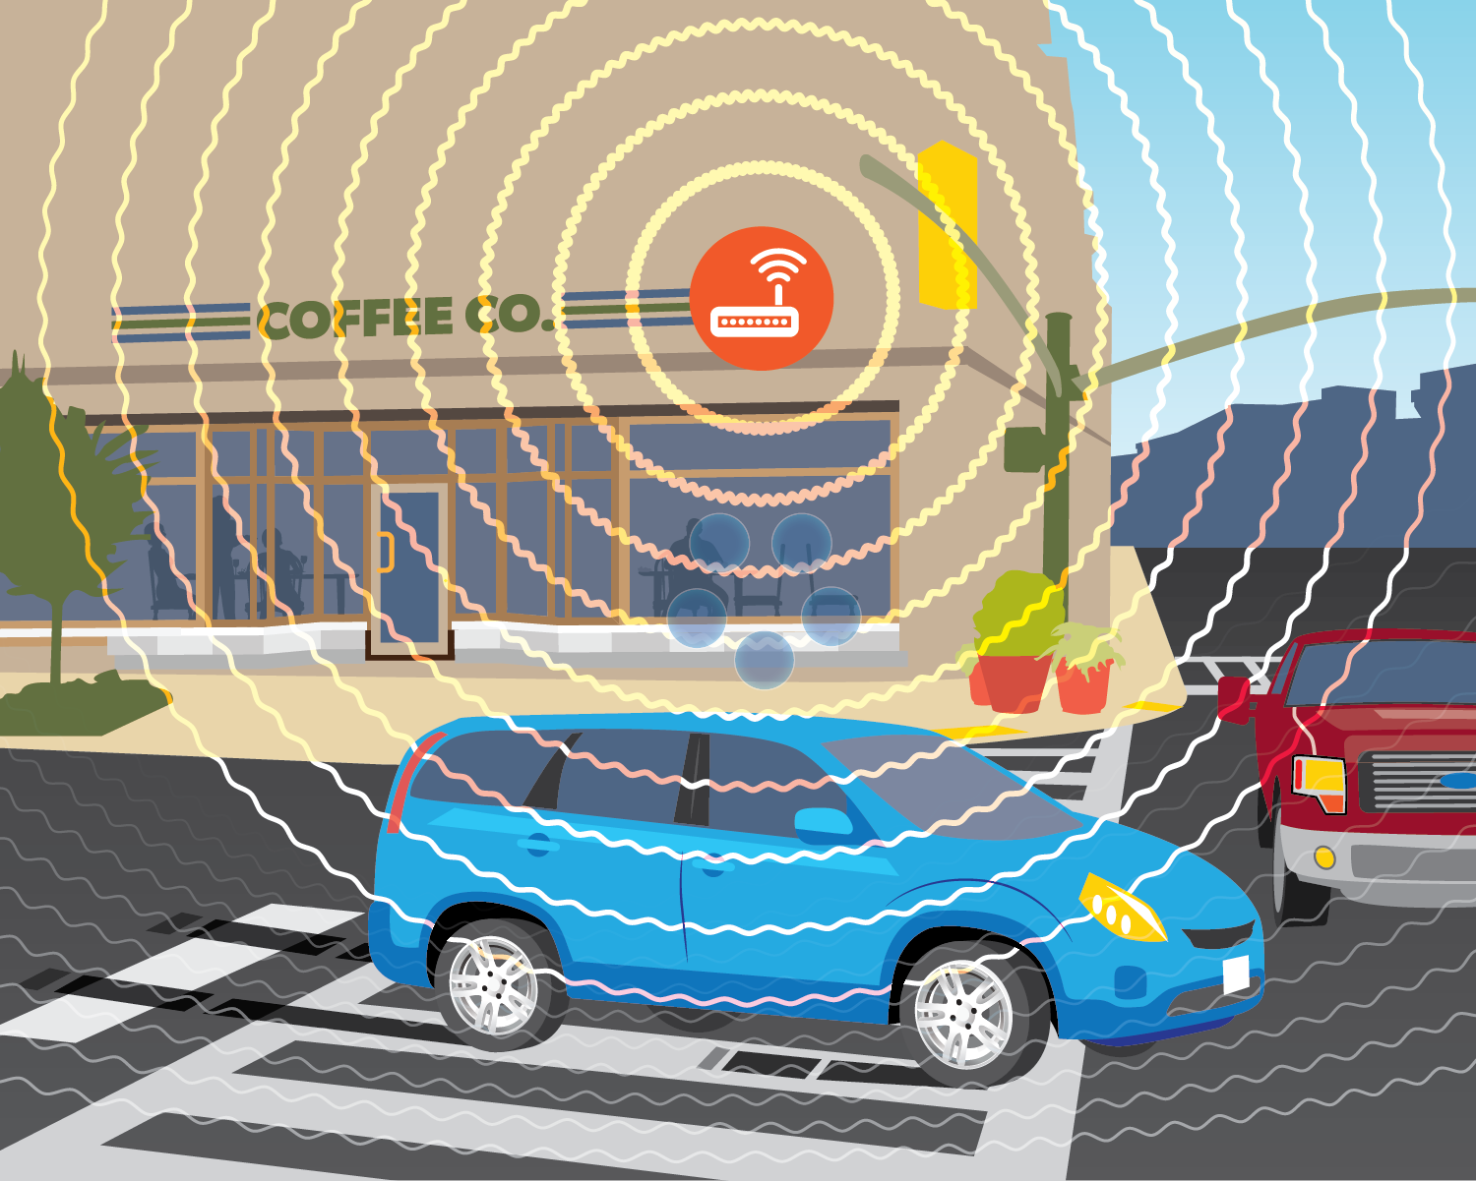
History of 5.9 GHz Safety Band
In 1999, the Federal Communications Commission (FCC) allocated the section of wireless spectrum at 5.850-5.925 GHz for intelligent transportation systems (ITS) services.
Since then, U.S. DOT has worked with industry and the public sector to develop, evaluate, and deploy new cooperative technologies, equipment, and applications known as connected vehicle technologies, on this dedicated band. The technologies now reliant on the Safety Band include vehicle-to-vehicle (V2V), vehicle-to-infrastructure (V2I), and vehicle-to-everything (V2X) communications.

Slide 5
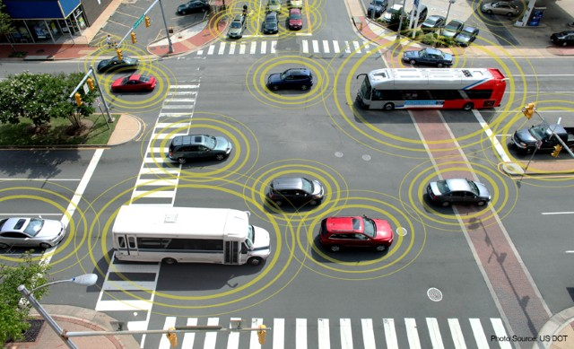
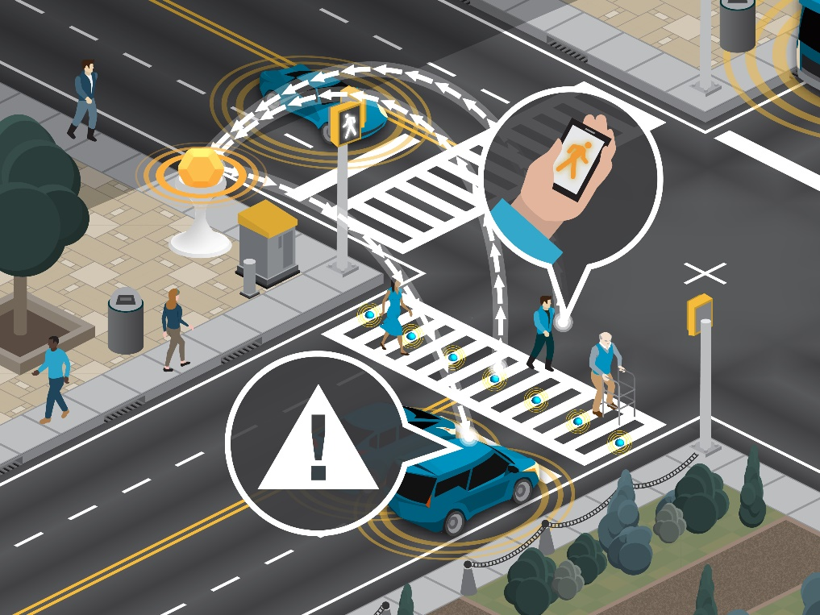
But what is V2X ?
Direct communications between devices (no cell tower needed)
Vehicles can communicate directly
with each other (vehicle-to-vehicle, V2V)
with roadside infrastructure— (vehicle-to-infrastructure, V2I)
and with portable devices such as those used by pedestrians (vehicle-to-pedestrian, V2P).

Slide 6
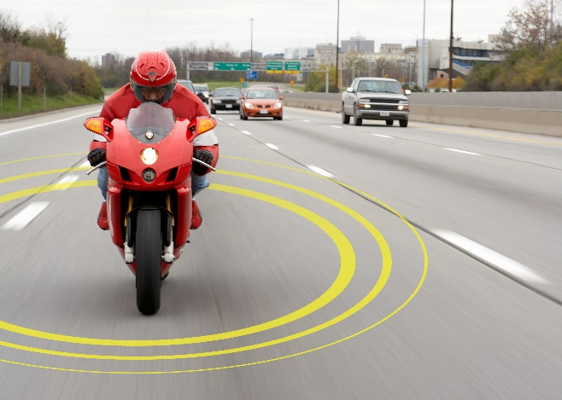
Such direct communications offers opportunities for game-changing enhancements in vehicle safety and mobility. Examples:
V2V: Messages are broadcast from each vehicle at a rapid rate (10 times per second!) and receiving vehicles use the information to predict potential collisions and warn the driver to take action.
V2I: At the roadside, such technology can be used to wirelessly notify drivers/vehicles of traffic signal information; work zone locations; lane closures; and other roadway anomalies to both enhance safety and reduce congestion.

Slide 7
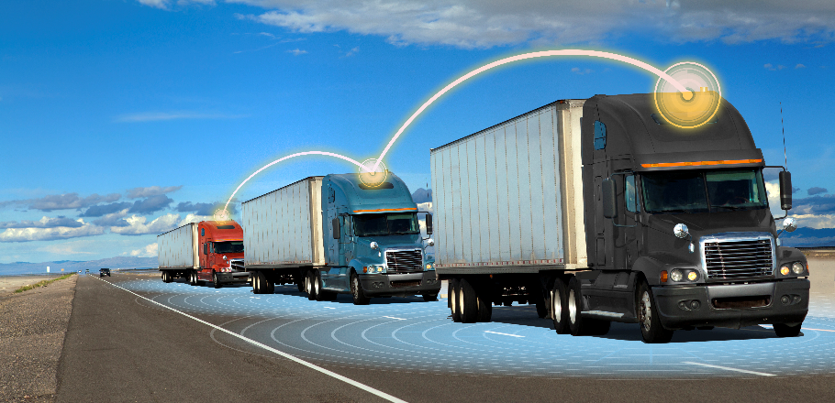
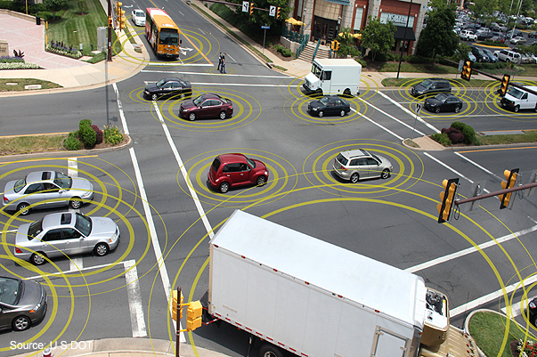
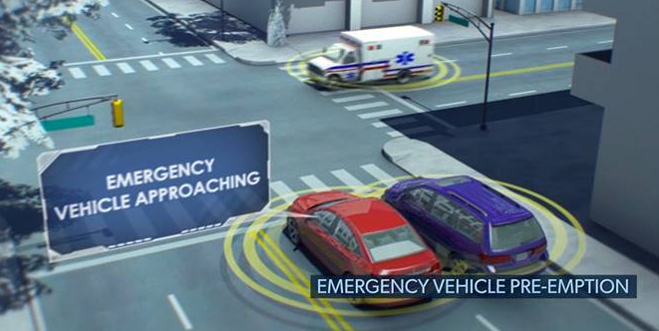
And in the near future, vehicles with automated driving systems (ADS) may also leverage V2X. Examples:
Commercial Vehicle Platooning
Coordinated Intersection Movement Assist
Notify ADS vehicles of approaching police and emergency vehicles
Send wireless notifications of traffic signal and other roadside messages to enhance situational awareness for automated vehicles
And other new and innovative features and applications

Slide 8
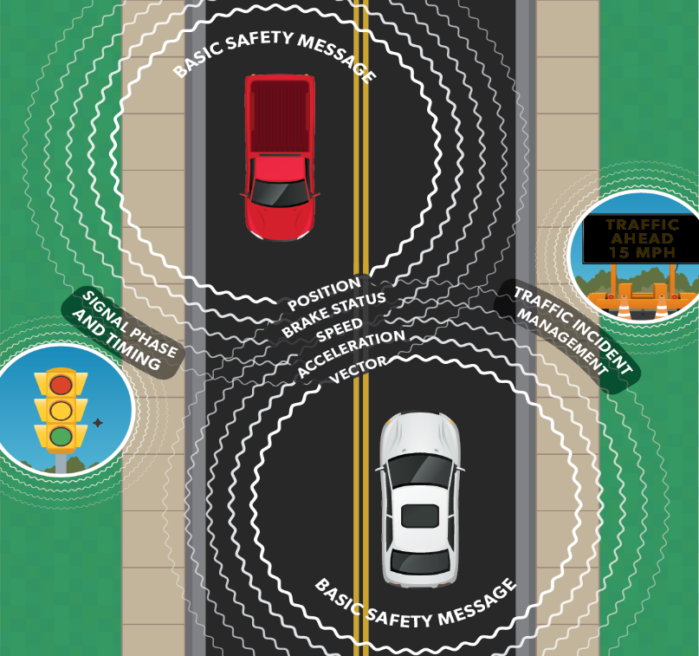
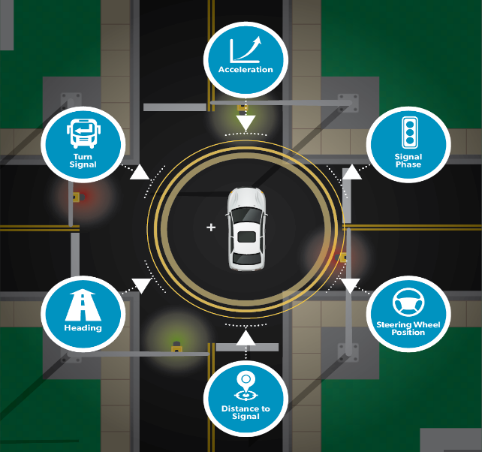
The Safety Band is in use today
Vehicle Detected
5.850 GHz |  |  |  |  |  | 5.925 GHz
 |  |  |  |  |  | CH 183
 |  | CH 175 |  |  | CH 181
5850-5855 reserve 5 MHz | CH 172 Service 10 MHz | CH 174 Service 10 MHz | CH 176 Service 10 MHz | CH 178 Service 10 MHz | CH 180 Service 10 MHz | CH 182 Service 10 MHz | CH 184 Service 10 MHz
V2V/V2I BSMs
SCMS
Red Light Viol
WAVE
SCMS
Red Light Viol
Public Safety
SPaT/MAP
SPaT/MAP
Curve Speed
RSA
Personal Safety
Curve Speed
Signal Preemption
HMI
Platooning
V2 Pedestrian
BSMs
OTA Updates
V2 Pedestrian
Signal Request
AVs
Probe
Signal Request
Probe

Slide 10
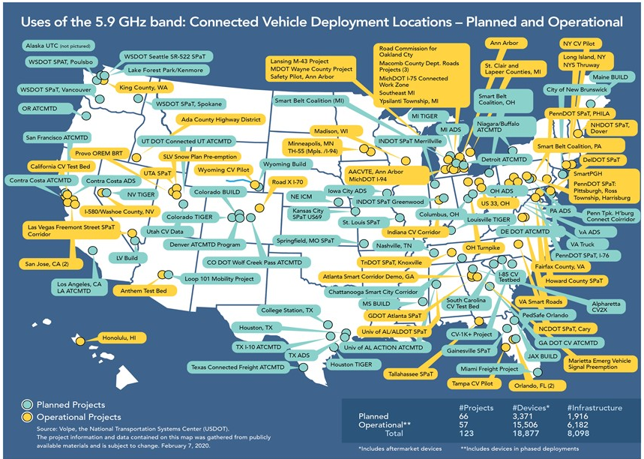
V2X is being deployed by State and local governments throughout the United States
There are currently 123 planned or operational connected vehicle deployment locations in the U.S., all of which use the Safety Band.
More than 18,000 vehicles are deployed with aftermarket V2X communications devices.
Over 6,000 infrastructure V2X devices have been installed at the roadside in 25 states.

Slide 11
Questions?
https://www.transportation.gov/content/safety-band

