Slide 2
Preparing a Benefit-Cost Analysis for INFRA Grants
Office of the Assistant Secretary for Transportation Policy

Slide 3
What is BCA?
Benefit-cost analysis (BCA) is a systematic process for identifying, quantifying, and comparing expected economic benefits and costs of a proposed infrastructure project.

Slide 4
Why do we do BCA?
Provides a useful benchmark from which to evaluate and compare potential transportation investments
Adds a degree of rigor to the project evaluation process

Slide 5
BCA and INFRA
All project sponsors should submit a benefit-cost analysis (BCA) as part of their INFRA grant application
Use of the BCA in INFRA
Evaluation of the Economic Vitality selection criterion
Assignment of a Freight Benefits rating
Assessment of project cost-effectiveness

Slide 6
USDOT BCA Review
USDOT economists will review the applicant’s BCA
Examine key assumptions
Correct for any technical errors
Perform sensitivity analysis on key inputs
Consider any unquantified benefits

Slide 7
Economic Vitality
USDOT considers the relative magnitude of estimated project benefits and costs
Assign projects to one of four benefit-cost ratio ranges
BCR > 3.0
BCR 1.5 - 3.0
BCR 1.0 - 1.5
BCR < 1.0
Also assign a confidence rating to the assessment (high, medium, low)

Slide 8
Freight Rating
USDOT considers the significance of freight benefits for a project
Assign one of three ratings, based on the share of total quantifiable benefits that are attributable to impacts on freight movement
Substantial freight benefits: ≥ 20%
Moderate freight benefits: 5-20%
Incidental freight benefits: < 5%

Slide 9
INFRA Cost Effectiveness Requirements
Large Projects
USDOT must determine that the project will be cost effective in order for it to be selected
Small Projects
USDOT must consider project cost-effectiveness in making selections
Cost-effectiveness determinations based on results of the BCA
Projects must be found to have estimated benefits that are reasonably likely to exceed costs in order to be considered cost effective

Slide 10
USDOT BCA Guidance
Covers all USDOT discretionary grant programs
Updated February 2021
Available at https://www.transportation.gov/office-policy/transportation-policy/benefit-cost-analysis-guidance

Slide 11
What’s New?
Updated monetization values
Additional guidance on valuing reductions in emissions (including CO₂)
Additional guidance on benefits from agglomeration economies and state of good repair projects

Slide 12
Transparent & Reproducible Analysis
BCAs should provide enough information for a reviewer to follow the logic and reproduce the results
Spreadsheet or database files showing the calculations
Technical memos describing the analysis and documenting sources of information used (assumptions and inputs)
Present annual benefit & cost streams by type (not just summary output)

Slide 13
Baselines
Should measure costs and benefits of a proposed project against a baseline alternative (“base” or “no build”)
“Do’s”
Factor in any projected changes (e.g., increased traffic volumes) that would occur even in the absence of the requested project
Factor in ongoing routine maintenance
Consider full long-term impacts of no build (e.g. bridge closure/posting)
Explain and provide support for the chosen baseline
“Don’t’s”
Assume that the same (or similar) improvement will be implemented later
Use unrealistic assumptions about alternative traffic flows

Slide 14
Demand Forecasts
Most benefit estimates depend on ridership or usage estimates
Provide supporting info on forecasts
Geographic scope, assumptions, data sources, methodology
Provide forecasts for intermediate years
Or at least interpolate—don’t apply forecast year impacts to interim years
Exercise caution about long-term growth assumptions
Consider underlying capacity limits of the facility

Slide 15
Analysis Period
Should cover both initial development and construction and a subsequent operational period
Generally tied to the expected service life of the improvement or asset
I.e., the number of years until you would anticipate having to take the same action again
Lesser improvements should have shorter service lives
Avoid excessively long analysis periods (over 30 years of operations)
Use residual value to cover out-years of remaining service life for long-lived assets
Recommend 20 years maximum for capacity expansion

Slide 16
Inflation and Discounting
Inflation Adjustments
Recommend using a 2019 base year for all cost and benefit data
Index values for the GDP Deflator included in the BCA guidance
Discounting
Use a 7% discount rate for all benefits and costs (except CO₂)

Slide 17
Scope of the Analysis
Project scope included in estimated costs and benefits must match
Don’t claim benefits from an entire project, but only count costs from the grant-funded portion
Scope should cover a project that has independent utility
May need to incorporate costs for related investments necessary to achieve the projected benefits
Project elements with independent utility should be individually evaluated in the BCA
BCA evaluation will cover both independent elements and the submitted project as a whole

Slide 18
Benefits
Should be presented on an annual basis
Don’t assume constant annual benefits without a good reason to do so
Negative outcomes should be counted as “disbenefits”
E.g., work zone impacts
Avoid double-counting benefits

Slide 19
Travel Time Savings
Recommended values found in BCA Guidance
See footnotes for discussion of non-vehicle time, long-distance travel, business travel
Consider vehicle occupancy where appropriate
Local/facility-specific values preferred
National-level values provided in BCA Guidance
If valuing travel time reliability:
Carefully document methodology and tools used
Show how valuation parameters are distinct from general travel time savings

Slide 20
Operating Cost Savings
Avoid double counting operating savings and other impacts
E.g., truck travel time savings, fuel consumption reductions
Localized, specific data preferred
Standard per-mile values for light duty vehicles and commercial trucks provided in DOT BCA Guidance

Slide 21
Safety Benefits
Typically associated with reducing fatalities, injuries, and property damage
Projected improvements in safety outcomes should be explained and documented
Justify assumptions about expected reductions in crashes, injuries, and/or fatalities (and document any CMF used)
Show clear linkage between project and improved outcomes
Use facility-specific data history for baseline where possible
Crash-related injury and fatality data may be available in different forms
MAIS/KABCO injury scales
Fatal/Injury crashes vs. fatalities/injuries
BCA Guidance provides values covering all of these

Slide 22
Emissions Reduction Benefits
For infrastructure improvements, emissions reductions will typically be a function of reduced fuel consumption
Recommended year by year unit values for CO₂, SO₂, NO_{x}, and PM_{2.5} found in BCA guidance
Be careful about the measurement units being applied
Reductions in CO₂ emissions should be discounted at 3 percent, while all others should be discounted at 7 percent

Slide 23
Benefits to Existing and Additional Users
Primary benefits typically experienced directly by users of the improved facility
Includes both “existing” users (under baseline) and “additional” users attracted to the facility as a result of the improvement
Standard practice in BCA would value benefits to additional users less than those for existing users (see BCA guidance)

Slide 24
Modal Diversion
Projected magnitude
Should be based on careful analysis of the market and potential for diversion from other modes that might be attributable to the project
Benefits estimates should not be based on comparing user costs of “old” and “new” mode
Would be reflected in benefits to additional users
Reductions in external costs would be relevant
E.g., emissions costs, pavement damage
If using 1997 HCAS values…
Don’t apply urban values to rural truck travel
Should net out highway user fees paid by trucks from marginal pavement damage costs

Slide 25
Other Benefits
Agglomeration Economies
State of Good Repair
Resilience
Consider expected frequency of events and their consequences
Noise Reduction
Emergency Response
FEMA methodology for fire and ambulance services
Quality of Life
Property Value Increases
Is a measure rather than a benefit—avoid double-counting

Slide 26
Unquantified Benefits
Should quantify magnitudes/timing of the impacts wherever possible
Should clearly link specific project outcomes to any claimed unquantified benefits

Slide 27
Capital Costs
Include all costs of implementing the project
E.g., design, ROW acquisition, construction
Regardless of funding source
Include previously incurred costs
Three forms of capital costs
Nominal dollars (project budget)
Real dollars (base year)
Discounted Real dollars (use in BCA)

Slide 28
Maintenance Costs
Net maintenance costs may be positive or negative
New facilities would incur ongoing maintenance costs over the life of the project
Rehabilitated/reconstructed facilities may result in net savings in maintenance costs between the build/no-build

Slide 29
Residual Value
For assets with remaining service life at the end of the analysis period, may calculate a “residual value” for the project
Simple approach: assume linear depreciation
Be sure to properly apply discounting

Slide 30
Comparing Benefits to Costs
Net Present Value (Benefits – Costs)
Benefit-Cost Ratio (Benefits / Costs)
Denominator should only include capital costs (i.e., net maintenance costs and residual value should be in the numerator)

Slide 31
Other Types of Economic Analysis
Examples
Economic Impact Analysis
Financial Impacts
Distributional Effects
Issues
Use different approaches and answer different questions than does BCA
Do not represent additional benefits to include in BCA

Slide 32
INFRA Grants
For additional INFRA information and how to apply: www.transportation.gov/buildamerica/INFRAgrants
For technical questions, please email: INFRAgrants@dot.gov.

Slide 33
Questions?

Slide 34
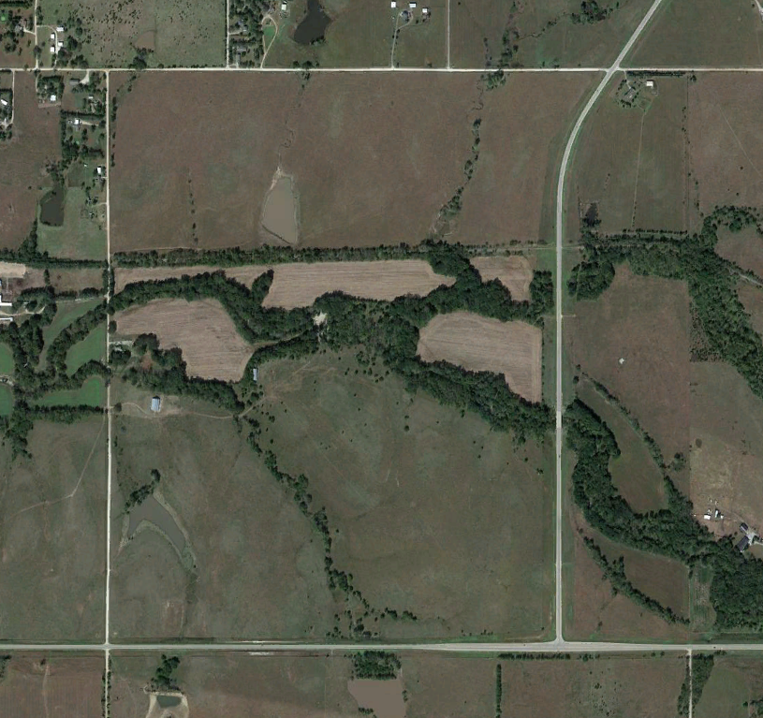
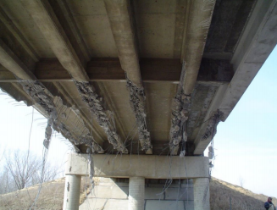
Hypothetical BCA Example
Proposed Project: Replace a deteriorating bridge.
Project Cost: $2.5 million
2020
AADT: 1,000 Cars per Day (Source: Traffic Count)
Avg. Speed: 45 mph (State DOT database)

Slide 35
Hypothetical BCA Example
No-Build Scenario: Bridge closes in 2025 and traffic is detoured
(2.6-mile route).

Slide 36
Hypothetical BCA Example
Build Scenario: Bridge Remains open to traffic
(1.0-mile route).
No-Build Scenario: Bridge closes in 2025 and traffic is detoured
(2.6-mile route).

Slide 37
Hypothetical BCA Example
Build Scenario: Bridge Remains open to traffic
(1.0-mile route).
No-Build Scenario: Bridge closes in 2025 and traffic is detoured
(2.6-mile route).
No-Build Scenario detour is 1.6 miles longer than Build Scenario route.

Slide 38
Approach
We want to compare the state of the world with and without the proposed project improvement.
No-Build Scenario: Bridge closes in 2025, traffic detours 2.6 miles.
Build Scenario: Bridge remains open, existing route is 1.0 miles.
The expected major benefit categories in this case would be vehicle operating cost savings and travel time savings for mitigating 1.6-miles of additional travel, starting in 2025.

Slide 39
Vehicle Operating Cost Savings
For simplicity, let’s assume no heavy trucks and no traffic growth.
Annual Vehicle Operating Cost Savings*
Vehicle Operating Cost Per Mile
Incremental Detour
Annualization Factor
=
x
AADT
x
x
*Undiscounted.

Slide 40
Vehicle Operating Cost Savings
For simplicity, let’s assume no heavy trucks and no traffic growth.
Annual Vehicle Operating Cost Savings*
Vehicle Operating Cost Per Mile
Incremental Detour
Annualization Factor
=
x
AADT
x
x
Annual Vehicle Operating Cost Savings*
=
*Undiscounted.

Slide 41
Vehicle Operating Cost Savings
For simplicity, let’s assume no heavy trucks and no traffic growth.
Annual Vehicle Operating Cost Savings*
Vehicle Operating Cost Per Mile
Incremental Detour
Annualization Factor
=
x
AADT
x
x
Annual Vehicle Operating Cost Savings*
=
1.6 Miles
No-Build Scenario route: 2.6 miles
Build Scenario route: 1.0 miles
*Undiscounted.

Slide 42
Vehicle Operating Cost Savings
For simplicity, let’s assume no heavy trucks and no traffic growth.
Annual Vehicle Operating Cost Savings*
Vehicle Operating Cost Per Mile
Incremental Detour
Annualization Factor
=
x
AADT
x
x
Annual Vehicle Operating Cost Savings*
=
1.6 Miles
x
1,000
Recent traffic count
*Undiscounted.

Slide 43
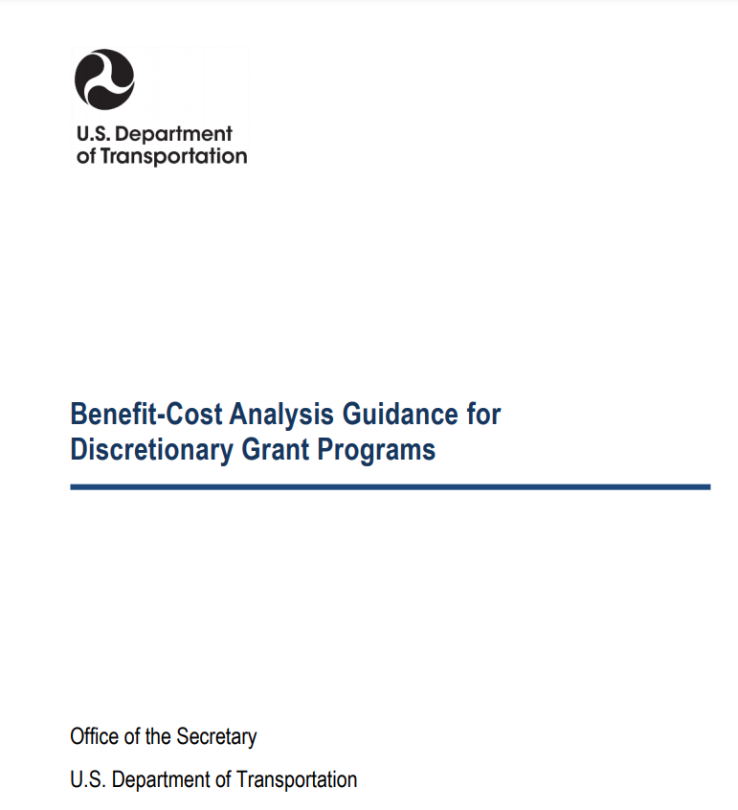
Vehicle Operating Cost Savings
For simplicity, let’s assume no heavy trucks and no traffic growth.
Annual Vehicle Operating Cost Savings*
Vehicle Operating Cost Per Mile
Incremental Detour
Annualization Factor
=
x
AADT
x
x
Annual Vehicle Operating Cost Savings*
=
1.6 Miles
x
1,000
x
$0.43
USDOT BCA Guidance
(Appendix A)
*Undiscounted.

Slide 44
Vehicle Operating Cost Savings
For simplicity, let’s assume no heavy trucks and no traffic growth.
Annual Vehicle Operating Cost Savings*
Vehicle Operating Cost Per Mile
Incremental Detour
Annualization Factor
=
x
AADT
x
x
Annual Vehicle Operating Cost Savings*
=
1.6 Miles
x
1,000
x
$0.43
x
365
We expect this project to have an impact each day (not just weekdays, for example).
*Undiscounted.

Slide 45
Vehicle Operating Cost Savings
For simplicity, let’s assume no heavy trucks and no traffic growth.
Annual Vehicle Operating Cost Savings*
Vehicle Operating Cost Per Mile
Incremental Detour
Annualization Factor
=
x
AADT
x
x
Annual Vehicle Operating Cost Savings*
=
1.6 Miles
x
1,000
x
$0.43
x
365
=
$251,120 Per Year
*Undiscounted.

Slide 46
Travel Time Savings
For simplicity, let’s assume no heavy trucks, an average speed of 45 mph, and no traffic growth.
Annual Vehicle Travel Time Savings*
Marginal Detour Time
Hourly Value of Time
Vehicle Occupancy
Annualization Factor
=
x
AADT
x
x
x
*Undiscounted.

Slide 47
Travel Time Savings
For simplicity, let’s assume no heavy trucks, an average speed of 45 mph, and no traffic growth.
Annual Vehicle Travel Time Savings*
Marginal Detour Time
Hourly Value of Time
Vehicle Occupancy
Annualization Factor
=
x
AADT
x
x
x
Annual Vehicle Travel Time Savings*
=
1.6 Miles
45 mph
No-Build Scenario route: 2.6 miles
Build Scenario route: 1.0 miles
Speed: Observed average speed on both routes
*Undiscounted.

Slide 48
Travel Time Savings
For simplicity, let’s assume no heavy trucks, an average speed of 45 mph, and no traffic growth.
Annual Vehicle Travel Time Savings*
Marginal Detour Time
Hourly Value of Time
Vehicle Occupancy
Annualization Factor
=
x
AADT
x
x
x
Annual Vehicle Travel Time Savings*
=
1.6 Miles
45 mph
x
1,000
x
Recent traffic count
*Undiscounted.

Slide 49
Travel Time Savings
For simplicity, let’s assume no heavy trucks, an average speed of 45 mph, and no traffic growth.
Annual Vehicle Travel Time Savings*
Marginal Detour Time
Hourly Value of Time
Vehicle Occupancy
Annualization Factor
=
x
AADT
x
x
x
Annual Vehicle Travel Time Savings*
=
1.6 Miles
45 mph
x
1,000
x
$17.90
USDOT BCA Guidance
(Appendix A)
*Undiscounted.

Slide 50
Travel Time Savings
For simplicity, let’s assume no heavy trucks, an average speed of 45 mph, and no traffic growth.
Annual Vehicle Travel Time Savings*
Marginal Detour Time
Hourly Value of Time
Vehicle Occupancy
Annualization Factor
=
x
AADT
x
x
x
Annual Vehicle Travel Time Savings*
=
1.6 Miles
45 mph
x
1,000
x
$17.90
x
1.67
USDOT BCA Guidance
(Appendix A)
*Undiscounted.

Slide 51
Travel Time Savings
For simplicity, let’s assume no heavy trucks, an average speed of 45 mph, and no traffic growth.
Annual Vehicle Travel Time Savings*
Marginal Detour Time
Hourly Value of Time
Vehicle Occupancy
Annualization Factor
=
x
AADT
x
x
x
Annual Vehicle Travel Time Savings*
=
1.6 Miles
45 mph
x
1,000
x
$17.90
x
1.67
x
365
We expect this project to have an impact each day (not just weekdays, for example).
*Undiscounted.

Slide 52
Travel Time Savings
For simplicity, let’s assume no heavy trucks, an average speed of 45 mph, and no traffic growth.
Annual Vehicle Travel Time Savings*
Marginal Detour Time
Hourly Value of Time
Vehicle Occupancy
Annualization Factor
=
x
AADT
x
x
x
Annual Vehicle Travel Time Savings*
=
1.6 Miles
45 mph
x
1,000
x
$17.90
x
1.67
x
365
=
$387,945 Per Year
*Undiscounted.

Slide 53
Hypothetical BCA Example
Assume construction in 2022, ten years of project operations, and no difference in bridge maintenance costs between the scenarios.
Year | Capital Cost |  | Vehicle Operating Cost Savings | Vehicle Travel Time Savings
2022 | $2,500,000 |  | $0 | $0
2023 | $0 |  | $0 | $0
2024 | $0 |  | $0 | $0
2025 | $0 |  | $251,120 | $387,945
2026 | $0 |  | $251,120 | $387,945
2027 | $0 |  | $251,120 | $387,945
2028 | $0 |  | $251,120 | $387,945
2029 | $0 |  | $251,120 | $387,945
2030 | $0 |  | $251,120 | $387,945
2031 | $0 |  | $251,120 | $387,945
2032 | $0 |  | $251,120 | $387,945
Bridge Closure Year (No-Build Scenario)

Slide 54
Hypothetical BCA Example
Next we discount costs and benefits using a 7% discount rate.
Discounted Value = Future Year Value / (1+Discount Rate)^(Future Year - Base Discounting Year)
Year | Capital Cost | Discounted Costs | Vehicle Operating Cost Savings | Vehicle Travel Time Savings | Discounted Benefits
2022 | $2,500,000 | $2,336,449 | $0 | $0 | $0
2023 | $0 | $0 | $0 | $0 | $0
2024 | $0 | $0 | $0 | $0 | $0
2025 | $0 | $0 | $251,120 | $387,945 | $487,539
2026 | $0 | $0 | $251,120 | $387,945 | $455,644
2027 | $0 | $0 | $251,120 | $387,945 | $425,836
2028 | $0 | $0 | $251,120 | $387,945 | $397,977
2029 | $0 | $0 | $251,120 | $387,945 | $371,941
2030 | $0 | $0 | $251,120 | $387,945 | $347,609
2031 | $0 | $0 | $251,120 | $387,945 | $324,868
2032 | $0 | $0 | $251,120 | $387,945 | $303,615
(251,120+387,945) / (1+0.07)^(2025-2021)
$2,500,000 / (1+0.07)^(2022-2021)
(251,120+387,945) / (1+0.07)^(2032-2021)

Slide 55
Hypothetical BCA Example
Next we sum the discounted benefits and costs to get total discounted benefits and total discounted costs.
Year | Capital Cost | Discounted Costs | Vehicle Operating Cost Savings | Vehicle Travel Time Savings | Discounted Benefits
2022 | $2,500,000 | $2,336,449 | $0 | $0 | $0
2023 | $0 | $0 | $0 | $0 | $0
2024 | $0 | $0 | $0 | $0 | $0
2025 | $0 | $0 | $251,120 | $387,945 | $487,539
2026 | $0 | $0 | $251,120 | $387,945 | $455,644
2027 | $0 | $0 | $251,120 | $387,945 | $425,836
2028 | $0 | $0 | $251,120 | $387,945 | $397,977
2029 | $0 | $0 | $251,120 | $387,945 | $371,941
2030 | $0 | $0 | $251,120 | $387,945 | $347,609
2031 | $0 | $0 | $251,120 | $387,945 | $324,868
2032 | $0 | $0 | $251,120 | $387,945 | $303,615
TOTAL |  | $2,336,449 |  |  | $3,115,030

Slide 56
Results – The NPV and BCR
Lastly, we calculate the project’s net present value (NPV) and benefit-cost ratio (BCR).
Net Present Value (NPV)
Total Discounted Benefits
Total Discounted Costs
=
-
=
$3,115,030
-
$2,336,449
=
$778,582
Benefit-Cost Ratio (BCR)
Total Discounted Benefits
Total Discounted Costs
=
=
$3,115,030
$2,336,449
=
1.3

Slide 57
Questions?

